Slide 1
Sending Histopathology Images to TCIA
Prepared by TCIA Pathology Manager
20-Aug-2020

Slide 2
There are 2 basic ways to submitting histopathology data to TCIA. This guide should help you get started.
Upload images to a Box folder supplied by TCIA staff
(slides 3-4)
Cloud based data transfer using command line tool Rclone
(slides 5-6)

Slide 3
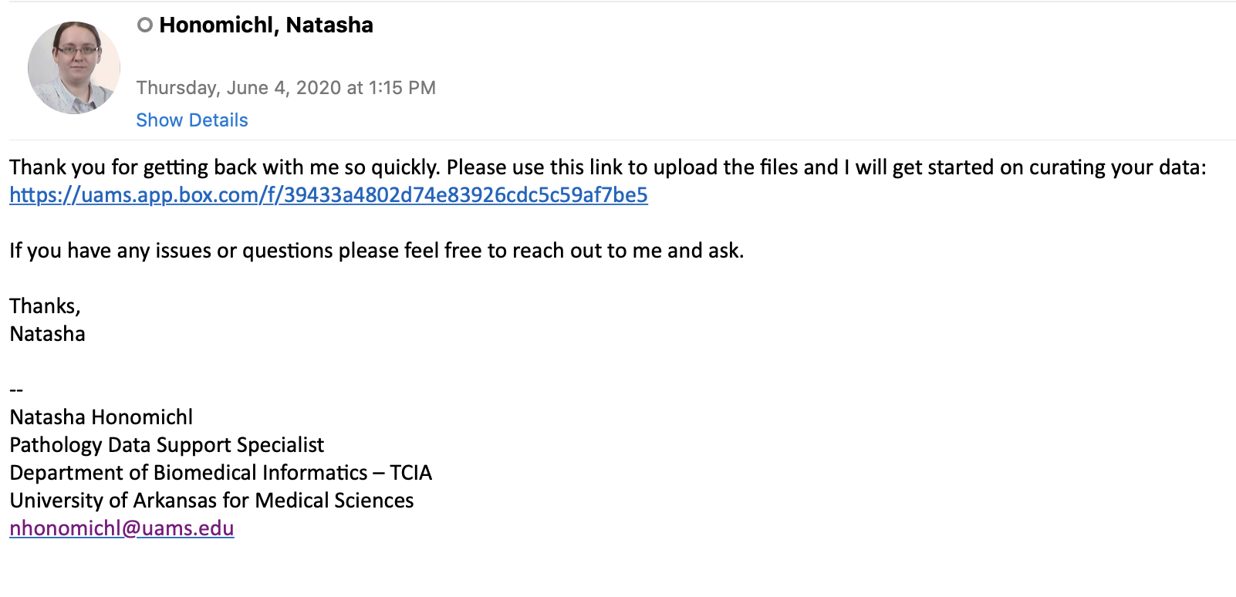
Uploading images via Box
You will be sent an email invitation like the example below by your TCIA contact (typically this is the curator for your collection).
Click link provided

Slide 4
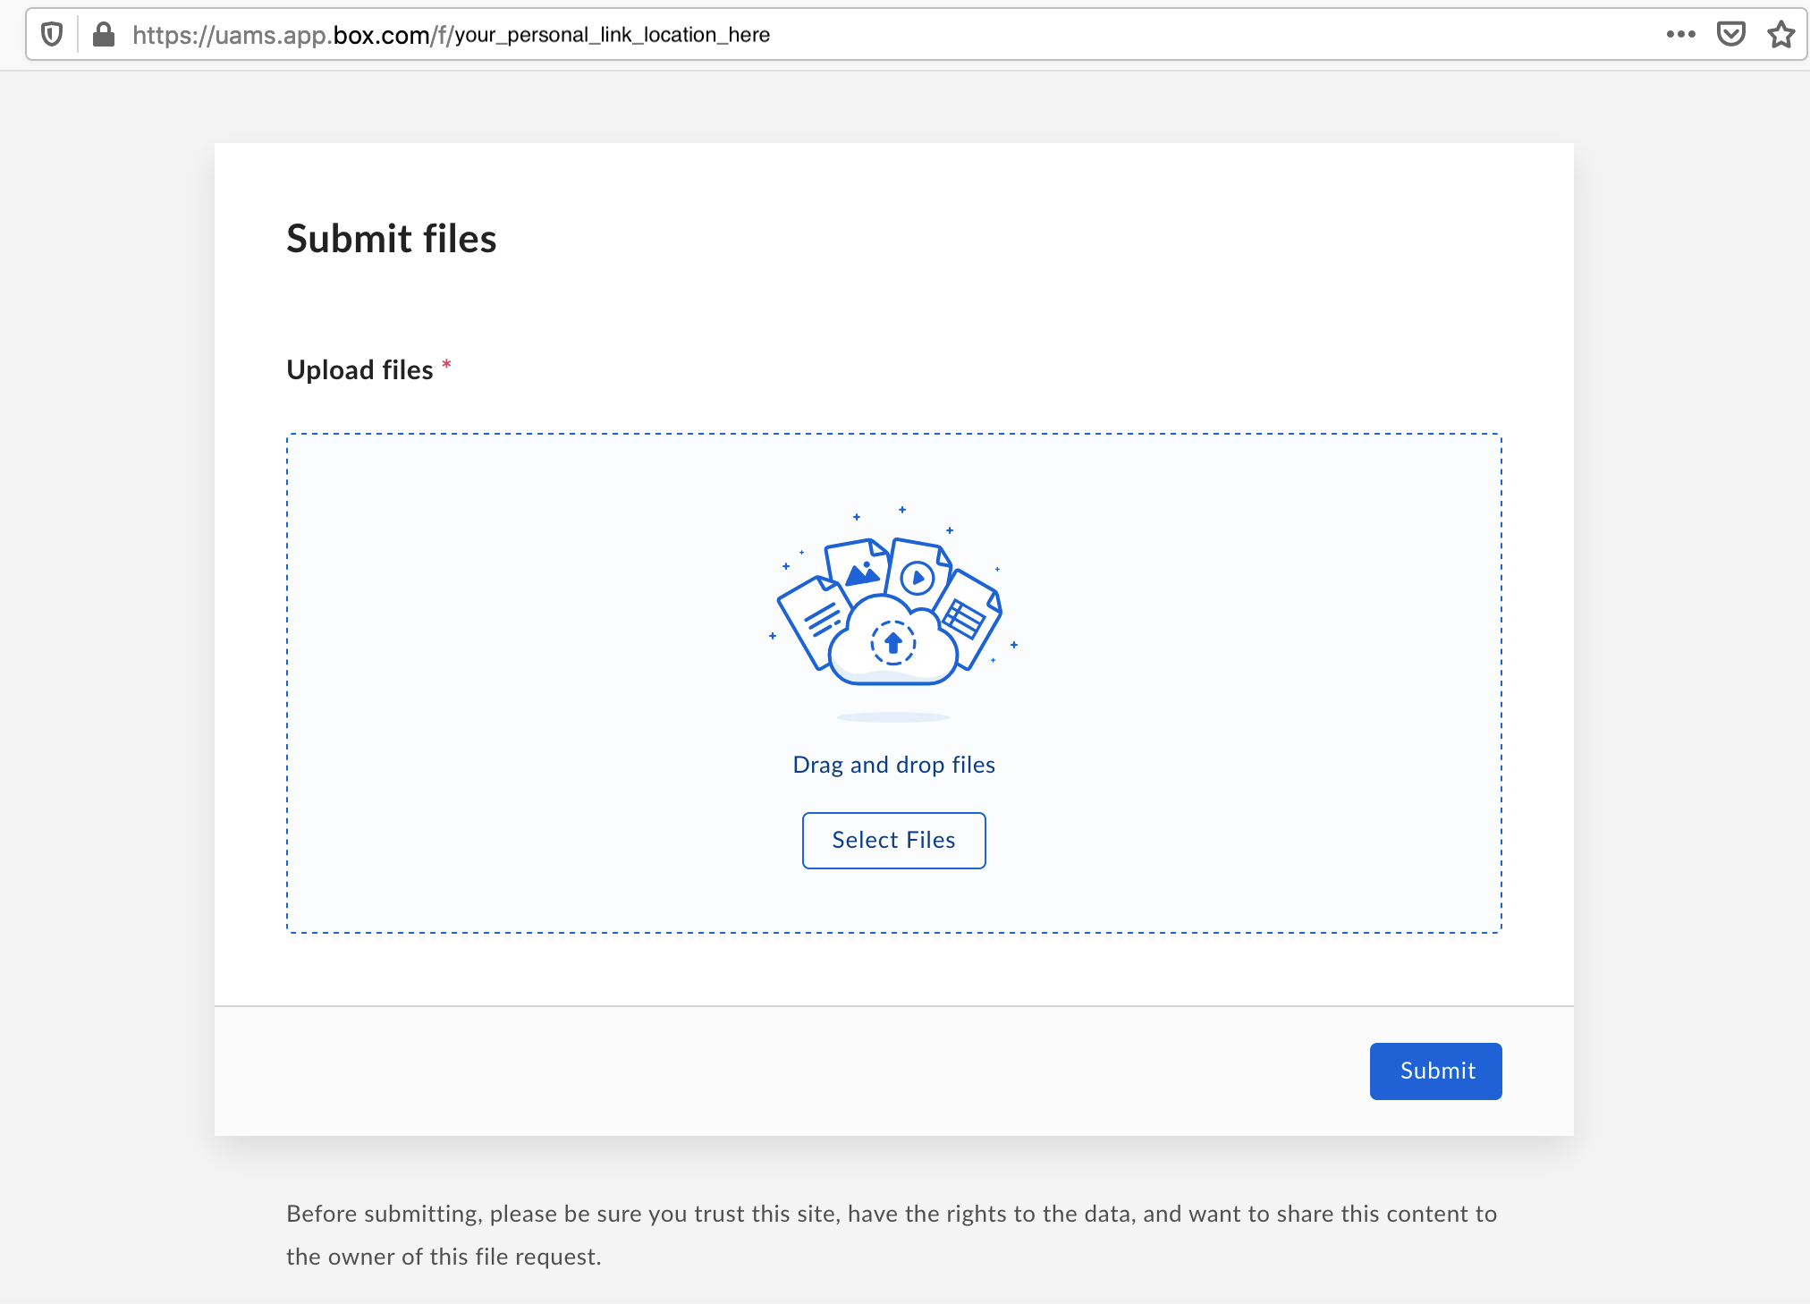
Uploading images via Box cont.
After clicking provided link, the webpage should look like this:
Please note Box natively has a 15GB max limit for file size. For this reason, we recommend uploading a zip file of your images and uploading in batches if necessary.

Slide 5
Uploading images via Rclone
Rclone is a command line program for managing and accessing files on cloud storage. It is capable of connecting to over 40 different providers. Depending on your system and the rules it has in place, we may need a user or guest account to transfer your data to us.
More information on which cloud providers are supported and the requirements needed for each can be found at https://rclone.org/.

Slide 6
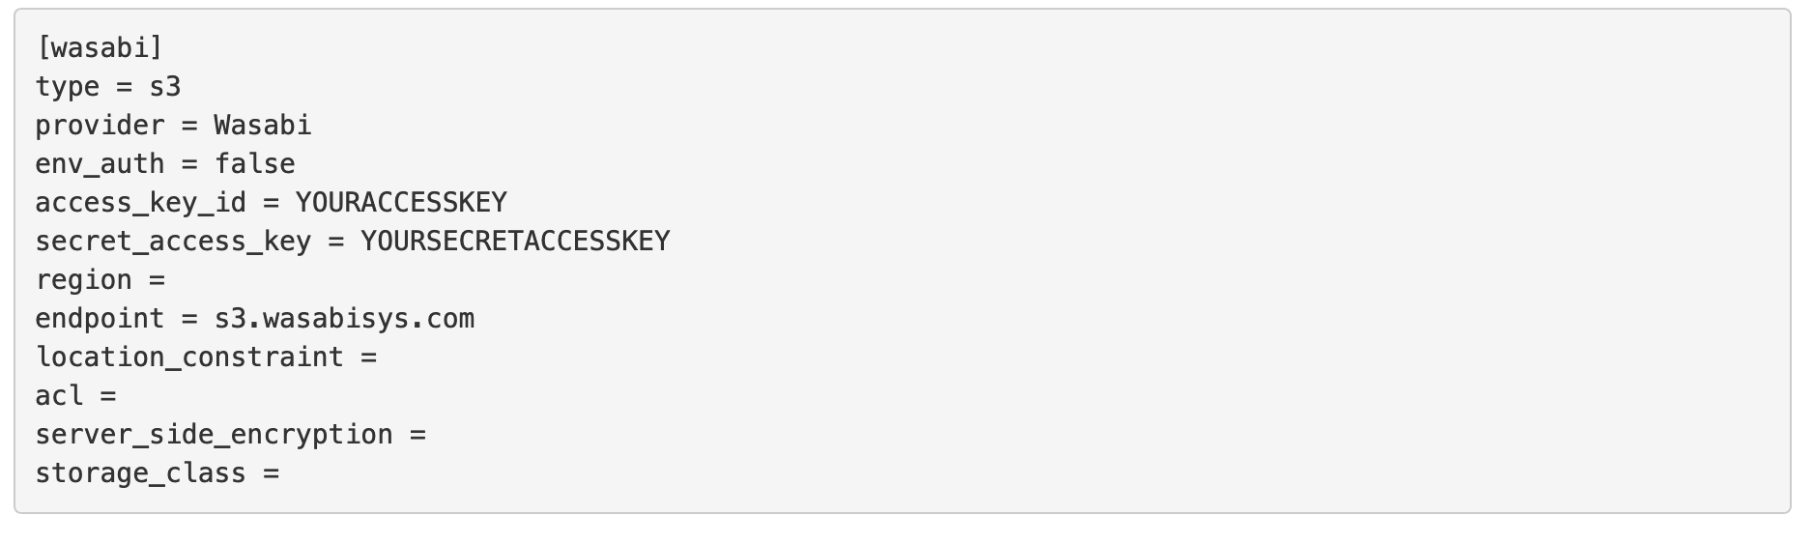
Here is an example of a set-up connection to a cloud-based service called Wasabi:
Notice this service requires an access key. Depending on your system, you might have to provide TCIA with some form of login in order for us to connect to you and download your data. If you are uncertain about this process and cannot use our other uploading process, Box, you may have to speak with your administrators.

