Slide 1
Sending Images to TCIA using the Wizard
Prepared by TCIA Project Managers
18-Jan-2019

Slide 2
There are 4 basic components to submitting data to TCIA. This guide should help you get started.
Download and unpack Clinical Trials Processor (CTP) (slides 3-6)
Complete input-output mapping table: file TCIA-submission-template.xlsx (slides 7-8)
Launch CTP via Launcher.jar (slide 9)
Process & transfer DICOM files to TCIA (slides 10-15)

Slide 3
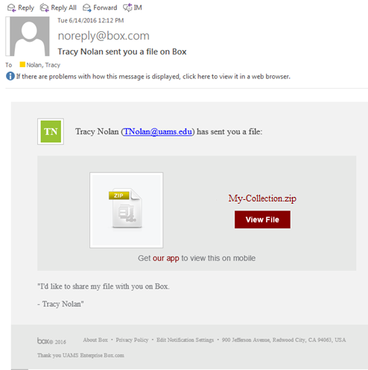
Step 1: Download and unpack CTP: invitation to download
Example emailed invitation to download (at right)
Click View File.

Slide 4
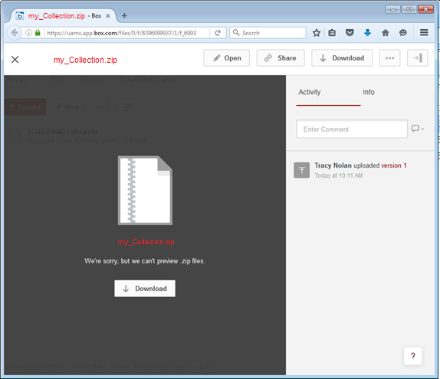
Step 1: Download and unpack CTP: download
This is the screen that will come up in your browser. There is no file preview: you must download the file to see it.
Click Download.

Slide 5
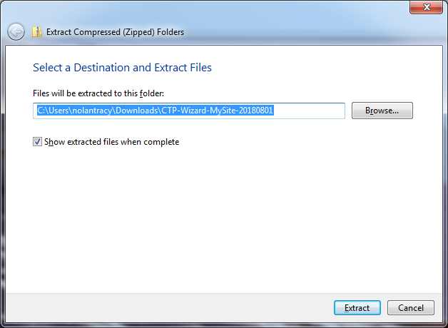
Step 1: Download and unpack CTP: unpack
Right-click, or ⌘-click, to choose “Extract” or “Unzip” and save the file to your Desktop.

Slide 6
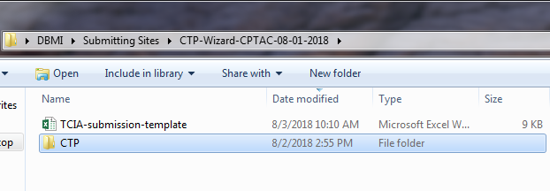
Once downloaded and unpacked you should have
TCIA-submission-template.xlsx (this will be completed by you and contains parameters used by CTP to de-identify and send the images)
CTP is java-based software used to perform image de-identification on your local computer and securely transfer it to TCIA.

Slide 7
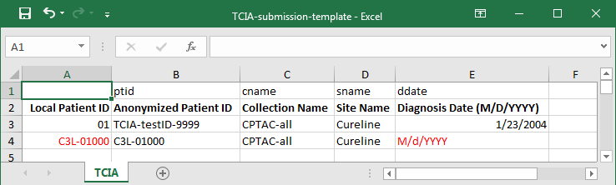
Step 2: Complete the Table: entered by you
Open the TCIA_submission_template.xlsx file
Complete the values in each row for each case you’re working on.
Save the template to a directory where you have write privileges.
Ensure that for every Subject entered, all the cells are completed.
Column A. Local Patient ID: this is the input value, from the original image, located in DICOM tag 0010,0020. This value will stay on your machine and is not transmitted. (See next slide for more detail)
Column B. CPTAC ID: this is the output value. Your data is transmitted to TCIA with only this ID.
Column C. Collection Name: the Collection Name assigned by TCIA. Each subject will belong to one collection. Ensure the correct Collection name for each subject is entered here.
Column D. Site Name: this is assigned by TCIA. Ensure this exists for each subject in the table.
Column E. Diagnosis Date: this value should come from your PI but may also be in the medical record. This value will stay on your machine and is not transmitted; however, it is used in calculations for duration of disease, etc. Enter in M/d/YYYY format as below.

Slide 8
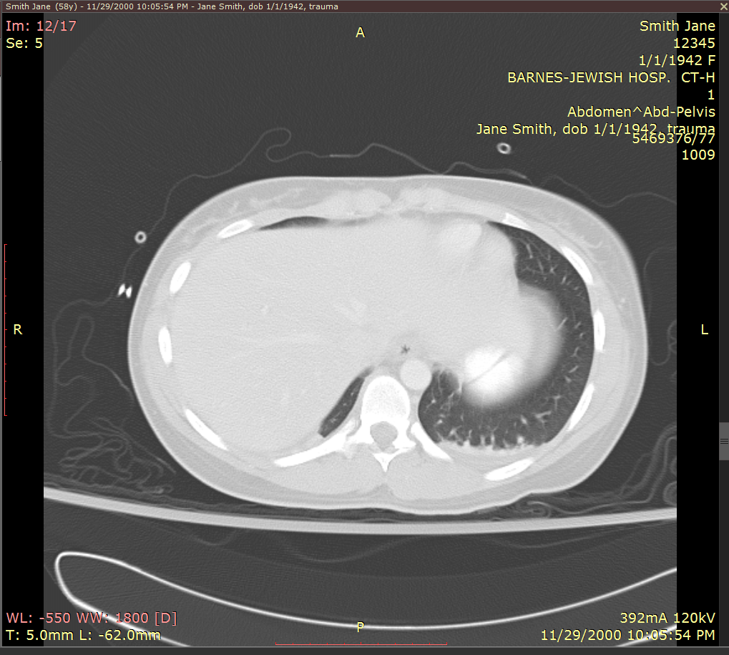
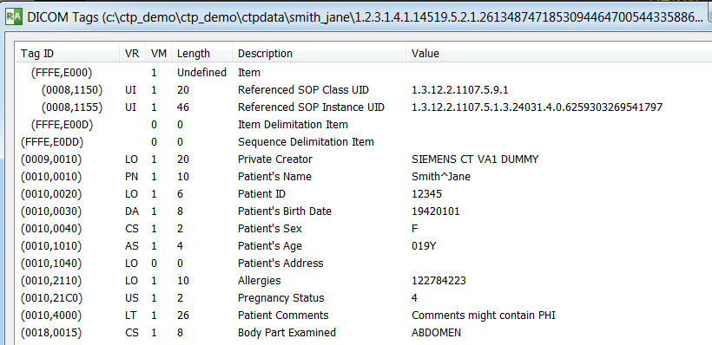
How to find the Patient ID
Patient ID displayed in a DICOM viewer (12345)
Patient ID from DICOM tags (12345)
The Local Patient ID is typically the hospital-assigned Medical Record Number (MRN) of the patient. In DICOM, PatientID is located in tag 0010,0020. Most DICOM viewers will directly display the Patient Name and Patient ID (left), or you can view the DICOM tags and look at the contents of DICOM tag 0010,0020 PatientID (right). The original PatientID represents PHI and must be de-identified. TCIA uses a table to anonymize PatientID. When a PatientID in a DICOM image matches the input value in this table, the output value is written into PatientID. If a Patient ID in an image does not match a value in the table, that image will be quarantined and not sent.

Slide 9
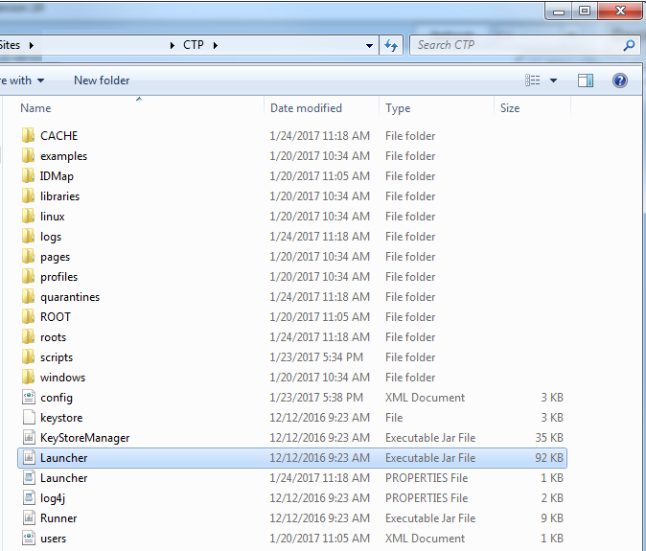
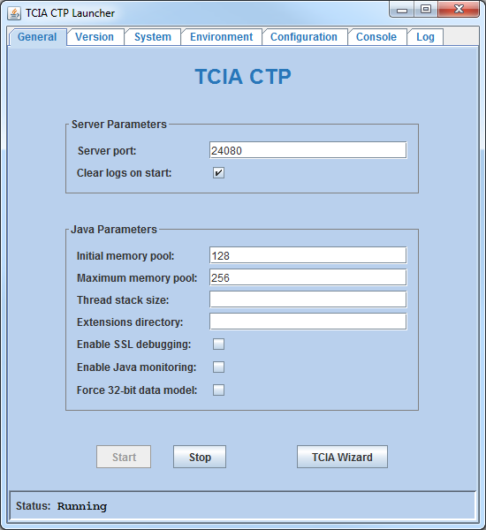
  Step 3: Launch the software
Inside the CTP folder, double click on the Executable Jar file “Launcher.jar” (as shown below)
Click Start. This will start the Clinical Trials Processor.
Click TCIA Wizard. This will open the Wizard interface.

Slide 10
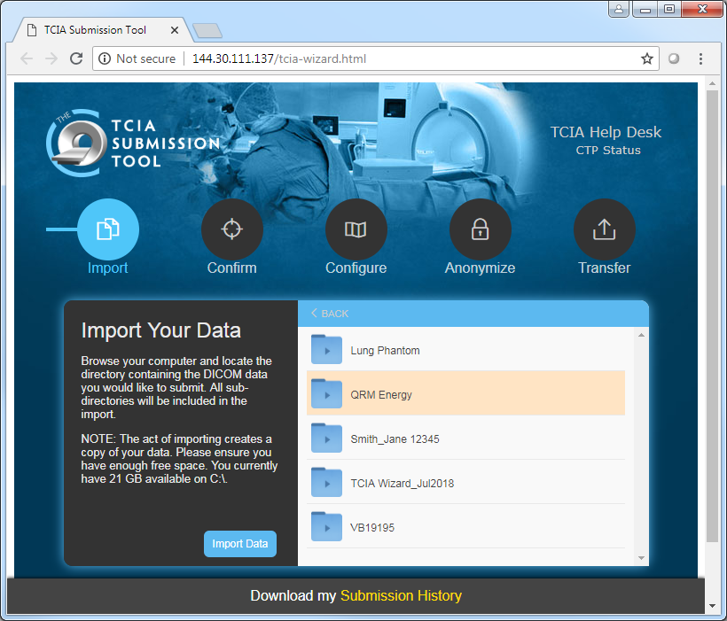
Wizard interface: Processing files
Browse to the folder where the images you want to submit are, and highlight the directory.
Click if you need to go back a directory level.
Click . See next slide.
NOTE: The act of importing creates a copy of your data within the Wizard folders. Please ensure you have enough local free space.
< BACK
Import Data
Browse to your directory here

Slide 11
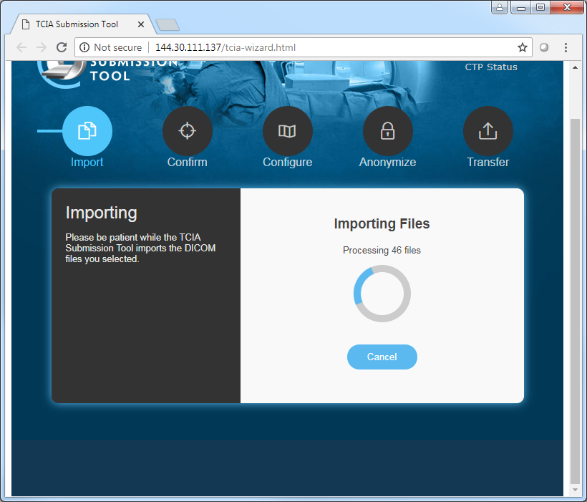
Wizard interface : Processing files
Above the spinner you will see a counter of how many files are being imported.

Slide 12
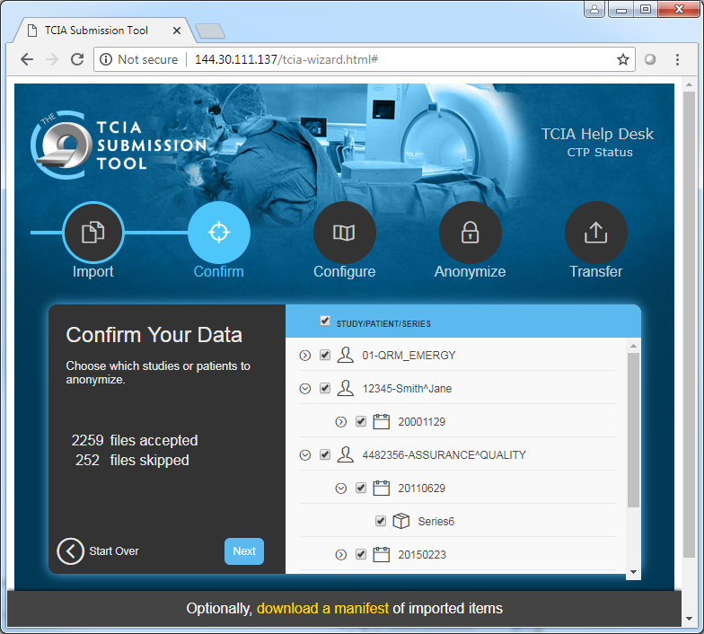
Wizard interface: Processing files
Review your data to confirm it has been imported properly. If you accidentally imported data, you don’t want send to TCIA you can deselect it before proceeding to the next step.
Click to move to the next screen.
Next

Slide 13
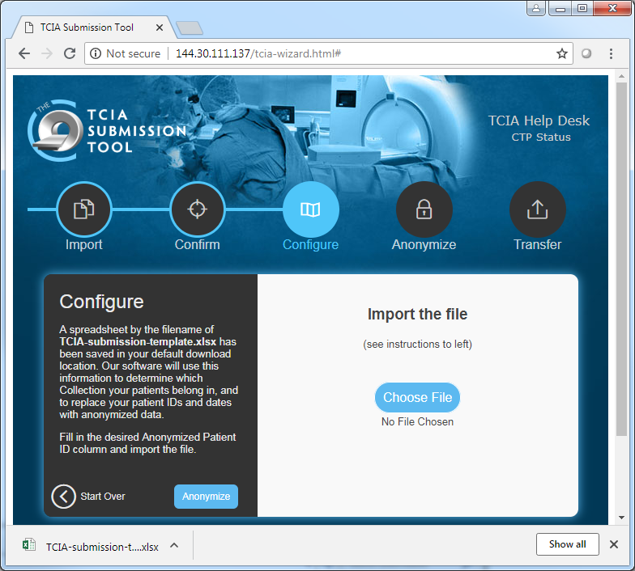
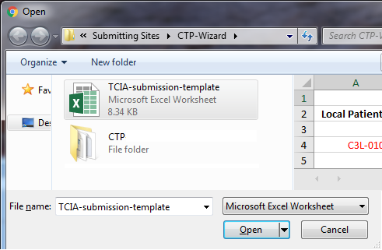
Wizard interface: Processing files
Refer to slide 7.
Click for a popup window:
Browse to the Submission Template you COMPLETED and saved.
Click Open.
Your selected filename will appear below the button.
Click Anonymize.
Choose File
Choose File
Email or phone with any questions about these processes. help@cancerimagingarchive.net (385)ASK-TCIA

Slide 14
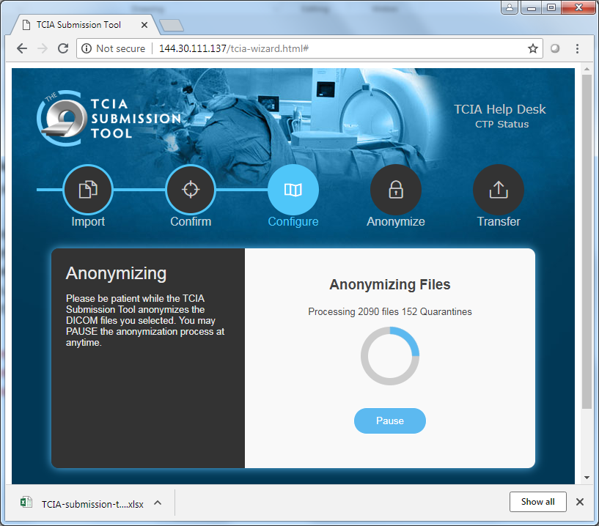
Wizard interface
Click
to begin anonymizing the data.
This step creates an anonymized copy of your data and saves it on your computer. No files are sent to TCIA at this stage.
If the CTP Wizard indicates that any files were quarantined during this process, contact TCIA support to troubleshoot.
Anonymize
Email or phone with any questions about these processes. help@cancerimagingarchive.net (385)ASK-TCIA

Slide 15
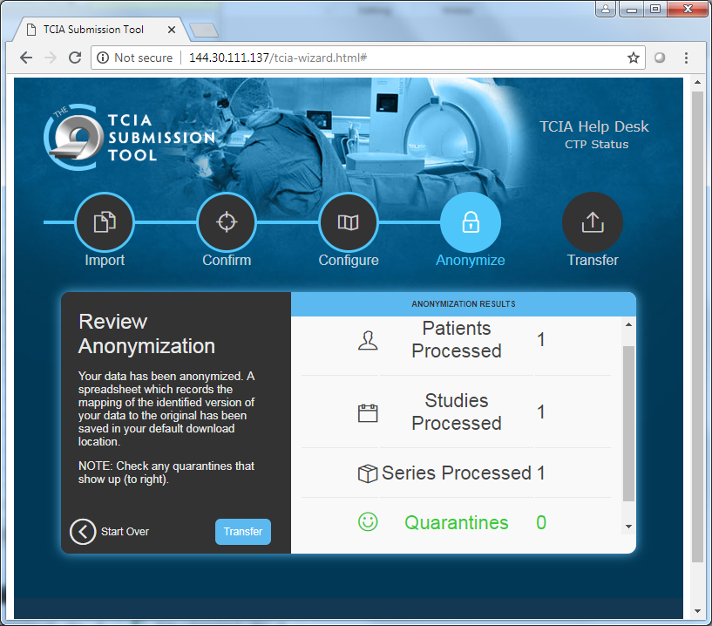
Wizard Interface
Click on to send the data to TCIA. The transfer generally takes a long time as you are sending large amounts of data across the internet.
Please leave your browser open and the wizard running. You can lock your desktop, or use another browser window during this process, but do not shut down the browser or the computer or disconnect the internet.
After the transfer is completed, you have the option to download and review the submission history to confirm the process has completed as intended.
Transfer
Email or phone with any questions about these processes. help@cancerimagingarchive.net (385)ASK-TCIA

