Slide 1



University School of Medicine
Department of Radiology and Imaging Sciences
Division of Neuroradiology

Slide 2

Associations between MR Imaging Features, Gene Expression Subtype, and Histopathologic Features of Glioblastomas
The Cancer Genome Atlas (TCGA)
Glioma Research Group
MRI Characterization Study

Slide 3
Associations between MR Imaging Features, Gene Expression Subtype, and Histopathologic Features of Glioblastomas
Emory University
  Department of Radiology and Imaging Sciences
  Department of Pathology
  Department of Biomedical Informatics
Thomas Jefferson University, Department of Radiology
University of Virginia, Department of Radiology and Medical Imaging
NCI / NIH
SAIC-Frederick, Inc.
Boston University, Department of Radiology

Slide 4




TCGA Glioma Research Group
Hwang, S.N.¹
Holder, C.A.¹
Clifford, R.J.²
Huang, E.²
Hammoud, D. ³
Nicolasjilwan, M.⁴
Raghavan, P.⁴
Wintermark, M.⁴
Gutman, D.A¹
Moreno, C.¹
Cooper, L.¹
Freymann, J.⁵
Kirby, J.⁵
Krishnan, A.¹
Dehkharghani, S.¹
Jaffe, C.C.⁶
Saltz, J.H.¹
Flanders, A.E. ⁷
Brat, D.J.¹
Buetow, K.H.²
¹Emory University
²National Cancer Institute
³National Institute of Health
⁴University of Virginia
⁵SAIC-Frederick, Inc.
⁶Boston University
⁷Thomas Jefferson University

Slide 5
Disclosures
No conflicts of interest to disclose

Slide 6
Specific Aims
TCGA has accumulated a wealth of genomic, histopathologic, and imaging data for glioblastomas.
Imaging findings may predict genomic and histopathologic features, providing noninvasive assessment of prognosis and response to therapy.
Specific hypotheses:
  Imaging features predict gene expression subtype
  Imaging features predict microvascularity

Slide 7

Background – TCGA
Joint effort of the National Cancer Institute (NCI) and the National Human Genome Research Institute (NHGRI)
Publicly available database for multiple types of tumors from different anatomic sites
  Pathology specimens
  Imaging
Purpose: Advance the understanding of the molecular basis of cancer through the application of genome analysis technologies, histopathology, and imaging.

Slide 8
Gene Expression Subtype of Glioblastomas
TCGA analysis included classifying glioblastomas into four subtypes based on gene expression pattern (Verhaak et al., Cancer Cell, 17:98-110, 2010)
  Proneural
  Neural
  Classical
  Mesenchymal
Proneural classification associated with longer survival although less responsive to aggressive therapy
Gene expression subtype available for 69 of the tumors with imaging

Slide 9
Histopathology
Data for 18 histopathologic features (e.g. microvascular hyperplasia) available for the TCGA tumors
Slides rated by 2 neuropathologists from a panel of 8
  Features rated as absent, present, or abundant.
  For initial assessment, ratings were reduced to 2 groups – “absent” versus “present/abundant”.
For the current work, we focused on the presence or absence of microvascular hyperplasia.
Data available for 28 of the tumors with imaging

Slide 10
Methodology - Overview
Multireader assessment of preoperative MR images
  75 glioblastoma patients
  VASARI imaging feature set
Each parameter reduced to a single score
  Majority rule
  Random selection in case of a tie
Statistical analysis
  Associations with
    Gene expression subtype
    Histopathologic parameters
  Student’s t-test
  Fisher exact test

Slide 11
MRI
Variations in protocols from multiple institutions and from different periods of time
  Most
    T1-weighted
    T2-weighted
    FLAIR
    DWI
    Post-contrast T1-weighted
  Some
    Diffusion tensor imaging
    Perfusion

Slide 12
Imaging Assessment
At least 3 CAQ neuroradiologists (from a panel of 6) independently reviewed each MRI data set
VASARI feature set
  https://wiki.nci.nih.gov/display/CIP/VASARI
  26 imaging features
  For the current analysis, we focused on the following parameters:
    Tumor dimensions (axial plane)
    Percent enhancing tumor
    Percent nonenhancing tumor
    Percent necrosis

Slide 13
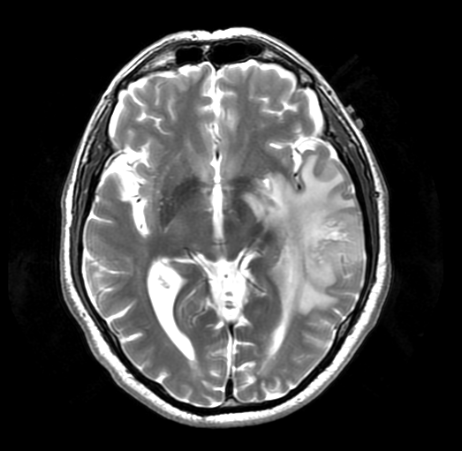
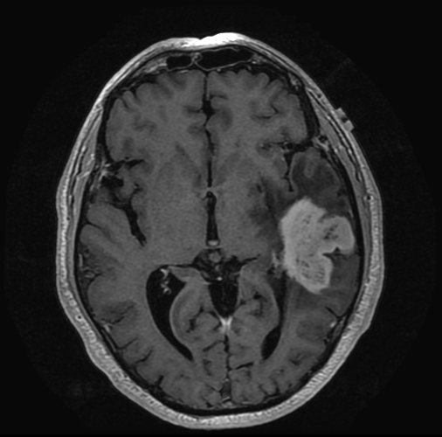
Lesion Dimensions
Maximum and perpendicular dimensions on the basis of the T2w images

Slide 14
Tumor Proportions
Assume the abnormality consists of:
  Enhancing tumor
  Nonenhancing tumor
  Necrosis
  Edema
Percent volume of each component rated on an ordinal scale
  0, 1-5%, 6-33%, 34-67%, 68-95%, 95-99%, 100%

Slide 15
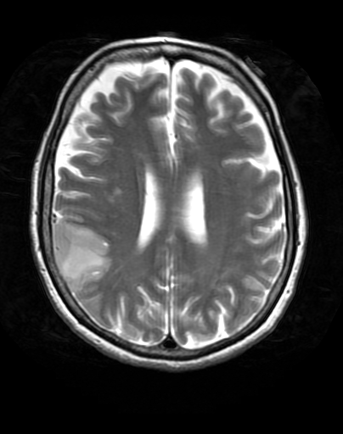
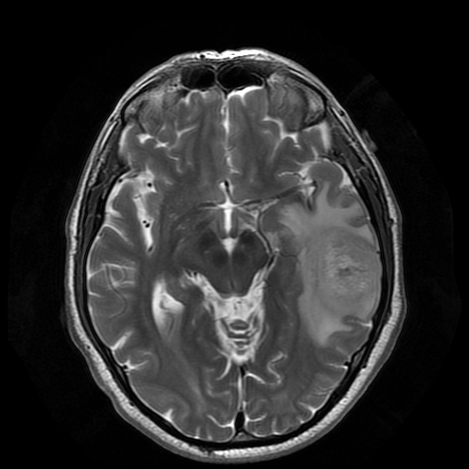
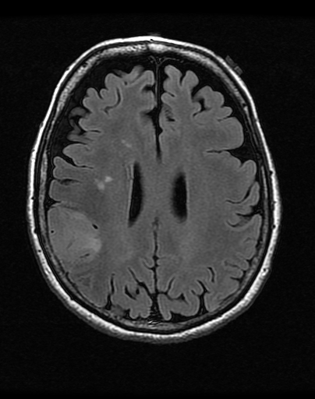
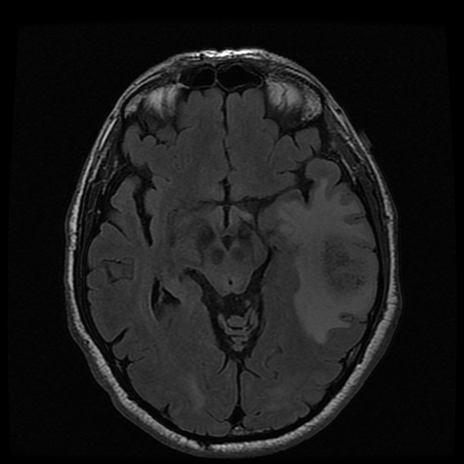
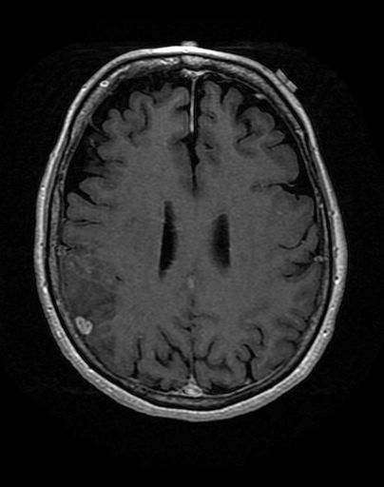
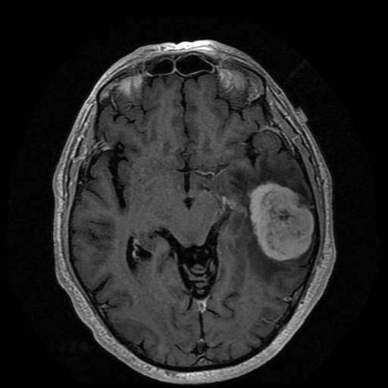
Proportion Enhancing Tumor
1-5%
68-95%
Notes:
06-0118

Slide 16
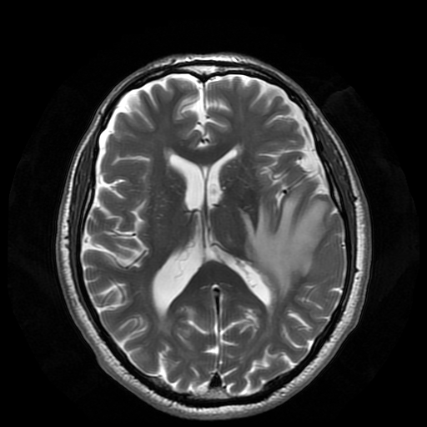
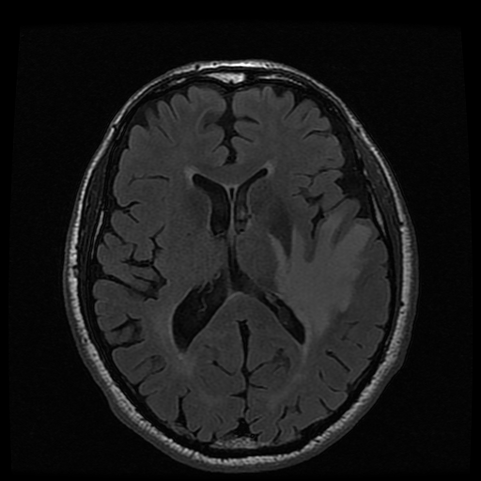
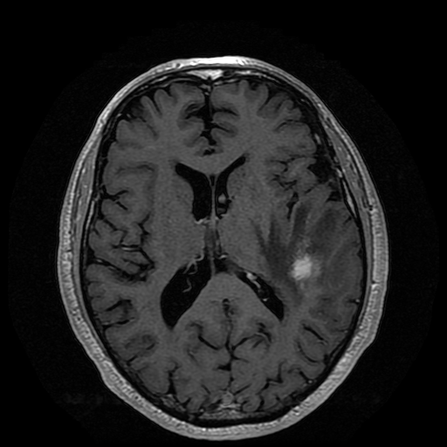
Proportion Nonenhancing Tumor
6-33%
68-95%
Notes:
06-0118

Slide 17
Proportion Edema
0%
34-67%
Notes:
06-0118

Slide 18
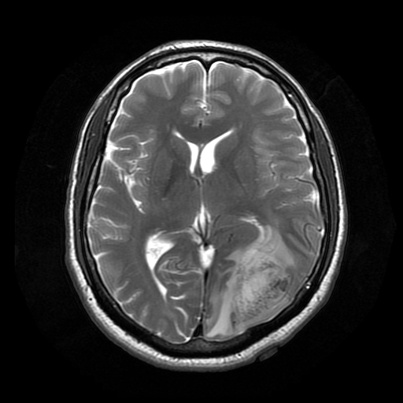
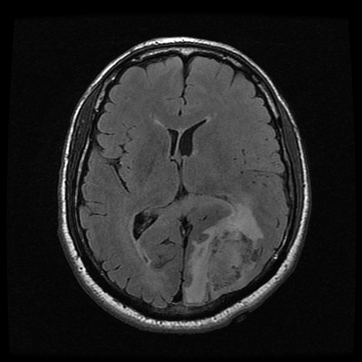
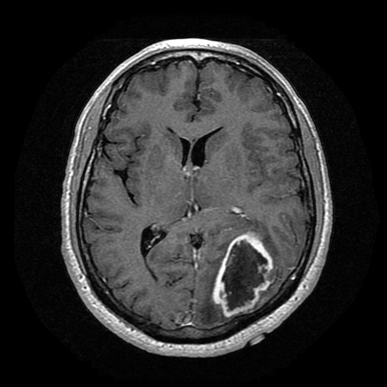
Proportion Necrosis
1-5%
34-67%
Notes:
06-0118

Slide 19
Other VASARI Features
Tumor location
Side
Eloquent brain
Avidity of enhancement
Cysts
Thickness of enhancing margin
Definition of enhancing margin
Hemorrhage
Diffusion
Pial invasion
Midline crossing
  Enhancing tumor
  Nonenhancing tumor
Distribution
  Multifocal
  Multicentric
  Gliomatosis
T1/FLAIR ratio
  Expansive
  Mixed
  Infiltrative
Ependymal invasion
Cortical Involvement
Deep WM invasion
Satellites
Calvarial remodeling

Slide 20
Data Reduction
Each imaging feature reduced to a single score
  The mean for continuous parameters (i.e. lesion size)
  Majority rule for ordinal parameters
  Random selection in case of a tie
Each parameter further reduced to binary classification
  E.g. <5% enhancement versus >5% enhancement

Slide 21
Gene Expression Subtype of Glioblastomas
Proneural classification is associated with longer survival although less responsive to aggressive therapy
  Proneural versus non-Proneural
Gene expression subtype available for 69 of the tumors with imaging.

Slide 22
Histopathology
Histopathologic data was available for 28 of the tumors with imaging
For initial assessment, the pathology ratings were reduced to 2 groups – “absent” versus “present/abundant”.

Slide 23
Statistical Analysis
Student’s t-test for differences in the means for the tumor dimensions with respect to gene expression subtypes and histopathologic features
Fisher’s exact test for assessing associations between the ordinal imaging parameters (e.g. proportion enhancing) and the nonimaging parameters.

Slide 24
Results – Gene Expression Subtype
1.00
Fisher’s exact test
Association between minimal enhancing tumor (< 5%) and Proneural classification
p=0.0006
0.75
Enhancement
>5%
0.50
0.25
<5%
0.00
not Proneural
Proneural
Proneural?

Slide 25
Microvascular Hyperplasia
1.00
Fisher’s exact test
Association between >5% proportion of necrosis and presence of microvascular hyperplasia
p=0.008
Supports the observation that hypoxia related to necrosis induces microvascular hyperplasia.
0.75
>5%
Necrosis
0.50
0.25
<5%
0.00
None
Present
Microvascular Hyperplasia

Slide 26
Tumor Size and Microvascular Hyperplasia
120
p = 0.007
Significant difference in the means of lesion size of tumors without versus tumors with microvascular hyperplasia
110
100
90
86 mm
80
Maximum tumor dimension (mm)
70
60
61 mm
50
40
None
Present
Microvascular Hyperplasia

Slide 27
Ongoing Work
Quantitative image analysis
  Volumes
  Morphology
  Perfusion
  DTI
Analysis of more images and data.

Slide 28
Conclusions
Association between Proneural subtype of glioblastoma and a smaller proportion of tumor enhancement
Larger tumor size and larger proportion of necrosis (derived from MR images) may be predictive of microvascular hyperplasia.
  Supports the observation that hypoxia related to necrosis induces microvascular hyperplasia
MRI may provide a noninvasive means of assessing gene expression subtype and histopathologic features for predicting prognosis and response to therapy.

Slide 29
TCGA Glioma Research Group
Tuesday, 3:46 pm, Ballroom 6 B/C
  Methodology for Multireader Assessment of MR Imaging Features of Gliomas in Clinical Trials
Thursday, 1:39 pm, Ballroom 6 B/C
  Prediction of Glioblastoma Multiforme Patient Survival Using MR Image Features and Gene Expression
Thursday, 2:11 pm, Room 606-609
  Associations between MR Imaging and Genomic Features of Glioblastomas

