Slide 1



Genomic Imaging: Creation of a Uniformed Terminology to Describe the Morphologic MR Imaging Features of Gliomas to
Augment Clinical Research in the Genomics of Cancer.
Tracking Number: 12-eEdE-1044-ASNR

Slide 2
Disclosures
None

Slide 3
Purpose and Objectives
We will explain through example how consistent use of a controlled terminology in brain tumor imaging augments both clinical reporting and clinical trials research.
We will guide the attendee through the entire MRI glioblastoma (GBM) featureset (known as VASARI featureset or BVT-RADS) using visual examples of each morphologic feature and the corresponding grading system.
We will explain the process for developing, testing, validating and using the featureset for cross-correlative analysis.
We will also provide a summary of the collaborative efforts of the TCGA Glioma Phenotype Research Group and give information for the interested reader on how to access the public datasets and/or join our group.

Slide 4
Background
Neuroimaging plays a critical role for diagnosis and therapeutic assessment in neuro-oncology. However, imaging has been less successful in establishing itself as a useful biomarker in oncologic research.
MRI is recognized for providing multiparameter features that are yet to be fully exploited in either clinic or research.
Research that incorporates imaging presents unique challenges due to nonstandard use of terminologies, absence of uniform data collection and validation.
These obstacles limit the potential impact that imaging could have as an effective biomarker in oncology.

Slide 5
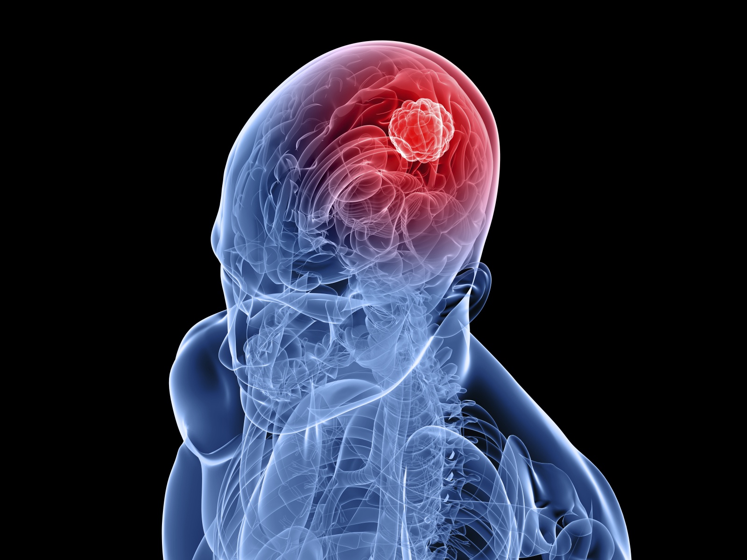
Background
Prior publications have examined the relationship of one or more imaging observations related to outcome.
Park et al. found that tumor volume, performance status and involvement of eloquent brain strongly impact survival.
Pope et al. reported that presence of non-contrast enhancing tumor conferred longer survival.
Necrosis has been found to have negative prognostic implications as does degree of contrast enhancement.
Lacroix et al found that the combination of age, performance status (given by KPS), extent of resection, degree of necrosis and contrast enhancement are the strongest predictors of survival.
There are no large published series which have assessed the value of a comprehensive (or complete) set of imaging features to predict outcome, survival or time to recurrence.

Slide 6


Why Genetics?
    The focus of oncology today is on personalized medicine. While tumors of the same cell type may “appear” similar histologically, they are different at the genetic level. This may explain why some tumors (and patients) respond better to identical treatments than others.
    There is tremendous interest in redefining cancer through the genetics of the pathologic tissue. The goal is to individualize therapy based upon a combination of conventional histology and genetic features.
    Now that the human genome has been mapped, organizations like the National Cancer Institute (NCI) are focusing attention on applying that technology to mapping common forms of cancer to define new classes of disease that may respond better to novel therapies.
    The Cancer Genome Atlas (TCGA) is an NIH initiative that is collecting and genetically analyzing common forms of cancer. One cell line collected and studied is glioblastoma (GBM).

Slide 7
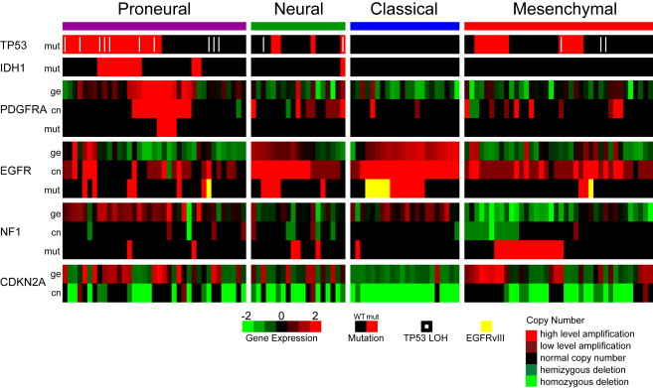
GBM: Molecular Sub-classes
    Genetic analysis is accomplished through tissue microarrays that assess for expression of specific clusters of genes that are known to be expressed or suppressed in different tumor types.
    In 2010, Verhaak et al. Identified four distinct classes of GBM based upon molecular (genetic) expression of several specific proteins which in turn are tied to specific genes:
      TP53 – encodes tumor protein p53. Normally in low concentration but mutant versions elevated in certain cancers. May contribute to loss of tumor suppression.
      IDH1 – isocitrate dehydrogenase. Also found in elevated concentrations in human glioma. Found in cytoplasm and peroxisomes.
      PDGFRA – alpha-type platelet-derived growth factor receptor. Can have a role in angiogenesis, cell proliferation and differentiation.
      EGFR – epidermal growth factor receptor. Overexpression or higher concentrations associated with uncontrolled cell growth and cancers such as lung, anal and GBM. This is a prototypical oncogene.
      NF1 – neurofibromatosis-related protein (neurofibromin 1). This protein is produced by many cells including oligodendrocytes and schwann cells. Acts normally as a tumor suppressor by inhibiting cell growth and division.
      CDKN2A - cyclin-dependent kinase inhibitor 2A. This protein is capable of inducing cell cycle arrest and apoptosis.
    Relative concentrations of these gene-expressed specific proteins define new genetic subclasses of GBM.
    Verhaak RG, et al. Cancer Cell 2010;17(1):98-110.

Slide 8
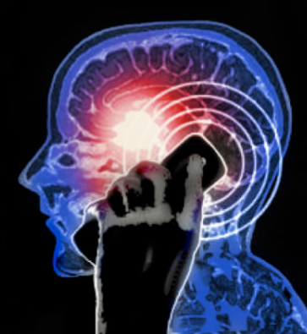
High-Grade Gliomas: Genomic Mapping
Genetic analysis has provided a greater understanding of the molecular basis of the tumor aggressiveness and heterogeneity.
Various molecular sub-classifications have been proposed based on the genetic makeup of high-grade gliomas hoping to better understand origins of tumor cells and molecular pathogenesis may predict response to targeted therapies.
Using genetic expression, four subclasses of GBM were proposed by Verhaak and three genetic subclasses were defined by Philips.
    Phillips HS, et al. Molecular subclasses of high-grade glioma predict prognosis, delineate a pattern of disease progression, and resemble stages in neurogenesis. Cancer Cell 2006;9(3):157-173.
    Verhaak RG, et al. Integrated genomic analysis identifies clinically relevant subtypes of glioblastoma characterized by abnormalities in PDGFRA, IDH1, VEGFR, and NF1. Cancer Cell 2010;17(1):98-110.

Slide 9
How can Neuro-imaging Play a Greater Role?
Genomic Imaging or Radiogenomics are terms used to describe the intersection between imaging and genetics.
Glioblastomas typically exhibit a very heterogeneous genome.
MRI provides a non-invasive comprehensive evaluation of the complex and heterogeneous appearance of high grade astrocytomas and glioblastomas.
A tumor’s complex imaging features are the phenotypic representation of the genetic makeup of that tumor.
If imaging observations could be assessed in a standardized and reproducible fashion could theyserve as an effective non-invasive surrogate for the genetic classification of a tumor?
Exploiting synergies between genetics, proteomics, pathology and imaging could provide a more precise model to forecast survival & response to novel therapies.
Genomic Features
Pathologic Features
Clinical Features
Imaging Features

Slide 10
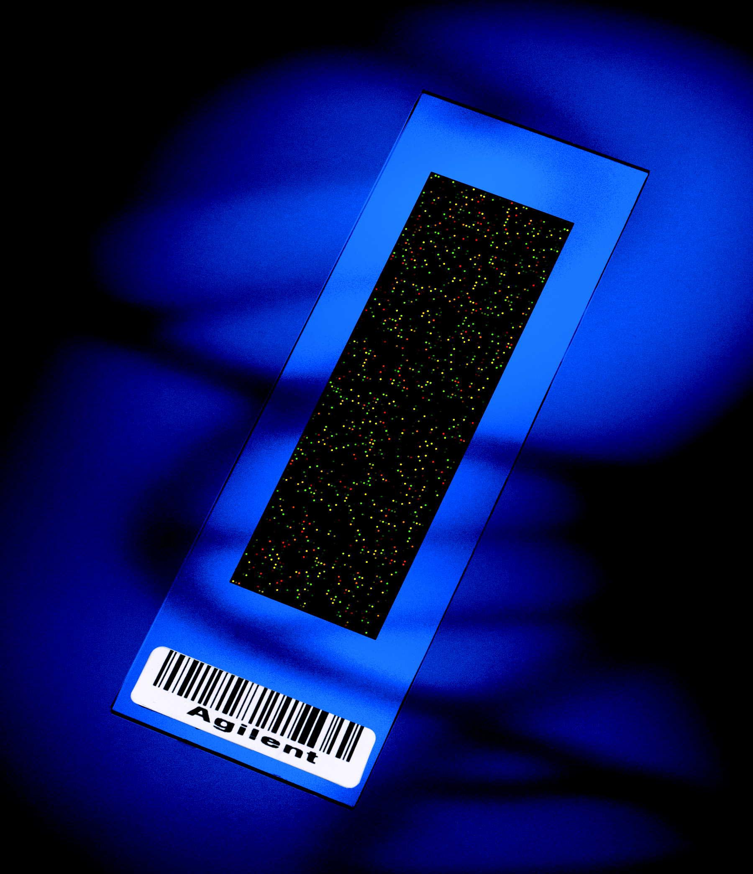
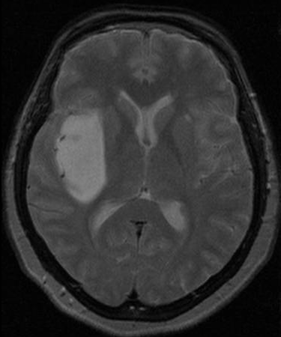
How Does One Effectively Marry Imaging Findings of a Tumor to its Genomics?
X
MRI Featureset
Infiltration
Enhancement
Nodularity
Necrosis
Edema
nCET
Diffusion
Hemorrhage
Genetic Microarray
MRI
= ?

Slide 11
Barriers
A barrier to effective imaging research is absence of controlled terminologies to describe pathologic findings. Despite advances in imaging technology there have been few innovations in standardizing terminologies used in medical imaging research.
This lack of consistency means that results of individual studies may remain isolated since results are often not directly comparable to one another.
A well regarded exception is the federally mandated use of ACR’s Breast Imaging Reporting and Data System (BI-RADS) which has been heralded as a potent driver for advancing therapeutic, research and quality initiatives in diseases of the breast. BI-RADS has made inroads into improving uniformity and clarity that document breast imaging findings.

Slide 12
Methodologies in Use Have Limited Application.
Classic methodology for clinical trials utilize variations of MacDonald and RECIST criteria with or without volume extrapolation and machine guidance.
These methods are designed to assess response to therapy but are not necessarily used to characterize the features of a naïve (untreated) tumor.
The central focus is to gauge change in an image observation rather than to catalog all of the characteristics on the image.
AJNR Am J Neuroradiol 2008;29:419–24

Slide 13
Inconsistent Use of Terminology
We are all trained to use terminologies or vocabularies to:
  Describe findings
  Communicate results
We all use terminologies differently based upon:
  Training etc.
  Personal preferences
e.g.: There is an infiltrating mass in the right frontal lobe measuring 6.5 by 3.4 cm in diameter that shows mild peripheral enhancement…..

Slide 14

Ambiguity in Reporting
MRI is a feature-rich technology.
In the context of cerebral neoplasia there is ambiguity in the use of subjective MR features.
  Degree of enhancement.
  Enhancing margins.
  Infiltration
  nCET versus edema
  Etc.
Terms are used inconsistently and have variable connotations to readers/observers.
Flawed for use in research.
Use of consistent terminology has greater value but is it feasible?

Slide 15

Existing Terminologies
Do Not Address Imaging Features
Terminologies in common use:
  UMLS – Unified Medical Language System
  SNOMED – Systemized Nomenclature of Medicine
  RadLex – Radiology Lexicon – has some, still incomplete.
All designed to provide a comprehensive terminology to describe anatomy & disease.
But do not encompass comprehensive imaging features observable across all trained observers.
No consistent set of imaging features are explicitly in use to describe the multiple complex patterns of a disease.

Slide 16
Objective
Can we create a subjective controlled vocabulary for primary brain tumor MRI features that meet these criteria?
  Comprehensive
  Relatively easy to use / implement
  Requires minimal training
  Reproducible
  Validated with multiple observers

Slide 17

Steps Necessary
Develop a comprehensive terminology that encompasses all of the rich MR imaging characteristics of GBMs based on literature, domain knowledge and experience.
Create a scoring system for the terminology.
Validate the terminology and scoring system.
Apply the terminology to a well-controlled set of imaging data.
Repeat assessment with multiple independent readers trained to use the terminology/scoring.
Assess agreement between readers.
Modify terminology as needed to remove ambiguity and increase clarity.
Repeat assessment with larger imaging dataset.
Re-validate, assess agreement and correlate imaging findings with genomics, pathology and clinical features.

Slide 18

Achieving Clarity & Concision with Terminology
There is a need to communicate a clear and concise message in clinical reporting and radiology research yet tremendous ambiguity exists because the lack of standards.
Programs like BI-RADS, RadLex and the RSNA Reporting initiative are efforts to standardize all terminology used in our profession, including subjective imaging features.
Phrases like “fluffy borders”, “trace enhancement”, “irregular margins”, “heterogenous signal” have variable connotations because their definitions have not been standardized nor have they been validated for reproducibility.

Slide 19

Achieving Clarity & Concision with Terminology
It is not enough to “invent” a terminology; the feature definitions and the scoring system devised must meet the following criteria:
  Be easily understood and applied by domain experts (i.e. neuroradiologists)
  Be relatively unambiguous in concept with clear distinction between scoring levels.
  Not require substantial cognitive effort in order to score a feature.
A list of all possible subjective imaging features for GBM were contributed by a group of neuroradiologists based upon domain expertise, experience and features that have been explored in the literature.
The list of potential GBM imaging features was distilled to a smaller list and the definitions and scoring systems were refined to a level in which they could be tested and validated.

Slide 20
Defining a Rich Set of Qualitative and Quantitative Image Biomarkers
This has been a community-driven ontology development project to create a comprehensive set of imaging observations for GBM.
  Collaboration with ASNR
Collaborators were asked to provide a list of clinical or literature observations that could be used to describe MRI features of GBM .
Imaging features (26 features / 4 categories)
  Location of lesion
  Morphology of lesion margin (definition, thickness, enhancement, diffusion)
  Morphology of lesion substance (enhancement, PS characteristics, focality/multicentricity, necrosis, cysts, midline invasion, cortical involvement, T1/FLAIR ratio)
  Alterations in vicinity of lesion (edema, edema crossing midline, hemorrhage, pial invasion, ependymal invasion, satellites, deep WM invasion, calvarial remodeling)

Slide 21
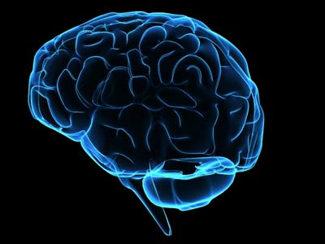
Representative Examples of the Glioblastoma MRI Feature-set
Each of the 26 features is represented by a index value (e.g. F2), a definition (in colored box) and possible scoring values.
The four cardinal features for any tumor consist of a combination of enhancing component, non-enhancing component, edema and necrosis.

Slide 22
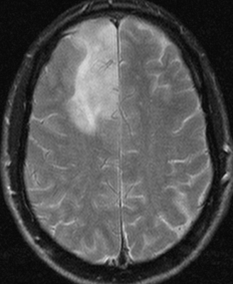
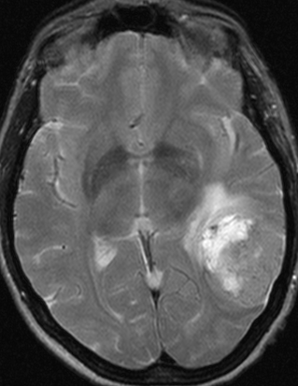

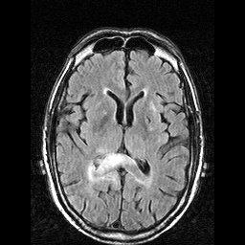
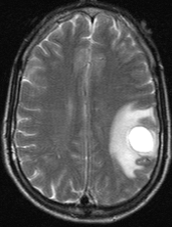
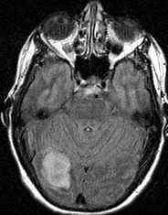
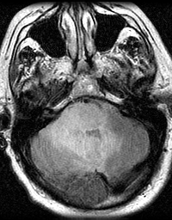
F1 -Tumor Location
Location of lesion geographic epicenter; the largest component of the tumor (either CET or nCET) (select one only).
Frontal - 1
Temporal - 2
Insular -3
Corpus Callosum
Parietal - 4
Occipital - 5
Brainstem - 6
Basal Ganglia - 8
Thalamus - 9

Slide 23
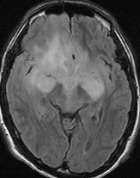
F2 – Side of Lesion Center
Right - 1
Center/Bilateral - 2
Left -3
Side of lesion epicenter
Notes:
2 – cases 32

Slide 24
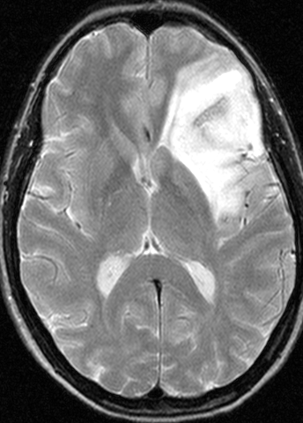
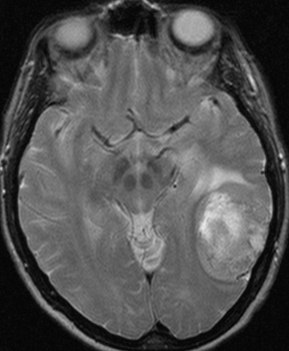
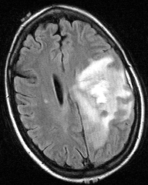
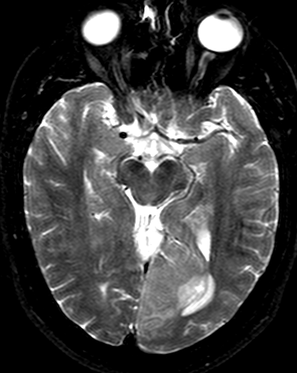
F3 – Eloquent Brain
2 - Speech Motor
3 - Speech Receptive
4 – Motor
5 - Vision
Does any component of the tumor (CET or nCET) involve eloquent cortex or the immediate subcortical white matter of eloquent cortex (motor,language, vision)? (multiple selections acceptable).

Slide 25
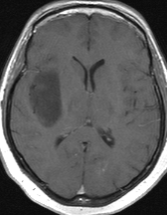
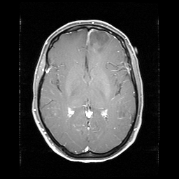
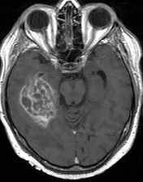
F4 – Enhancement Quality
1 - None
2 – Minimal/Mild
3 – Marked/Avid
Qualitative degree of contrast enhancement is defined as having all or portions of the tumor that demonstrate significantly higher signal on the postcontrast T1W images compared to precontrast T1W images. Mild/minimal = when barely discernable degree of enhancement is present relative to pre-contrast images. Marked/avid = obvious tissue enhancement.

Slide 26
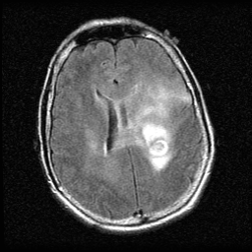
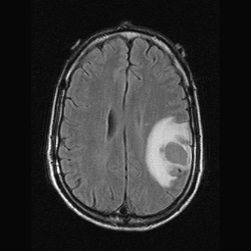
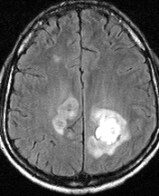
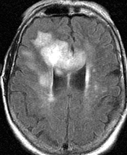
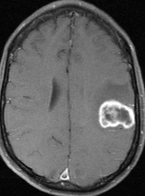
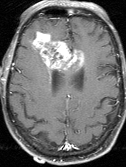
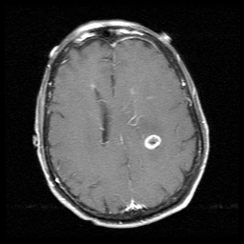
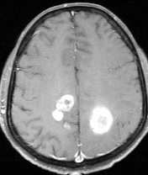
F5 – Proportion Enhancing
(3) < 5%
(4) 6-33%
(5) 34-67%
(6) 68-95%
Visually, when scanning through the entire tumor volume, what proportion of the entire tumor would you estimate is enhancing. (Assuming that the entire abnormality may be comprised of: (1) an enhancing component, (2) a non-enhancing component, (3) a necrotic component and (4) a edema component.)

Slide 27
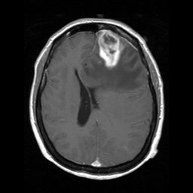
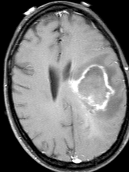
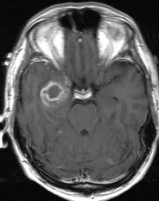
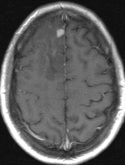
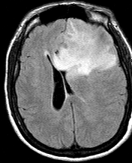

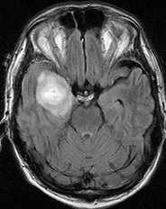
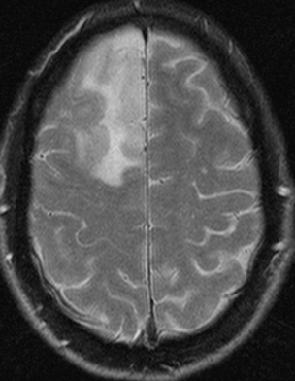
F6 – Proportion nCET
(3) < 5%
(4) 6-33%
(5) 34-67%
(6) 68-95%
Visually, when scanning through the entire tumor volume, what proportion of the entire tumor is estimated to represent non-enhancing tumor (not edema)? Non-enhancing tumor is defined as regions of T2W hyperintensity (less than the intensity of cerebrospinal fluid, with corresponding T1W hypointensity) that are associated with mass effect and architectural distortion, including blurring of the gray-white interface.(Assuming that the the entire abnormality may be comprised of: (1) an enhancing component, (2) a non-enhancing component, (3) a necrotic component and (4) a edema component.)

Slide 28
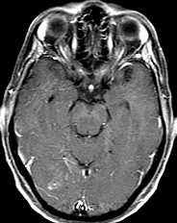
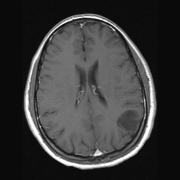

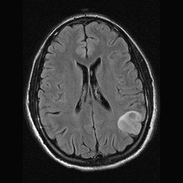
F6 – Proportion nCET
(7) < 95%
(8) 100%
Visually, when scanning through the entire tumor volume, what proportion of the entire tumor is estimated to represent non-enhancing tumor (not edema)? Non-enhancing tumor is defined as regions of T2W hyperintensity (less than the intensity of cerebrospinal fluid, with corresponding T1W hypointensity) that are associated with mass effect and architectural distortion, including blurring of the gray-white interface.(Assuming that the the entire abnormality may be comprised of: (1) an enhancing component, (2) a non-enhancing component, (3) a necrotic component and (4) a edema component.)
Notes:
8 – case 28

Slide 29
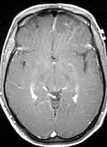
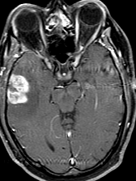
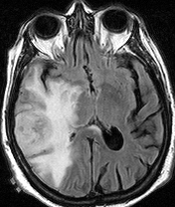
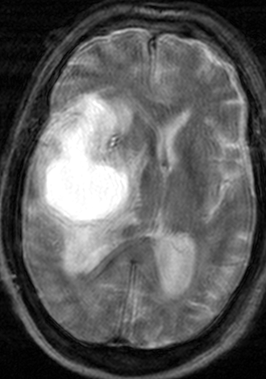
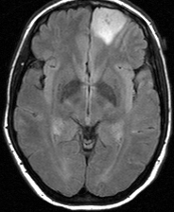
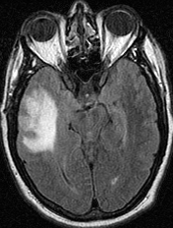
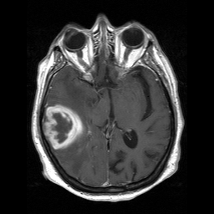
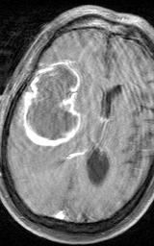
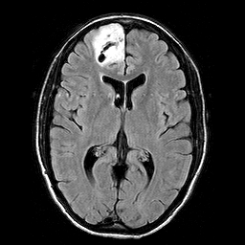
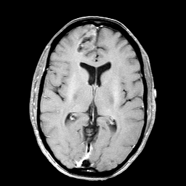
F7 – Proportion Necrosis
(2) None
(3) < 5%
(4) 6-33%
(5) 34-67%
Visually, when scanning through the entire tumor volume, what proportion of the tumor is estimated to represent necrosis. Necrosis is defined as a region within the tumor that does not enhance or shows markedly diminished enhancement, is high on T2W and proton density images, is low on T1W images, and has an irregular border). (Assuming that the entire abnormality may be comprised of: (1) an enhancing component, (2) a non-enhancing component, (3) a necrotic component and (4) a edema component.)
(6) 68-95%
(7) >95%
(8) All 100%

Slide 30
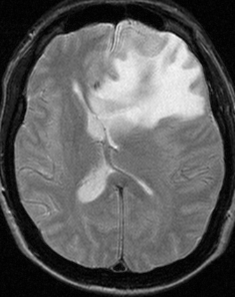
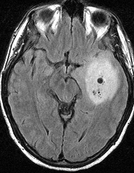

F8 – Cysts
(1) No
(2) Yes
Cysts are well defined, rounded, often eccentric regions of very bright T2W signal and low T1W signal essentially matching CSF signal intensity, with very thin, regular, smooth, nonenhancing or regularly enhancing walls, possibly with thin, regular, internal septations
Notes:
Cases 30 - yes
Case 26 - No

Slide 31




F9 – Multifocal or Multicentric
(2) Multifocal
(3) Multicentric
(4) Gliomatosis
Multifocal is defined as having at least one region of tumor, either enhancing or nonenhancing, which is not contiguous with the dominant lesion and is outside the region of signal abnormality (edema) surrounding the dominant mass. This can be defined as those resulting from dissemination or growth by an established route, spread via commissural or other pathways, or via CSF channels or local metastases, whereas Multicentric are widely separated lesions in different lobes or different hemispheres that cannot be attributed to one of the previously mentioned pathways. Gliomatosis refers to generalized neoplastic transformation of the white matter of most of a hemisphere.
Notes:
Gliomatosis - #8
Multicentric - #30
Multifocal - #12

Slide 32





F10 – T1/FLAIR ratio
(1) Expansive
(2) Mixed
(3) Infiltrative
Expansive = size of pre-contrast T1 abnormality (exclusive of signal intensity) approximates size of FLAIR abnormality. Mixed = Size of T1 abnormality moderately less than FLAIR envelope; Infiltrative = Size of pre-contrast T1 abnormality much smaller than size of FLAIR abnormality. (Use T2 if FLAIR is not provided)
Notes:
Expansive = #52
Mixed - #27
Infiltrative - #8

Slide 33





F11 – Thickness of enhancing margin
(3) Thin (< 3 mm)
(4) Thick/nodular (=> 3 mm)
() Solid
The scoring is not applicable if there is no contrast enhancement. If most of the enhancing rim
Is thin, regular, and measures < 3 mm in thickness and has homogenous enhancement the grade is thin. If most of the rim demonstrates nodular and/or thick enhancement, the grade is thick. If there is only solid enhancement and no rim, the grade is solid.
Notes:
Thin - #3, 14
Thick/nodular - #21
Solid - #29

Slide 34



F12 – Definition of the enhancing margin
(2) Well-defined
(3) Poorly-defined
The scoring is not applicable (n/a) if there is no contrast enhancement. Assess if most of the outside margin of the enhancement is well defined or poorly defined. Are you able to easily trace the margin of enhancement?
Notes:
Well defined - #10, 12
Poorly definted - #18

Slide 35




F13 – Definition of the non-enhancing margin (e.g. Grade III)
(2) Well-defined
(3) Poorly-defined
If most of the outside non-enhancing margin of the tumor is well defined and smooth (geographic), versus if the margin is ill-defined and irregular.
Notes:
smooth - #9 (chage to well defined)
Irregular - #32 (change to poorly defined)

Slide 36









F14 – Proportion of Edema
(2) None 0%
(3) < 5%
(4) 6-33%
(5) 34-67%
Visually, when scanning through the entire tumor volume, what proportion of the entire abnormality is estimated to represent vasogenic edema? (Edema should be greater in signal than than nCET and somewhat lower in signal than CSF. Pseudopods are characteristic of edema). (Assuming that the the entire abnormality may be comprised of: (1) an enhancing component, (2) a non-enhancing component, (3) a necrotic component and (4) a edema component.)
(6) 68-95%
(7) >95%
(8) All 100%
Notes:
None - #28
<5% - #13
6-33% - #7
34-67% - #19
68-95% - #
>95% - #
All - #

Slide 37







F16 – Hemorrhage
(1) No
(2) Yes
Intrinsic hemorrhage in the tumor matrix. Any intrinsic foci of low signal on T2WI or high signal on T1WI. (Use Bo image if necessary for confirmation.)
Notes:
Yes - #19, 7
No - #26

Slide 38










F17 – Diffusion Characteristics
(2) Facilitated
(3) Restricted
Mixed
Predominantly facilitated or restricted diffusion in the enhancing or nCET portion of the tumor. (Based on ADC map). [Rate CET alone when present, otherwise use nCET]. Indeterminate = unsure. Mixed = relatively equal proportion of facilitated and restricted. No ADC maps = use no-images. Proportion of tissue not relevant.
Notes:
Facilitated - #31
Restricted - #27
Neither - #11

Slide 39







F18 – Pial Invasion
(1) No
(2) Yes
Enhancement of the overlying pia in continuity with enhancing or non-enhancing tumor
Notes:
No - #11, 9
Yes - #17, 52, 26, 21

Slide 40






F19 – Ependymal Extension
(1) No
(2) Yes
Invasion of any adjacent ependymal surface in continuity with enhancing or non-enhancing tumor matrix.
Notes:
No - #51, 52
Yes - #10, 16, 17, 32

Slide 41



F20 – Cortical Involvement
(1) No
(2) Yes
Non-enhancing or enhancing tumor extending to the cortical mantle, or cortex is no longer distinguishable relative to subjacent tumor.
Notes:
No - #27
Yes - #1, 2, 28

Slide 42




F21 – Deep White Matter Invasion
Internal Capsule
Brainstem
(1) No
Corpus Callosum
Enhancing or nCET tumor extending into the internal capsule, corpus callosum or brainstem.
Notes:
No - #
Yes - #

Slide 43



F22 – nCET Crosses Midline
(2) No
(3) Yes
nCET crosses into contralateral hemisphere through white matter commissures (exclusive of herniated ipsilateral tissue).
Notes:
No - #
Yes - #23

Slide 44






F23 – CET Crosses Midline
(2) No
(3) Yes
Enhancing tissue crosses into contralateral hemisphere through white matter commisures (exclusive of herniated ipsilateral tissue).
Notes:
No - #15
Yes - #27,29

Slide 45


F24 – Satellites
(2) Yes
A satellite lesion is an area of enhancement within the region of signal abnormality surrounding the dominant lesion but not contiguous in any part with the major tumor mass.
Notes:
No - #
Yes - #15, 12

Slide 46


F25 – Calvarial Remodeling
(2) Yes?
Erosion of inner table of skull (possibly a secondary sign of slow growth)
Notes:
No - #
Yes - #30

Slide 47
Cross-sectional Diameter Measure Used to Estimate Size.
A markup should consist of a single irregular polygon which circumscribes the perimeter of the FLAIR abnormality on a single axial image that demonstrates the largest cross sectional area.
The measurements (f29 & f30) should consist of the longest diameter and it’s perpendicular.
There is a single markup to correspond with each set of annotations.

Slide 48

VASARI Featureset
Initial featureset was tested and validated by three local neuroradiologists using MR images belonging to a brain tumor tissue bank known as REMBRANDT (Repository of Molecular Brain Neoplasia Data).
Collectively, the MR imaging features became known as VASARI (Visually AcesSAble Rembrandt Images)
  Giorgio Vasari (1511-1574), painter, architect.
Giorgio Vasari

Slide 49

What is the VASARI GBM Featureset?
VASARI is a controlled vocabulary for describing the baseline visual features of human gliomas on clinical MRI.
This visual reference serves as a guide for applying the VASARI MR feature set for human gliomas.
This comprehensive list contains visual examples of the 26 most common features used to describe primary cerebral neoplasia on standard contrast enhanced MR imaging.
  This excludes advanced MR imaging features such as DSC, MT, MRS, DTI and perfusion/permeability.
To be used as a reference by expert reviewers as a guideline for scoring visual MR features.
Images selection based upon scoring from consensus of three expert neuroradiologists from 33 individual glioma cases contributed to the NCI Rembrandt collection from Thomas Jefferson University Hospital (https://wiki.cancerimagingarchive.net/display/Public/REMBRANDT ).

Slide 50
Reader Agreement in a Pilot Assessment of the Feature-set
Pilot project using 33 cases independently evaluated by three neuroradiologists.
High inter-observer agreement among
the three readers using 33 discrete cases.
  (kappa = 0.68, p<0.001)
Percentage agreement was also high for most features individually
  22 of 30 features (73%) had agreement > 50%
  Twelve features (40%) had >80% agreement
  No feature had less than 20% agreement
Feature agreement rose substantially when used with tolerance (+/- 1).

Slide 51

Phase II
Larger GBM Dataset with
Multicenter Participation

Slide 52
Our Charge
Apply principles from pilot study and expand to a much larger dataset using more experts from disparate locations.
Set the stage for discovery of new relationships between imaging and the other “omics” in glioblastoma.
Assemble “a team” of motivated neuroradiologists from different institutions who were willing to contribute their time to advancing the science.
Capture the baseline MR imaging studies from the originating sites corresponding to a large centralized glioma repository, The Cancer Imaging Archive (TCIA) corresponding to molecular analysis of tissue in TCGA.
  UCSF
  Henry Ford Hospital
  Emory University
Train the neuroradiologists on the proper use of the taxonomy (VASARI featureset).
Complete several rounds of remote scoring using an open source research PACS solution (Clear Canvas, Toronto, Canada) using a centralized storage model (TCIA) for images and a centralized data storage (annotation and image markup or AIM).

Slide 53

TCGA - The Cancer Genome Atlas Study
Source of the Phase II data came from GBM patients stored in TCGA.
TCGA is a program to chart the genomic changes involved in more than 20 types of cancer.
To date, TCGA has achieved comprehensive sequencing, characterization, and analysis of the genomic changes in glioblastoma multiforme and ovarian cancer.
Cancers selected for study were chosen based on specific criteria that include:
  Poor prognosis and overall public health impact
  Availability of human tumor and matched-normal tissue samples that meet TCGA standards for patient consent, quality and quantity
Large collection of GBMs collected and processed through this effort.
Corresponding baseline MR imaging studies were collected.

Slide 54

TCGA and TCIA
The Cancer Genome Atlas (TCGA) researchers have recently cataloged recurrent genomic abnormalities in GBM providing a platform for better understanding of the molecular basis of these aggressive but heterogeneous tumors.
In parallel the Cancer Imaging Program (CIP) is retrospectively obtaining radiological imaging data for TCGA patients and making it available via The Cancer Imaging Archive (TCIA).
Integration of this vast genomic information with imaging data (radio-genomics) may not only strengthen this understanding but also provide an opportunity to use some of the non-invasive imaging features or parameters as biomarkers.
http://cancerimagingarchive.net

Slide 55
Recruitment & Training
6 neuroradiologists were recruited from three geographically distinct facilities (NIH, Emory, UVA).
Visual VASARI training manual distributed to the group to provide uniform understanding of 26 features and scoring methodology.
Q&A addressed in a single tcon.
Ambiguous features modified prior to official scoring.
Imaging from pilot project used as test cases (3).
Agreement evaluated on test cases prior to evaluation of study cases.
111 brain tumors have been scored by three or more readers to date.

Slide 56


Distributed Architecture for Remote Scoring of Images Enabled by TCIA and Clear Canvas
TCIA
Emory
Centralized Data Storage of Scores
NIH
Emory
UVA

Slide 57


Utilizing the NCI Semantics and Technologies To Support Phenotype/Genotype Clinical Analysis
Image Annotation Data
Genomic &
Clinical
Analytic Results
Image
+
+
=
Cross-correlative analysis between datasets is easily achievable.

Slide 58
Project Status
111 baseline MRI studies scored by 3 or more neuroradiologists; next round is pending.
Cross-correlative analysis is underway to establish relationship of imaging features, clinical parameters and genetics to predicting survival.
Multi-variant analysis to determine if imaging improves the predictive value of a model using clinical and genetic information alone.
Multiple parallel projects examining the role of DSC/DCE imaging, DTI, machine-based segmentation and texture analysis to improve characterization of the tumors.
Data is public and readily available from TCIA at: https://wiki.cancerimagingarchive.net/display/Public/VASARI+Research+Project

Slide 59


Remote Collaboration Leverages Domain Expertise at Relatively Low Cost
This method of collaborative research in a federated environment is both efficient and cost-effective.
Research assets and data are distributed to and from central archives to home institutions of investigators at no cost.
Research directives are managed on weekly administrative teleconferences including strategic plans for abstract and manuscript submissions.
Participants are motivated by the opportunity for new discoveries, the excitement of developing new collaborations and the ability to work with high quality datasets.

Slide 60
Discussion
The key to establishing imaging as an effective biomarker in clinical research lies with standardizing not only image acquisition parameters but also the methods by which radiologists classify and characterize the disease process.
Because of the idiosyncratic methods in which radiologists communicate findings it is difficult to derive value from reports in a research context. Subjective MR features such as degree of enhancement, definition of margins, infiltration, discrimination between non-contrast enhancing tumor from edema are ambiguous and not reproducible.
Standardization of image observations or features is paramount for it to play a central role in characterization of disease.
Preliminary results derived from the first one-hundred cases analyzed support the concept that imaging has a direct relationship to the genetic features of GBM subtypes and has a role in forecasting survival.
The combined work of the TCGA Glioma Phenotype Research Group has shown that collaborative discovery can be highly productive and an example for collaborative science.

Slide 61
Summary
Our terminology and reporting system for assessing brain tumors captures a broad spectrum of rich and detailed imaging features. These comprehensive and detailed descriptors can be quickly adapted by neuroradiologists. Moreover, consistent use of a standardized vocabulary adds value to clinical imaging as a valid biomarker for grading and treatment response.
Federated collaborative research projects such as this one should serve as a model for multi-disciplinary research in the future.

Slide 62











TCGA Glioma Phenotype Research Group
Hwang, S.N.¹
Holder, C.A.¹
Clifford, R.J.²
Huang, E.²
Hammoud, D. ³
Nicolasjilwan, M.⁴
Raghavan, P.⁴
Wintermark, M.⁴
Gutman, D.A¹
Moreno, C.¹
Cooper, L.¹
Freymann, J.⁵
Kirby, J.⁵
Krishnan, A.¹
Dehkharghani, S.¹
Jaffe, C.C.⁶
Saltz, J.H.¹
Brat, D.J.¹
Colen, R.R.⁸
Rubin, D.L.⁹
Jain, R¹⁰
Flanders, A.E. ⁷
Erickson, B.J.¹¹
¹Emory University
²National Cancer Institute
³National Institute of Health
⁴University of Virginia
⁵SAIC-Frederick, Inc.
⁶Boston University
⁷Thomas Jefferson University
⁸Brigham & Women’s Hospital
⁹Stanford University
¹⁰Henry Ford Hospital
¹¹Mayo Clinic

Slide 63
Who is the TCGA Glioma Phenotype Research Group?
The TCGA Glioma Phenotype Research Group is part of the Cancer Imaging Program (CIP) TCGA Radiology Initiative. The group began as an ad hoc multi-institutional research team dedicated to discovering the value of applying controlled terminology to the MR imaging features of patients with gliomas. Research trials that incorporate imaging present unique challenges due to nonstandard use of terminologies, absence of uniform data collection and validation. These obstacles traditionally limit the impact of imaging as an effective biomarker in oncology.
The original purpose of this project was to assess reliability of tools and terminology developed by the Cancer Bioinformatics Grid (caBIG) initiative when performing a multireader simultaneous assessments of glioblastoma MR imaging features. It has since grown into a number of diverse research initiatives conducted by a geographically disparate open science research team.

Slide 64
Group Projects
VASARI Research Project - Multiple readers reviewing TCGA brain cases and evaluating them based on the VASARI feature set and evaluating the results for reader agreement along with possible connection to related clinical/genetic/pathology data collected for the TCGA. This project is being led by Adam Flanders at Thomas Jefferson University.
DSC T2* MR Perfusion Analysis - Survival prediction using molecular classification of glioblastomas using DSC T2* MR perfusion. This project has been accepted/presented at multiple conferences (see below) and is being led by Rajan Jain at Henry Ford Hospital.
Prediction of outcome using clinical, imaging and genetic information - This project seeks to use the VASARI Research Project output in combination with data from the TCGA Data Portal to evaluate survival and time to recurrence. This project is being led by Max Wintermark and Manal Nicolas Jilwan of the University of Virginia.
Mapping of Edema/Cellular Invasion to MR Phenotypes - This project set out to present the first comprehensive radiogenomic analysis using quantitative MRI volumetrics and large-scale gene- and microRNA expression profiling in GBM. This project was led by Pascal Zinn and Rivka Colen of MDACC and BWH respectively.
Growth Kinetics - A collaboration between Andrew Trister at Sage Bionetworks and Kristin Swanson at the University of Washington to make measurements of tumor growth kinetics in two modes (diffusion and proliferation) from pretreatment MRIs.
Man-machine correlation of VASARI features between human and machine observers - This project is being led by Dave Gutman (Emory) and Rivka Colen (BWH).
Analysis of Diffusion-Sensitized MRI for Predicting the Histopathologic, Genomic, and Clinical Features - This is a newer project being initiated and led by Scott Hwang at Emory University
CAD Texture Analysis - Led by Ashlee Byrd and Brad Erickson at Mayo, they are using multispectral features, including intensity, texture, and morphology, to identify imaging features that predict genetic patterns.

Slide 65
Other ASNR 2012 Presentations from the TCGA Glioma Phenotype Research Group
Imaging Genomics: An Introduction into Imaging Genomic Mapping in Brain Tumors.
Imaging Genomics: Correlation of Invasive Genomic Composition and Patient Survival using Qualitative and Quantitative MRI parameters.
Imaging Genomic Mapping of Edema/Cellular Invasion MRI-Phenotypes in Glioblastoma Multiforme.
Quantitative Histogram Analysis of Diffusion and Diffusion Tensor Imaging of Glioblastomas for the Prediction of Clinical Outcome - a TCGA Glioma Phenotype Research Group project.
Associations Between Genomic Features and Quantitative Histogram Analysis of Diffusion and Diffusion Tensor Imaging of Glioblastomas - a TCGA Glioma Phenotype Research Group Project.
Man vs Machine - Validation of the qualitative imaging feature set VASARI using volumetric analysis by 3-D Slicer of the TCGA GBM data set.
Genomic Imaging: Gliomas and Perfusion Imaging - a TCGA Glioma Phenotype Research Group project.
Survival prediction in glioblastoma: Role of tumor blood volume versus molecular sub-classification using genomic mapping - a TCGA Glioma Phenotype Research Group project.

Slide 66

More Information
Learn more about the TCGA Glioma Phenotype Research Group at:
https://wiki.cancerimagingarchive.net/display/Public/TCGA+Glioma+Phenotype+Research+Group

