Slide 1
TCIA CPTAC Pathology Portal
Quickstart

Slide 2
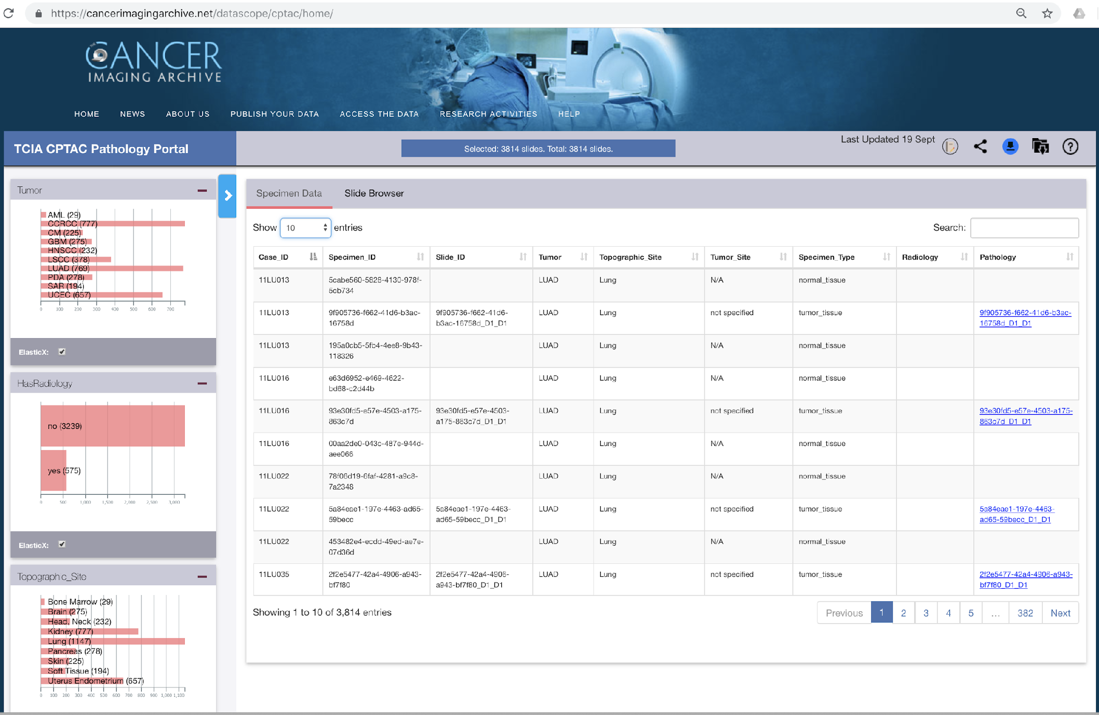
QuickStart
https://cancerimagingarchive.net/datascope/cptac/home/
An interactive overview of pathology review data and specimen information.
Tumor type, site
%Necrosis
%Tumor Nuclei
%Total Cellularity
Links to Radiology data
https://bit.ly/cptac-datascope

Slide 3
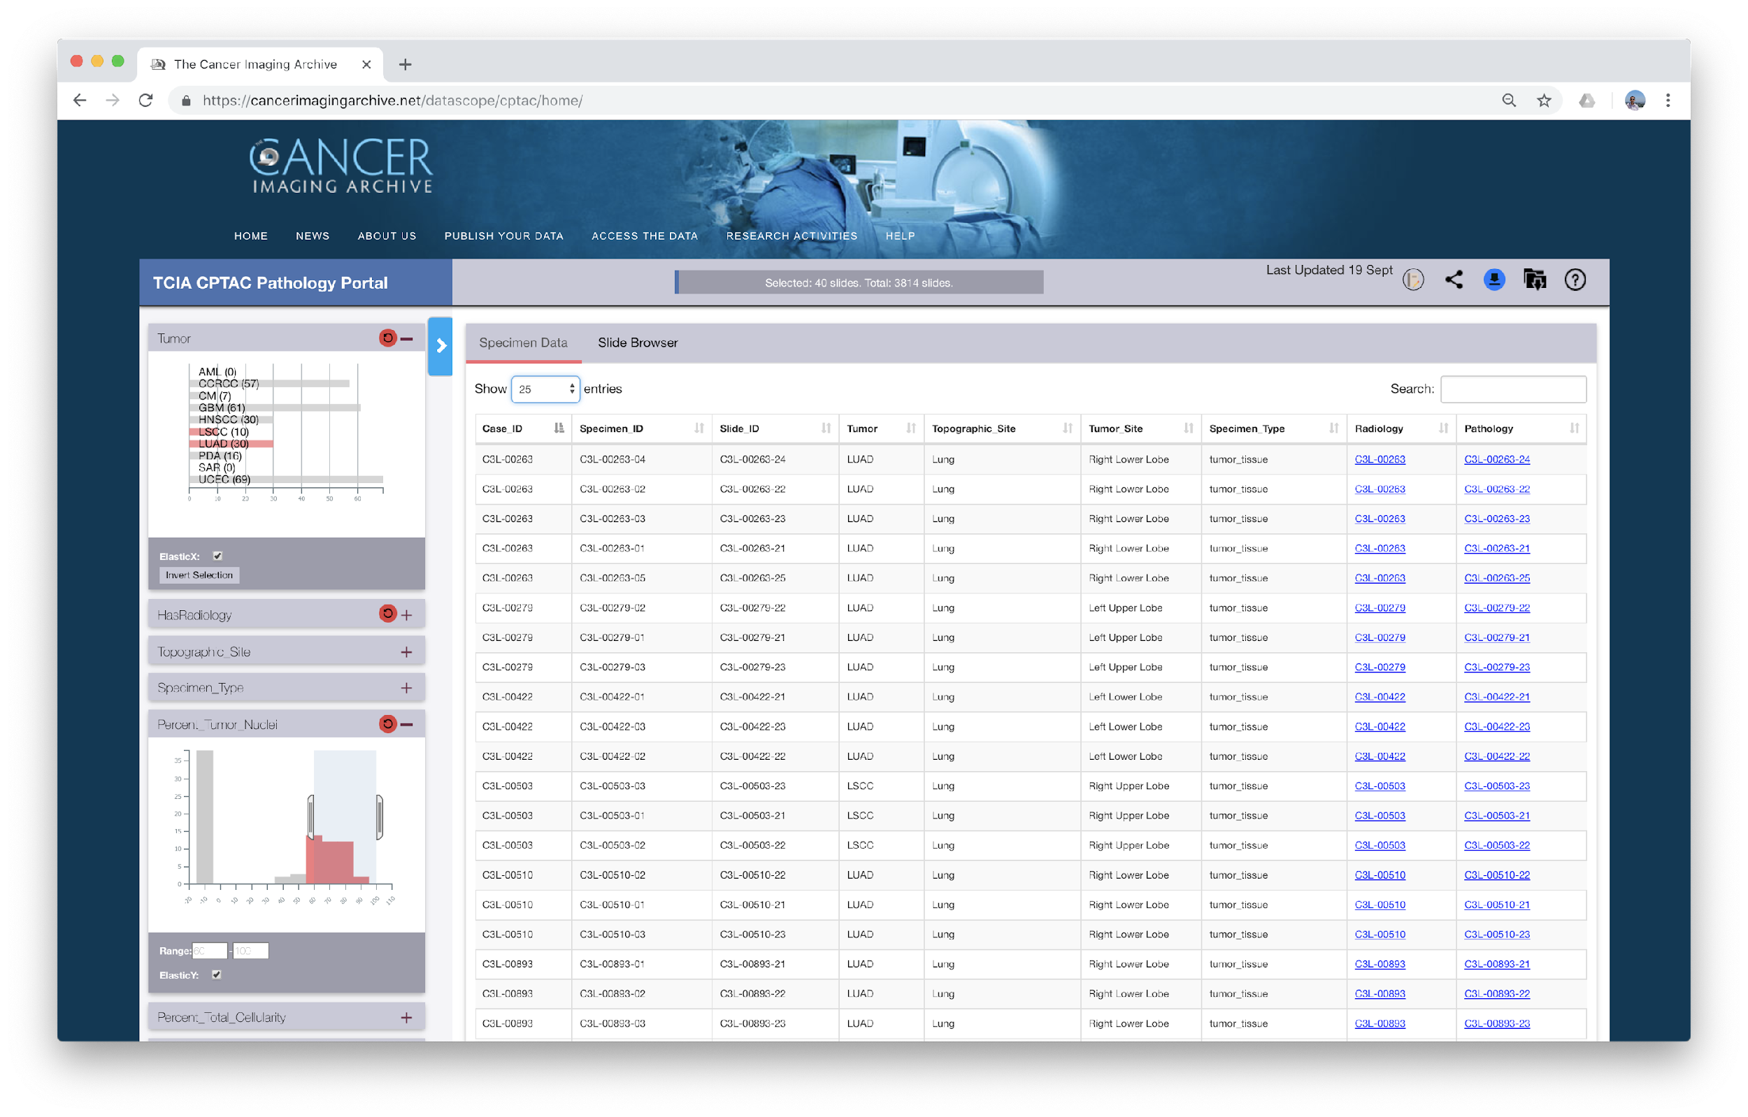
Data Dictionary
Number of slides in cohort
Click to see all filters
Download cohort data
Interactive Filters to create cohorts
Request bulk download of images
Share a cohort
Click to see pathology thumbnails of cohort
Click to see Radiology data of corresponding CaseID
Click to view Pathology Image
TCIA CPTAC Data Portal — Powered by DataScope

Slide 4
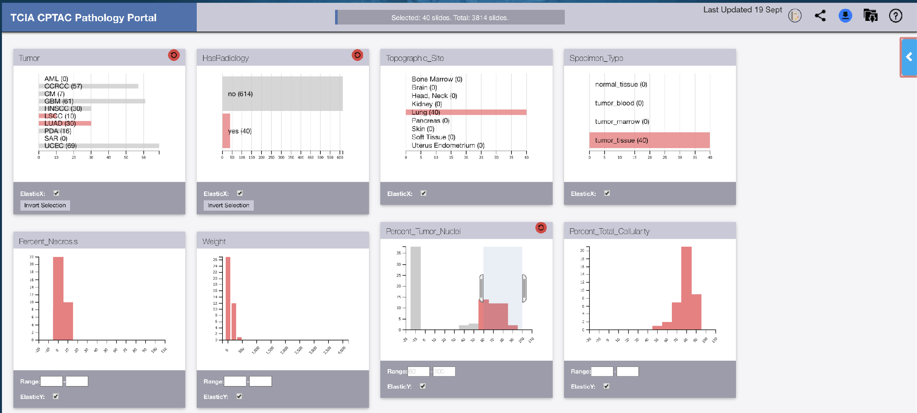
Slice-Dice Data
Click to switch to previous view
Click to switch to previous view
Interactive Filters:
Tumor: LSCC and LUAD
Has Radiology: True
Percent Tumor Nuclei: {60, 100}
We now trim the cohort to only LUAD, LUSC subjects
Next we select only those where we have radiology
AND the % tumor nuclei is 60-100%
40 slides out of a total of 3814

Slide 5
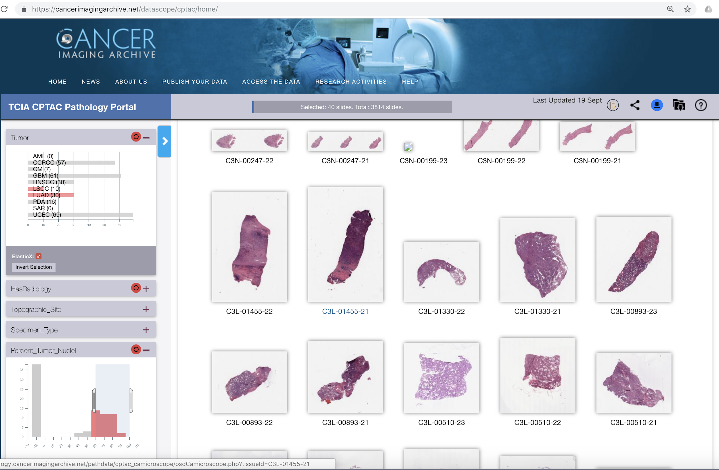
View Cohort
View Specimen Data of Cohort
View Thumbnails of Pathology Images
Click on Thumbnails to Visualize Images

Slide 6
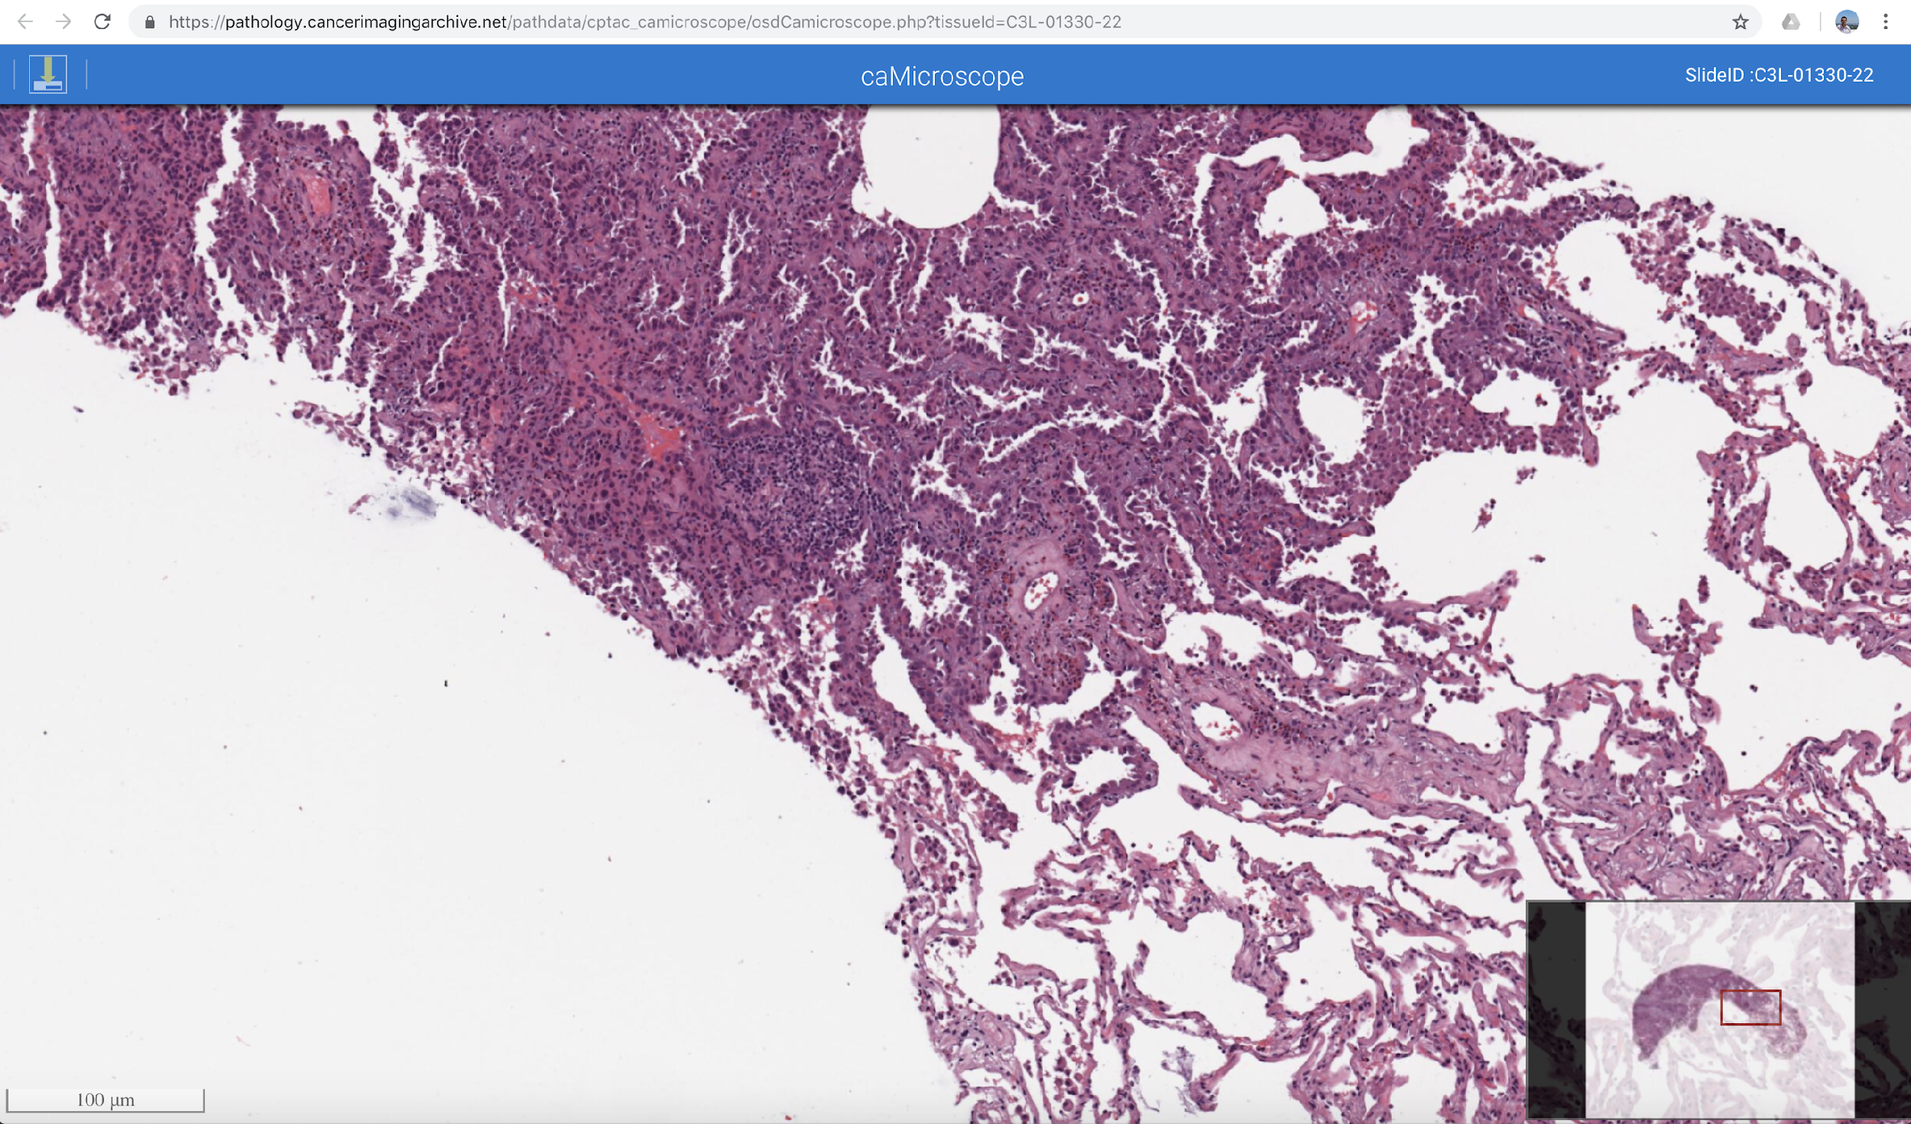
Scroll to Zoom
Use the mouse to Pan
Click to download image
Visualize Pathology Image using caMicroscope

