Slide 1

Using RSNA's Clinical Trial Processor (CTP) Software for Clinical Trials and Research Applications
John Perry
Justin Kirby
Notes:
(Title slide)

Slide 2
Clinical Trials Dataflow
DICOM
Database
HTTP
Internet
HTTP / HTTPS
DICOM
DICOM
Data Acquisition
Sites
Principal Investigator
Site
Notes:
(Content slide, color option 1)

Slide 3
CTP
Stand-alone application for clinical trials data:
  Processing and communication
  De-identification of Protected Health Information (PHI)
Simple installation and configuration:
  Single XML configuration file
Configurable for:
  Data acquisition sites
  Principal investigator sites
Platform-independent
Notes:
(Content slide, color option 1)

Slide 4
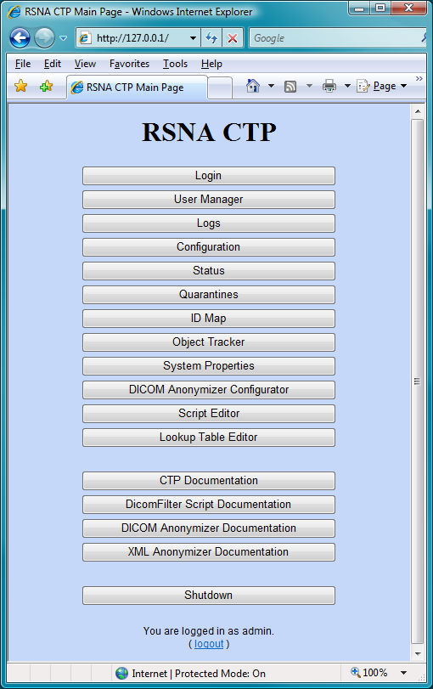
CTP Admin Web Server
Administrative functions
Account management
Status display
Configuration display
System properties display
Script editors
Authentication
Notes:
(Content slide, color option 1)

Slide 5
CTP Data Objects
DicomObject
  Images
  SR / KOS / GSPS objects
XmlObject
  Text data
  Flexible schema for identifiers
ZipObject
  Encapsulation of trial-specific files
  Embedded manifest to carry the identifiers
Notes:
(Content slide, color option 1)

Slide 6
CTP Processing Pipelines
A pipeline is an ordered sequence of stages
A stage is an element to perform a function:
  ImportService
  Processor
  StorageService
  ExportService
Pipelines can have as many stages as necessary
CTP supports multiple pipelines
Notes:
(Content slide, color option 1)

Slide 7
Standard Import Services
DicomImportService - DICOM Storage SCP
HttpImportService - HTTP and HTTPS
PollingHttpImportService - HTTP for firewall penetration
DirectoryImportService - manual submission
ArchiveImportService - bulk import
Notes:
(Content slide, color option 1)

Slide 8
Standard Processors
DicomFilter - triage for DicomObjects
XmlFilter - triage for XmlObjects
ZipFilter - triage for ZipObjects
DicomDecompressor - convert DICOM images
DicomPixelAnonymizer - blank pixel regions
DicomAnonymizer - de-identify DicomObjects
XmlAnonymizer - de-identify XmlObjects
ZipAnonymizer - de-identify ZipObject manifests
Notes:
(Content slide, color option 1)

Slide 9
Standard Processors
DicomTranscoder - convert DICOM objects
ObjectCache - PHI capture
ObjectLogger - performance measurement
MemoryMonitor - operation monitoring
IDMap - PHI ID lookup
ObjectTracker - data acquisition management
DatabaseVerifier - transfer confirmation between sites
Notes:
(Content slide, color option 1)

Slide 10
Standard Storage Services
FileStorageService
  Indexed file management
  Web access with authentication
BasicFileStorageService
  Indexed file management for the National Cancer Institute NBIA system
DirectoryStorageService
  Hierarchical disk storage
Notes:
(Content slide, color option 1)

Slide 11
Standard Export Services
DicomExportService - DICOM Storage SCU
HttpExportService - HTTP and HTTPS
PolledHttpExportService - HTTP for firewall penetration
FtpExportService - FTP
AIMExportService - HTTP to AIM data repository
DatabaseExportService - external database interface
Notes:
(Content slide, color option 1)

Slide 12
FileStorageService
Configurable tree structure
Built-in web server
  Authentication
  Browse patients / studies / data objects
  Display images (tile / stack / series)
  Export data objects of all types
  Programmatic access via Ajax servlet
Notes:
(Content slide, color option 1)

Slide 13
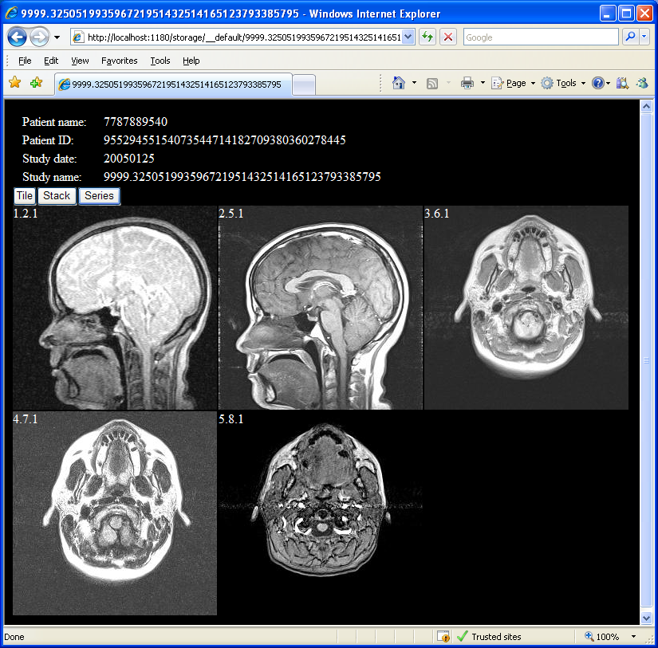
FileStorageService Viewer
Notes:
(Content slide, color option 1)

Slide 14
DatabaseExportService
Integrated queue management
DatabaseAdapter
  Interface between the DatabaseExportService and the database itself
  Must be developed for each unique database schema
  Standard class to extend for a specific application
Notes:
(Content slide, color option 1)

Slide 15
CTP Example
Data Acquisition Site
CTP
DicomImportService
DicomAnonymizer
HttpExportService
Modality
…
PACS
Principal Investigator Site
CTP
HttpImportService
FileStorageService
DatabaseExportService
DicomExportService
Local Disk
External Database
Workstation
Notes:
(Content slide, color option 1)

Slide 16
Firewall Penetration
Principal Investigator Site
DMZ
Internet
HTTP / HTTPS
CTP
HttpImportService
PolledHttpExportService
DMZ
Secure Network
CTP
PollingHttpImportService
… (additional stages)
Notes:
(Content slide, color option 1)

Slide 17
Adapting CTP
Flexible
  All standard stages are highly configurable
Extensible
  Integrated class loader
  Interface-based structure
  Abstract classes for easy development of new stages
  Base class for developing database interfaces
Notes:
(Content slide, color option 1)

Slide 18
CTP
Runs on Windows, Mac, Linux, Solaris
Requires only Java
Java and CTP are free
MIRC/CTP Users Meeting:
  Monday, 11/29, from 3:00-4:15 in N127
Notes:
(Content slide, color option 1)

Slide 19
Questions/Answers & Help
The MIRC Wiki
  http://mircwiki.rsna.org
RSNA Forums
  http:forums.rsna.org
  User Comments, Questions, & Answers
  RSNA MIRC Software Announcements
  MIRC Implementers Corner
Notes:
(Content slide, color option 1)

Slide 20
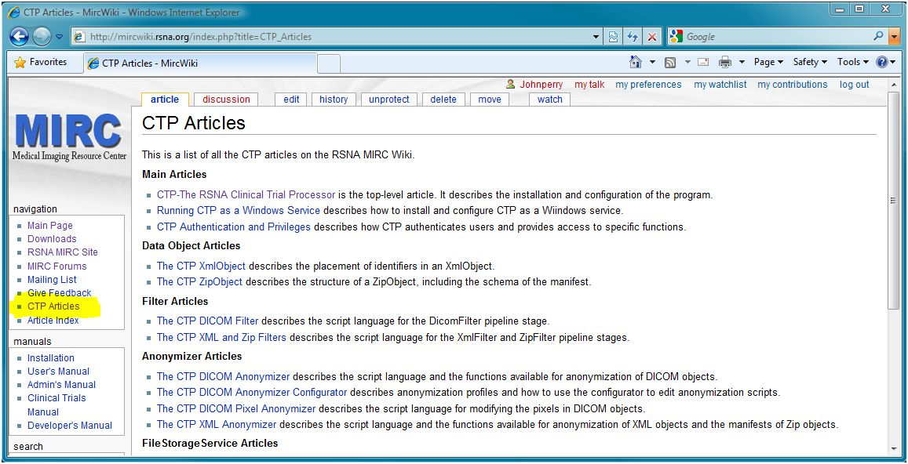
RSNA MIRC Wiki
Notes:
(Content slide, color option 1)

Slide 21
Practical Applications
Intro to de-identification challenges
  DICOM metadata
  Private Tags
  Burned-in Annotations/Screen captures
DICOM Standard for de-identification
  History & Rationale (Supplement 142)
  CTP Profiles
Real world examples
Notes:
(Content slide, color option 1)

Slide 22
De-Identification
Challenges
  Varying usage scenarios:
    public archive vs limited data use agreement
  Complexity of DICOM headers
  Burned in PHI
  Private tags, lack of vendor uniformity in usage
Notes:
(Content slide, color option 1)

Slide 23
De-Identification
De-identification Methods
  Safe Harbor
  Statistical
http://privacyruleandresearch.nih.gov/research_repositories.asp
Notes:
The first way, the "safe-harbor" method, is to remove all 18 identifiers enumerated at section 164.514(b)(2) of the regulations 1. Data that are stripped of these 18 identifiers are regarded as de-identified, unless the covered entity has actual knowledge that it would be possible to use the remaining information alone or in combination with other information to identify the subject.
The second way is to have a qualified statistician determine, using generally accepted statistical and scientific principles and methods, that the risk is very small that the information could be used, alone or in combination with other reasonably available information, by the anticipated recipient to identify the subject of the information. The qualified statistician must document the methods and results of the analysis that justify such a determination.

Slide 24
The Safe Harbor 18 (1-3)
Name
Location; all geographic subdivisions smaller than a state, including street address, city, county, precinct, zip code, and their equivalent geocodes.
Dates (all dates related to the subject of the information, e.g. birth dates, admission dates, discharge dates, encounter dates, surgery dates, etc.)
Notes:
(Content slide, color option 1)

Slide 25
The Safe Harbor 18 (4-9)
Telephone numbers
Fax numbers
Electronic mail addresses
Social security numbers
Medical record numbers
Health plan beneficiary numbers
Notes:
(Content slide, color option 1)

Slide 26
The Safe Harbor 18 (10-15)
Account numbers
Certificate / license numbers
Vehicle identifiers and serial numbers, including license plate numbers
Device identifiers and serial numbers
Web Uniform Resource Locators (URLs)
Internet Protocol (IP) address numbers
Notes:
(Content slide, color option 1)

Slide 27
The Safe Harbor 18 (16-18)
Biometric identifiers, including finger and voice prints
Full face photographic images and any comparable images
Any other unique identifying number, characteristic, or code
Notes:
(Content slide, color option 1)

Slide 28
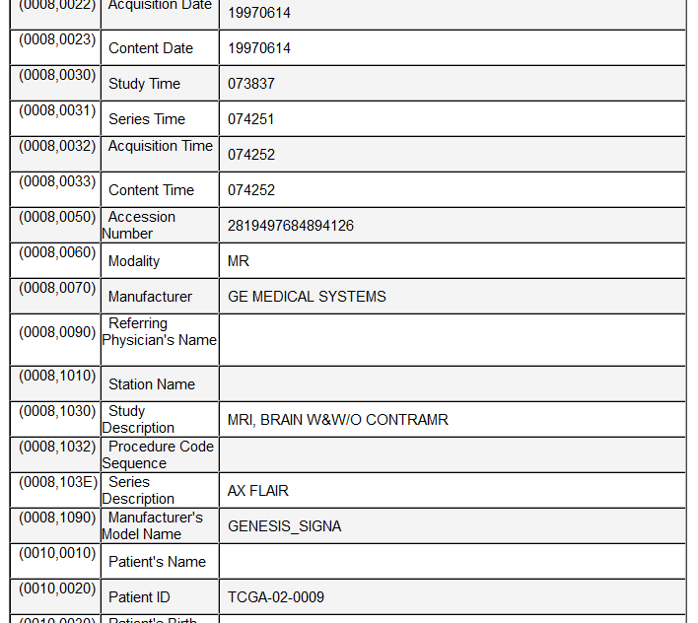
Challenges
PHI can appear in hundreds of places in DICOM
  Dates
  Identifiers
  Free text
Notes:
(Content slide, color option 1)

Slide 29
Challenges
DICOM standardizes metadata in image headers but not all vendors use standard tags exactly the same way
Private tags allow for storage of non-standard items
Most DICOM software requires non-null UIDs, dates, etc to function properly
Removal of dates renders many types of scientific analysis impossible
Notes:
(Content slide, color option 1)

Slide 30
DICOM Supplement 142
DICOM Working Group 18: Supplement 142
  Extension of the confidentiality profile in PS 3.15 with additional profiles
  Provide instruction for implementers
    Listing of any tag potentially containing PHI
    Codes for what to do with each of those tags
  Ensure compliance with HIPAA as it relates to DICOM
Notes:
(Content slide, color option 1)

Slide 31
DICOM Supplement 142
Basic Application Level Confidentiality Profile:
  the identity of any responsible parties or family members
  the identity of any personnel involved in the procedure
  the identity of the organizations involved in ordering or performing the procedure
  additional information that could be used to match instances if given access to the originals, such as UIDs, dates and times
  private attributes
Notes:
(Content slide, color option 1)

Slide 32
DICOM Supplement 142
Profiles that require removal of additional information:
  Clean Pixel Data Option
  Clean Recognizable Visual Features Option
  Clean Graphics Option
  Clean Structured Content Option
  Clean Descriptors Option
Notes:
(Content slide, color option 1)

Slide 33
DICOM Supplement 142
Profiles that require retention for specific uses:
  Retain Longitudinal Temporal Information with Full Dates Option
  Retain Longitudinal Temporal Information with Modified Dates Option
  Retain Patient Characteristics Option
  Retain Device Identity Option
  Retain UIDs
  Retain Safe Private Option
Notes:
(Content slide, color option 1)

Slide 34
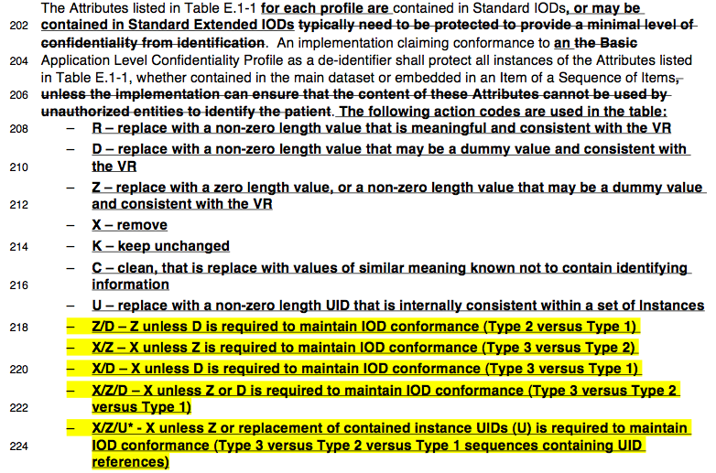
DICOM Supplement 142
Notes:
(Content slide, color option 1)

Slide 35
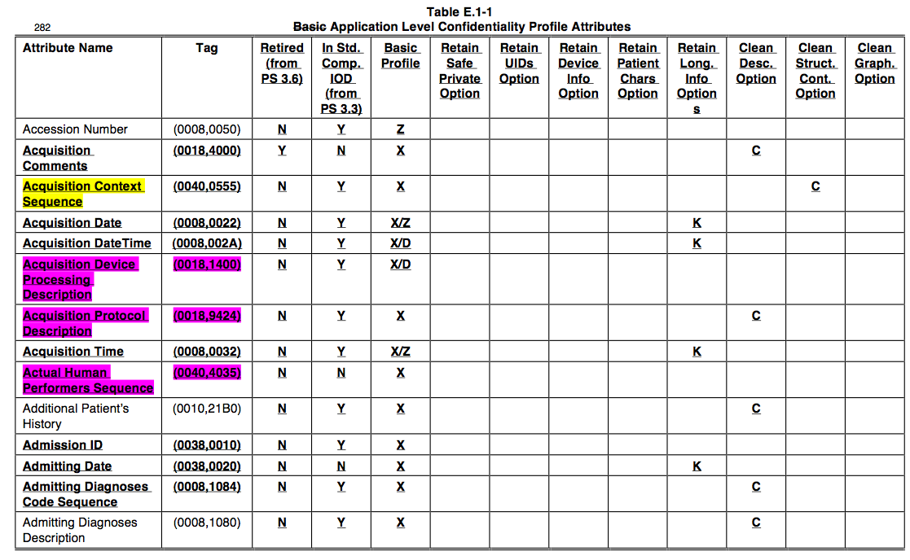
DICOM Supplement 142
Notes:
(Content slide, color option 1)

Slide 36
DICOM Supplement 142
Cancer Imaging Program (CIP) began a project in Feb 2009 to collaborate with WG18 and RSNA to implement S142 in CTP
  April ’09 – CTP extended to include functionality to support S142 Profiles
  April ‘09 – Initial implementation of S142 “Basic Profile” script created
  December ‘09 – Implemented S142 “option” Profiles
Notes:
(Content slide, color option 1)

Slide 37
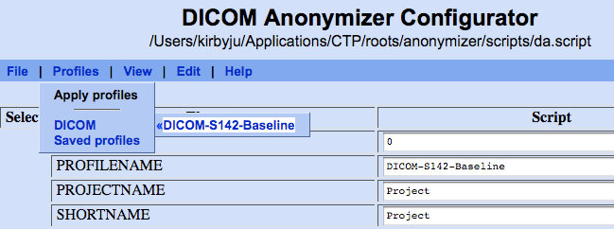
DICOM Supplement 142
Initial implementation of Basic Profile
Notes:
(Content slide, color option 1)

Slide 38
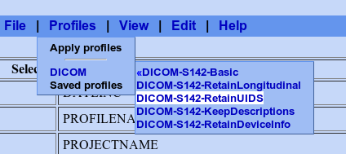
DICOM Supplement 142
Additional S142 option scripts were added
Notes:
(Content slide, color option 1)

Slide 39
DICOM Attribute Confidentiality Profile
In 2011 Supplement 142 was incorporated into DICOM Standard
Now located within the Attribute Confidentiality Profile (DICOM PS 3.15: Appendix E)
Regular updates provided as part of new CTP releases
Notes:
(Content slide, color option 1)

Slide 40
CTP Implementations
Examples:
  De-identification of images for presentations
  De-identification/transfer of images from PACS to research database
  Clinical Trials
  Public Archive
Notes:
(Content slide, color option 1)

Slide 41
De-identification of Images
Images located on local hard drive, and to remain on local hard drive after de-identification
IRB approval to leave original exam dates unmodified
Useful information is known to be kept in Series Description tags
Some private tags required to do perfusion analysis
Notes:
(Content slide, color option 1)

Slide 42
De-identification of Images
DICOM Profiles
  Basic Profile
  Retain Longitudinal Temporal Information with Full Dates Option
  Clean Descriptors Option (requires manual review and adjustment to script)
  Retain Safe Private Option (requires knowledge of vendor software to retain known safe perfusion tags)
Notes:
(Content slide, color option 1)

Slide 43
De-identification of Images
Directory Import Service Stage
DICOM Anonymizer Stage
File Storage Service Stage
Save de-identified DICOM
images to hard drive
Import from hard drive
Process may need to be repeated if PHI is
discovered and needs to be cleaned
Database Export
Verify Submission
QC Review
File Storage
PACS/HDD
De-Identification
HTTP Export
HTTP/DICOM Import
Database Export
Verify Submission
QC Review
File Storage
PACS/HDD
De-Identification
HTTP Export
HTTP/DICOM Import
Database Export
Verify Submission
QC Review
File Storage
PACS/HDD
De-Identification
HTTP Export
HTTP/DICOM Import
Database Export
Verify Submission
QC Review
File Storage
PACS/HDD
De-Identification
HTTP Export
HTTP/DICOM Import
Notes:
(Content slide, color option 1)

Slide 44
Transfer to Research Database
  Images located on PACS, to be stored in research database after de-identification
  IRB approval requires dates to be disguised
  Metabolic information about the patients are required for SUV analysis
Notes:
(Content slide, color option 1)

Slide 45
Transfer to Research Database
DICOM Profiles
  Basic Profile
  Retain Longitudinal Temporal Information with Modified Dates Option
  Retain Patient Characteristics Option
Notes:
(Content slide, color option 1)

Slide 46
Transfer to Research Database
Local CTP de-identifies data before it leaves local network
PACS
DICOM Import Stage
DICOM Anonymizer Stage
HTTP Import Stage
Basic File Storage Service Stage
HTTP Export Stage
Database Export Stage
Database Export Service Stage
Remote CTP receives de-identified images and stores them in Research
Database Software (e.g. NBIA, XNAT)
Database Export
Verify Submission
QC Review
File Storage
PACS/HDD
De-Identification
HTTP Export
HTTP/DICOM Import
Database Export
Verify Submission
QC Review
File Storage
PACS/HDD
De-Identification
HTTP Export
HTTP/DICOM Import
Database Export
Verify Submission
QC Review
File Storage
PACS/HDD
De-Identification
HTTP Export
HTTP/DICOM Import
Database Export
Verify Submission
QC Review
File Storage
PACS/HDD
De-Identification
HTTP Export
HTTP/DICOM Import
Notes:
(Content slide, color option 1)

Slide 47
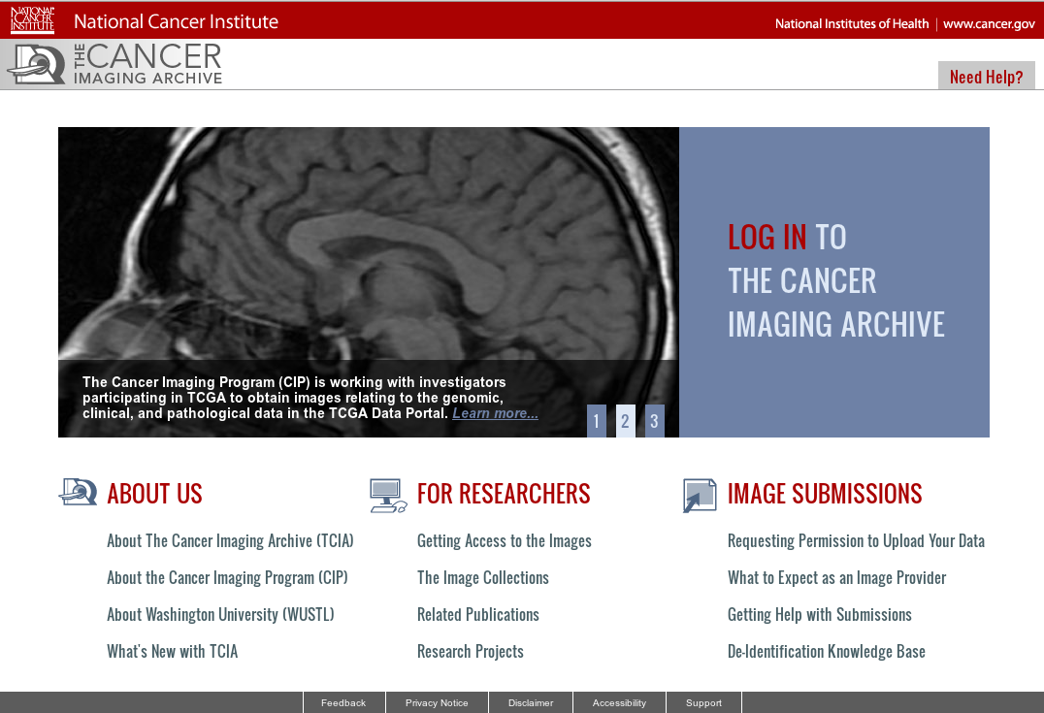
The Cancer Imaging Archive (TCIA)
Notes:
(Content slide, color option 1)

Slide 48
The Cancer Imaging Archive (TCIA)
Using CTP to manage a public database of de-identified images
  Launched in 2011 by the Cancer Imaging Program in cooperation with Washington University of St. Louis
  Freely available large and growing archive service providing DICOM images for use in research
  Designed as a resource for cancer researchers, engineers/developers, and professors
  Attend workshop ICIA41 on Wednesday, 10:30-12:00 in S401CD
Notes:
(Content slide, color option 1)

Slide 49
The Cancer Imaging Archive (TCIA)
Extensive QC required due to public release of data sets
Multi-phase de-identification methodology
  Visual inspection of pixel data and DICOM elements
  TagSniffer and Extraction Tool to generate reports on DICOM elements
  Reports cross referenced with vendor conformance statements, used to build Knowledgebase
Notes:
(Content slide, color option 1)

Slide 50
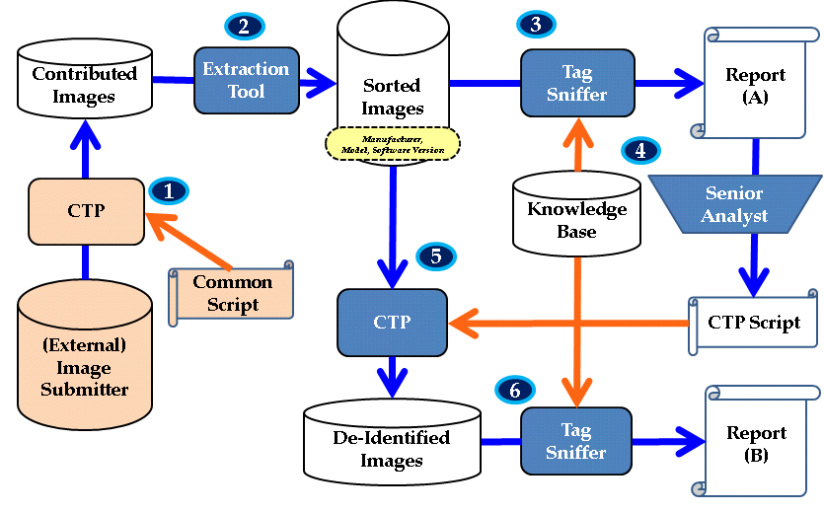
The Cancer Imaging Archive (TCIA)
Notes:
Diagram of the de-id workflow at TCIA

Slide 51
TCIA De-Identification Knowledge Base
Intended to be a community resource
Tag Sniffer software available as open source
Regularly updated repository of modality/vendor/software version specific profiles for private tags
Visit the Education Exhibit LL-INE1265-WEA on Wednesday from 12:15-12:45 to learn more
Notes:
(Content slide, color option 1)

Slide 52
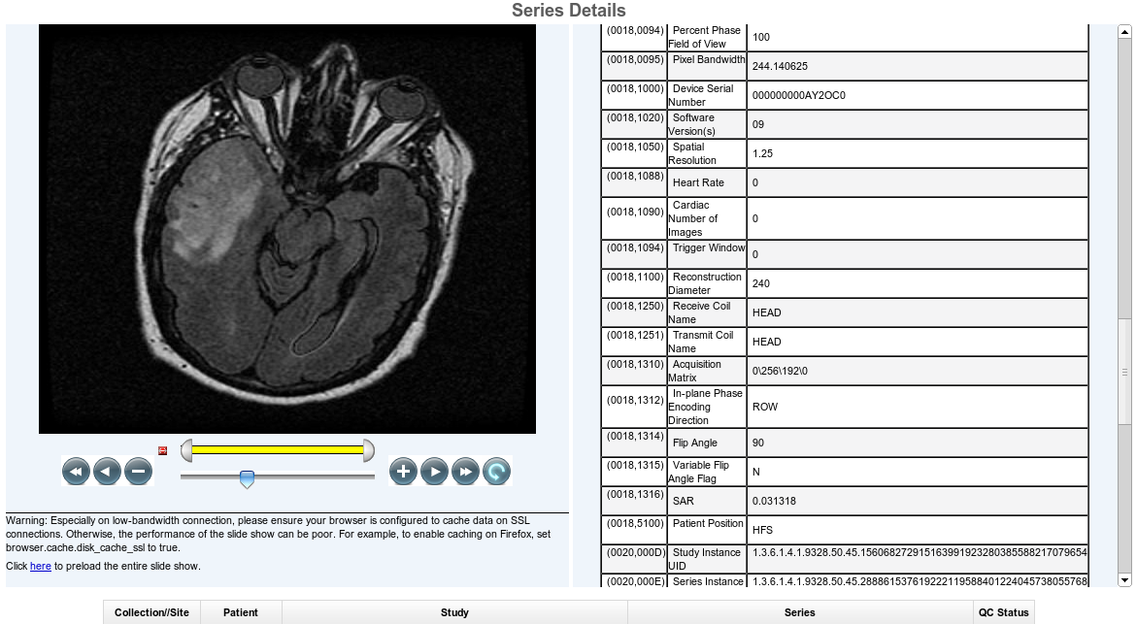
The Cancer Imaging Archive (TCIA)
Notes:
NBIA QC tool screenshot – allows TCIA staff to review of both DICOM headers and pixels at a glance

Slide 53
Brigham & Women’s Database
Brigham and Women's Hospital/Harvard Medical School, Boston MA, National Center for Image Guided Therapy
  Prostate Core (PI Clare Tempany) Multiparametric MRI of Prostate Cancer
  QIN project (PI Fiona Fennessy) Department of Radiology
Several projects, all of which are related to prostate cancer imaging
Notes:
(Content slide, color option 1)

Slide 54
Brigham & Women’s Database
Multiple CTP pipelines in single instance of CTP
XNAT (http://www.xnat.org/) as central archive
Patient ID lookup table maintained by a person who is authorized to access patient information.
No PHI gets into XNAT.
All of the servers are accessible only within the firewalled hospital internal network.
Notes:
(Content slide, color option 1)

Slide 55
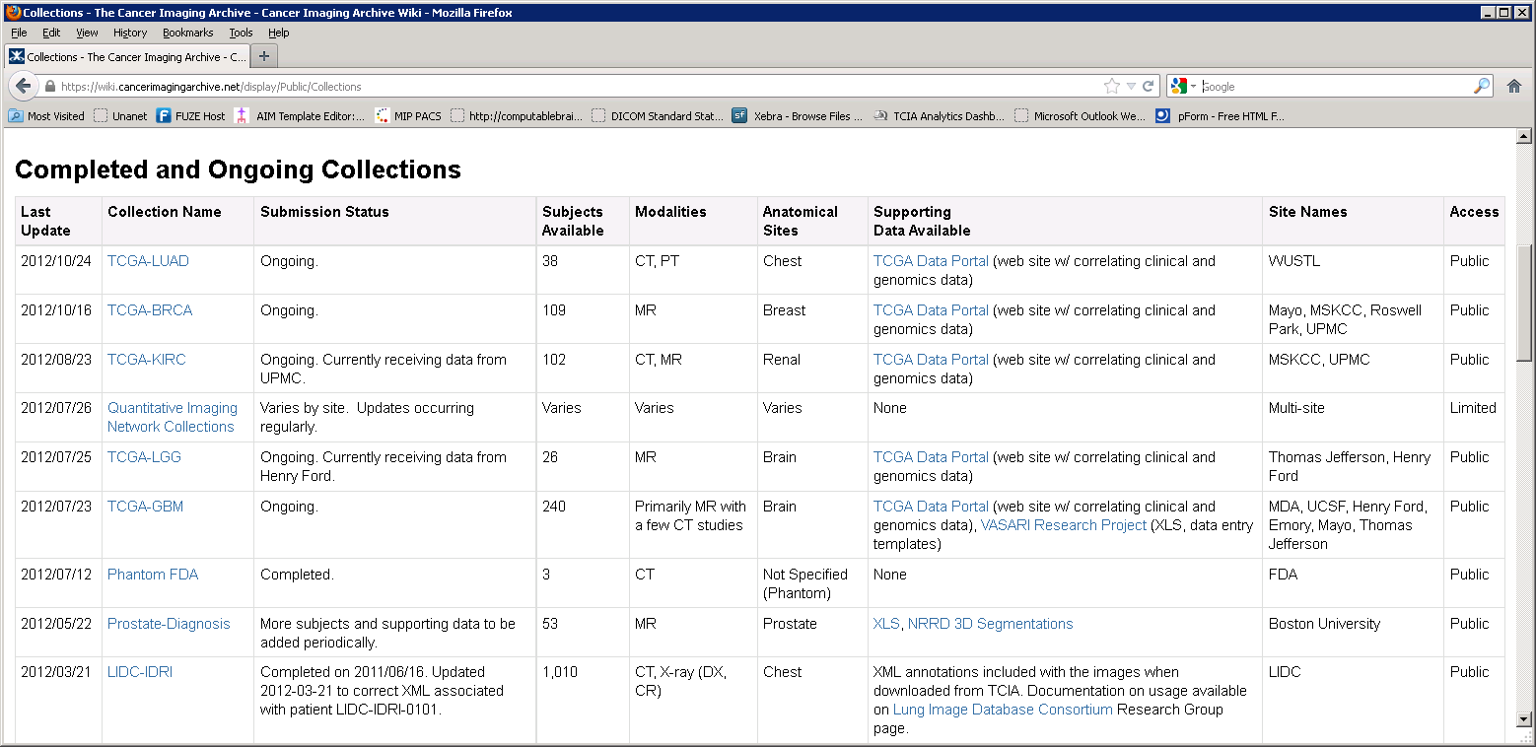
The Cancer Imaging Archive (TCIA)
Notes:
(Content slide, color option 1)

