Slide 1
TCGA GBM VASARI data analysis
Ying Hu, Chunhua Yan,
Qing-rong Chen,
Daoud Meerzaman
05/08/2012

Slide 2
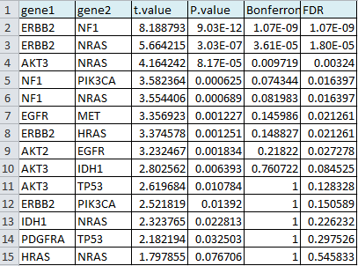
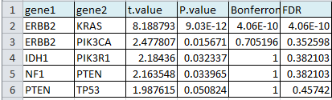
Correlation analysis
(CNV, mutation and sub-type)
CNV
Mutation

Slide 3
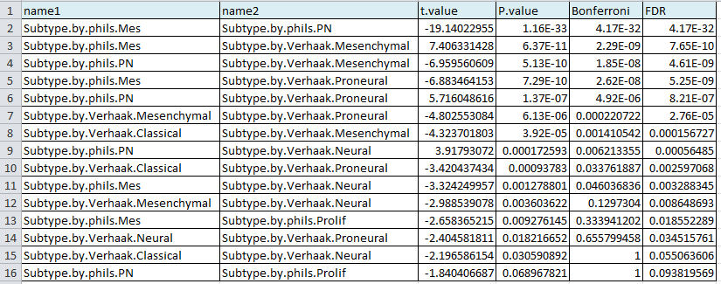
Correlation analysis
Sub-type

Slide 4
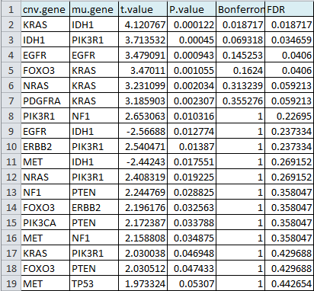
Association analysis between CNV and Mutation

Slide 5
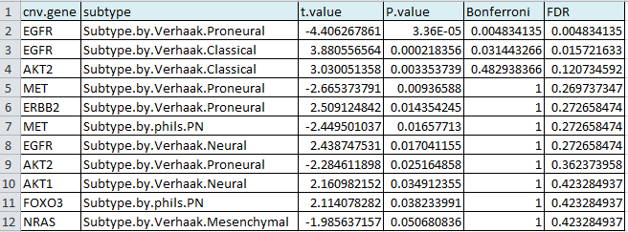
Association analysis between CNV and Sub-type

Slide 6
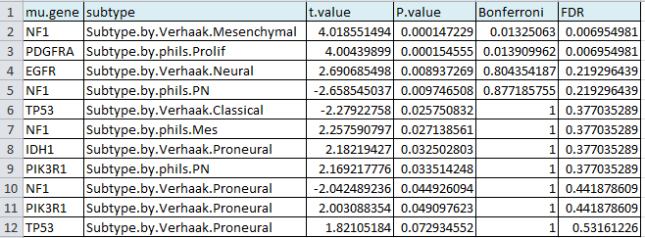
Association analysis between Mutation and Sub-type

Slide 7
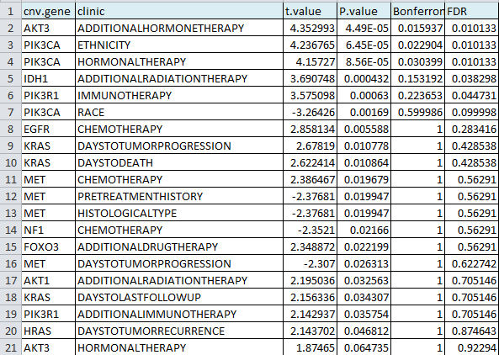
Association analysis between CNV and clinical information

Slide 8
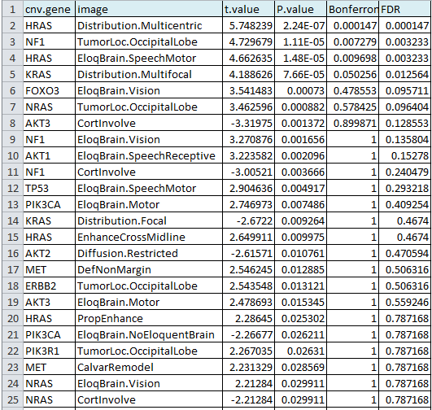
Association analysis between CNV and image

Slide 9
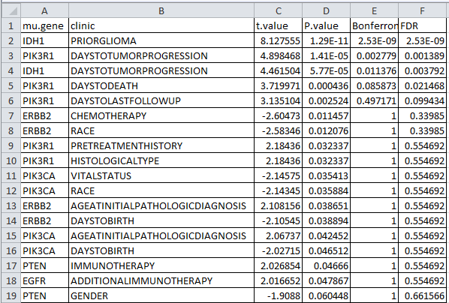
Association analysis between mutation and clinical information

Slide 10
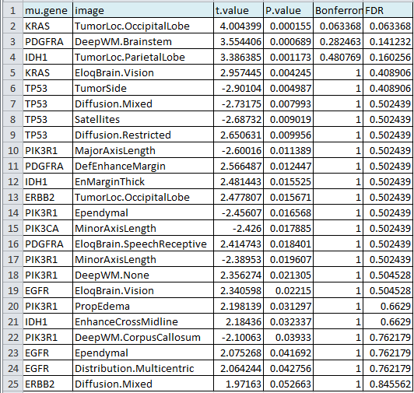
Association analysis between mutation and image

Slide 11
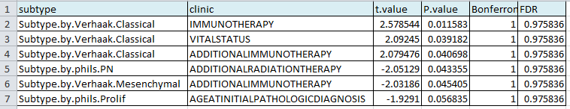
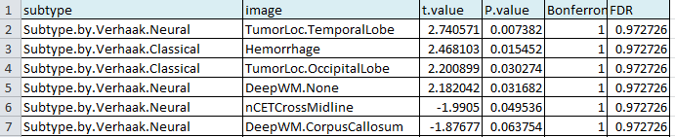
Association analysis between sub-type and clinical information
Association analysis between sub-type and image

Slide 12
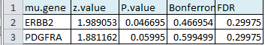
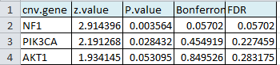
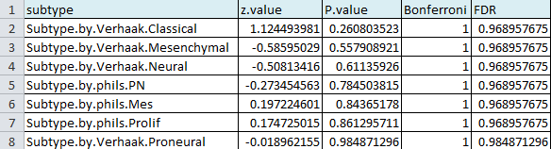
Survival analysis (Cox model) of Mutation
Survival analysis (Cox model) of CNV
Survival analysis (Cox model) of Sub-type

Slide 13
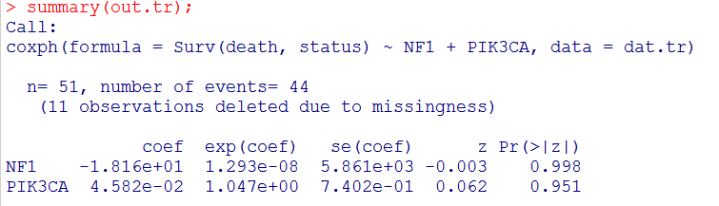
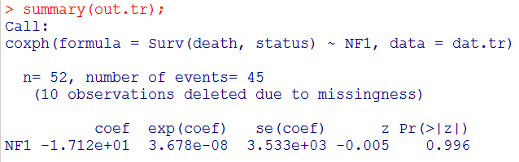
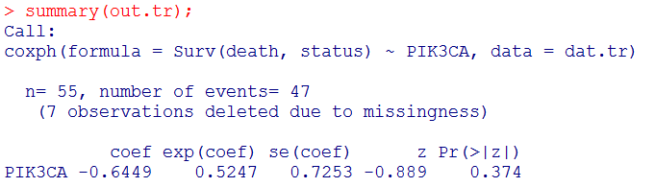
Survival analysis (Cox model) of CNV by training data set

Slide 14
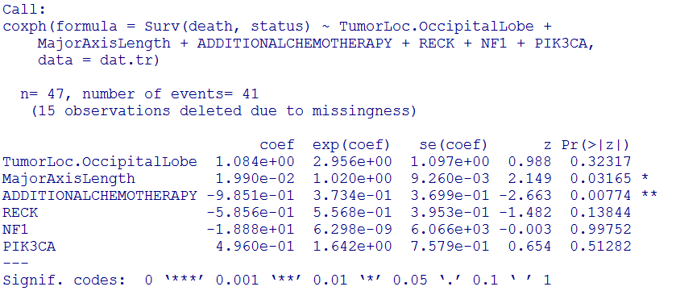
Survival (Cox model) analysis

