Slide 1
Public Databases for Radiomics Research: Current Status and Future Directions
Presenter: Justin Kirby
Email: justin.kirby@nih.gov

Slide 2
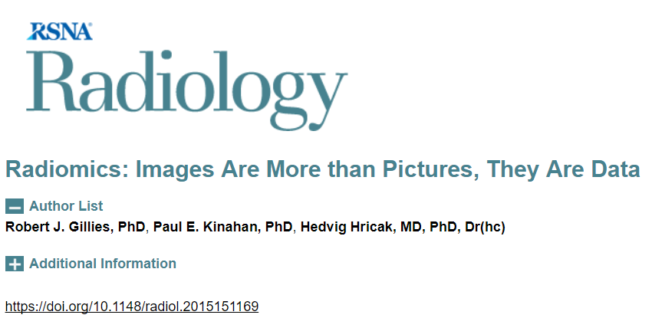
What is radiomics?
“With high-throughput computing, it is now possible to rapidly extract innumerable quantitative features from tomographic images (computed tomography [CT], magnetic resonance [MR], or positron emission tomography [PET] images).”

Slide 3
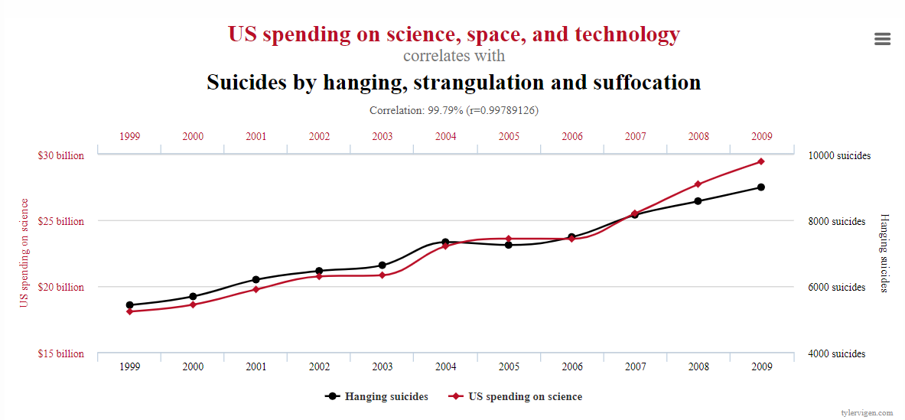
Why is data sharing important for radiomics research?
Given enough data, you will eventually find a correlation with something…
https://www.tylervigen.com/spurious-correlations

Slide 4
How can we ensure radiomic features are driven by biology?
Test your feature stability against data from other institutions
  Different patient populations
  Different scanners
  Different acquisition protocols
This is significantly easier when people share data!

Slide 5
Other benefits: Data sharing enables better science
Increase transparency and catch potential mistakes
Significantly cheaper than acquiring new data
  Re-use for secondary research aims (e.g. same images/ROIs, new features)
  Combine multiple data sets to generate more statistically robust results
Create benchmark data sets to objectively compare analytic performance
  Challenge competitions
  Simplify FDA approval -- e.g. Medical Device Development Tools (MDDT) program

Slide 6
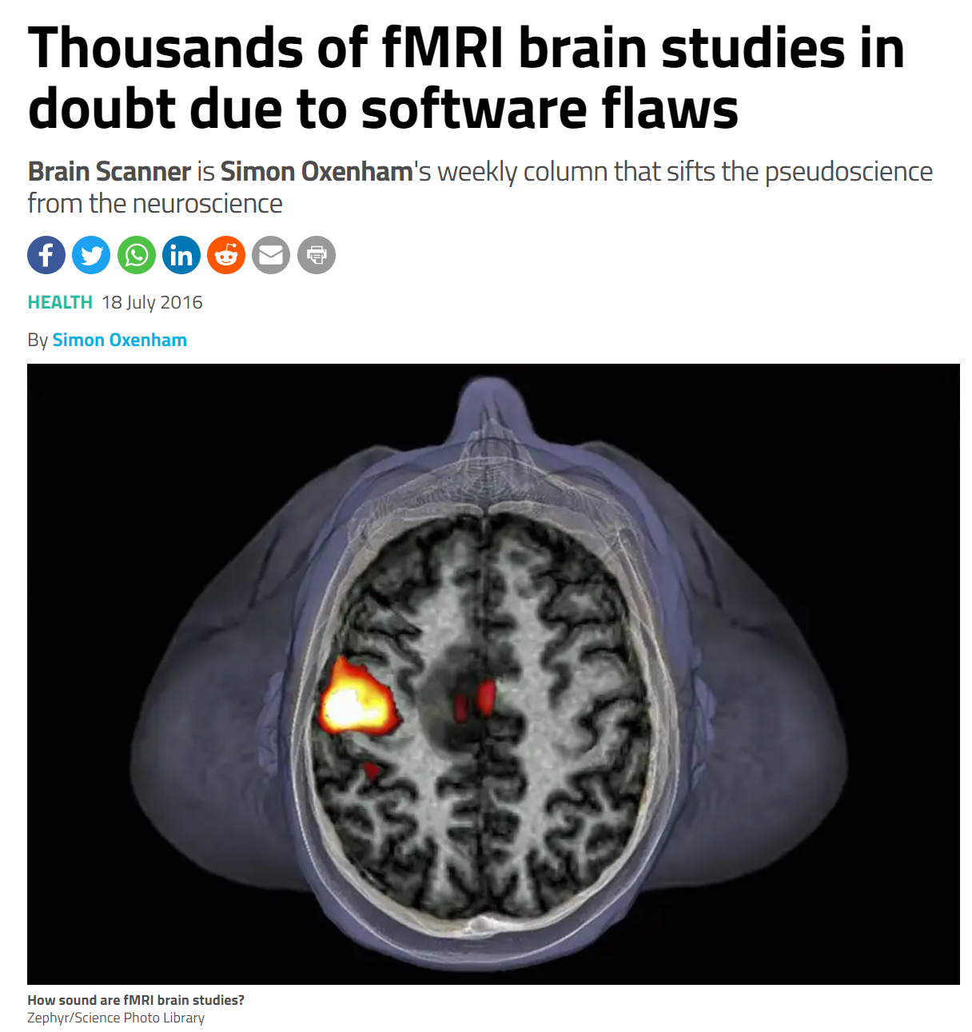
Example of data sharing benefits: Catching mistakes
“…software flaws in the popular fMRI data analysis packages SPM, FSL and AFNI meant this technique routinely produced false positives, resulting in errors 50 per cent of the time or more.”
“Anders Eklund and Hans Knutsson at Linköping University in Sweden and Thomas Nichols at the University of Warwick, UK, calculated this by analysing brain data from a collaborative open fMRI project called 1000 Functional Connectomes.”
https://www.newscientist.com/article/2097734-thousands-of-fmri-brain-studies-in-doubt-due-to-software-flaws/#ixzz65qHm18sk

Slide 7
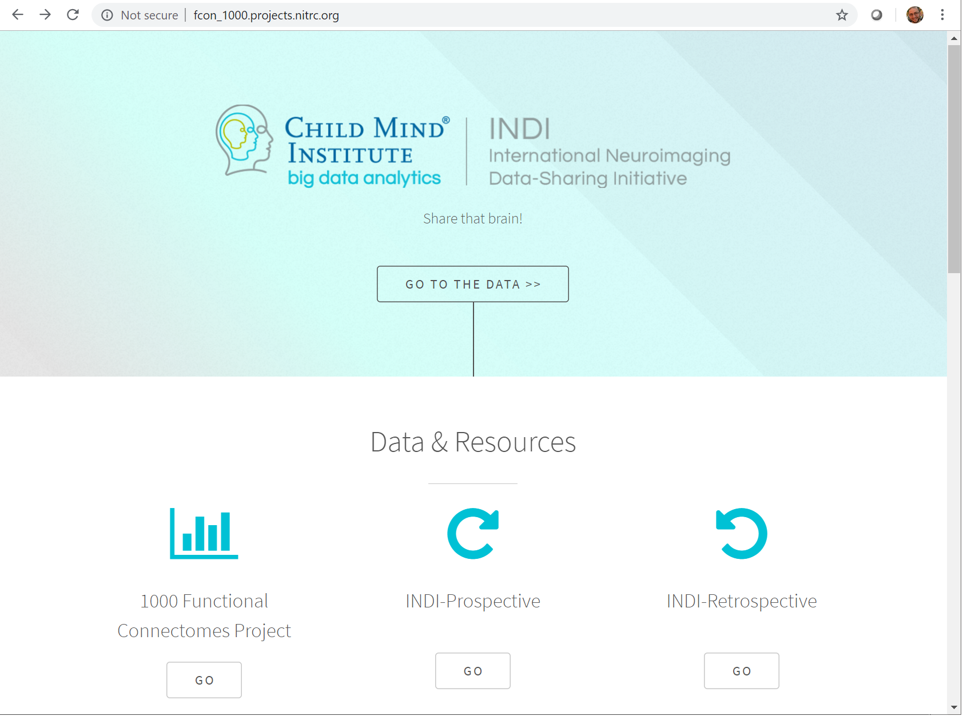
Example of data sharing benefits: Catching mistakes
Made possible by data sharing
“Share that brain!”
http://fcon_1000.projects.nitrc.org/

Slide 8
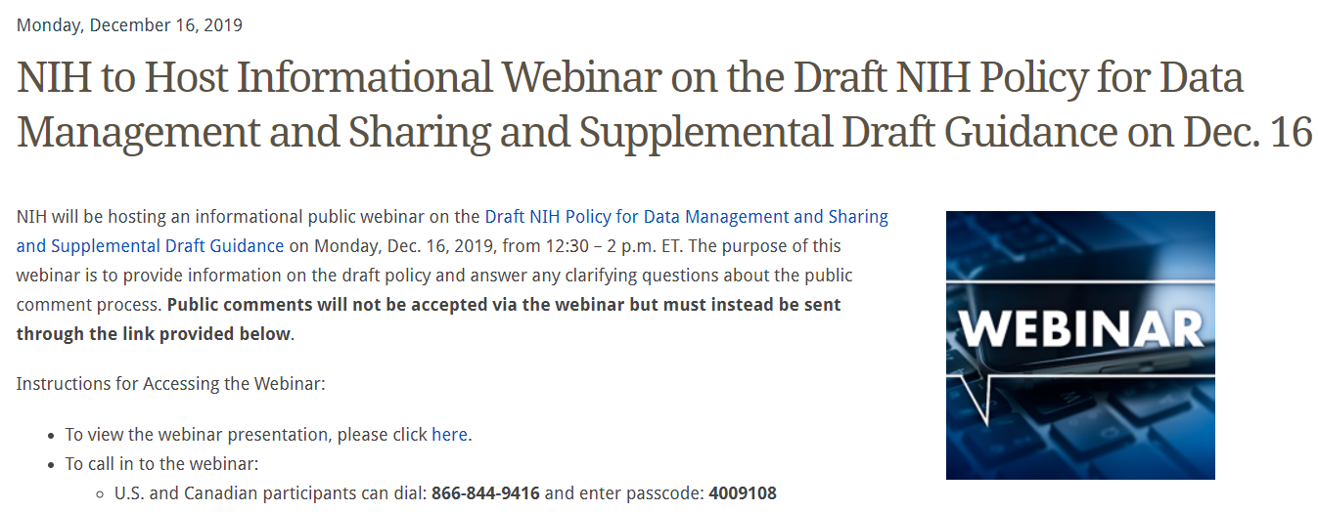
Funding requirements to share data
Funding organizations recognize the benefits of sharing data!
National Institutes of Health (NIH) data sharing plan required for grants higher than $500K/year in direct support
Numerous additional requirements from NIH programs which require depositing data in specific databases: https://www.nlm.nih.gov/NIHbmic/nih_data_sharing_policies.html

Slide 9
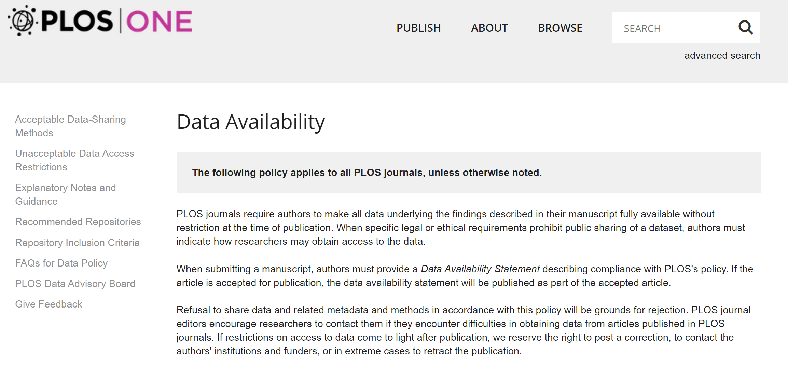
Publisher requirements to share data
https://journals.plos.org/plosone/s/data-availability

Slide 10

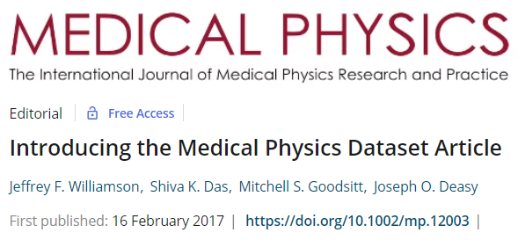
“Data Descriptor” manuscripts
Papers describing the dataset rather than scientific findings generated from the data

Slide 11


Medical Physics Dataset Articles (MPDA) Special Issue
Seeking submissions from contributors who would like to publish articles about datasets they’ve shared on TCIA.
MPDAs make it easier to use publicly available data by allowing authors to publish manuscripts which describe scientifically or clinically valuable open-access datasets.
Unlike traditional manuscripts, these are focused on helping others reuse data rather than publishing novel scientific discoveries.
Dataset Articles from
Submission Deadline: December 20, 2019
https://aapm.onlinelibrary.wiley.com/hub/journal/24734209/mpda-call-for-papers

Slide 12
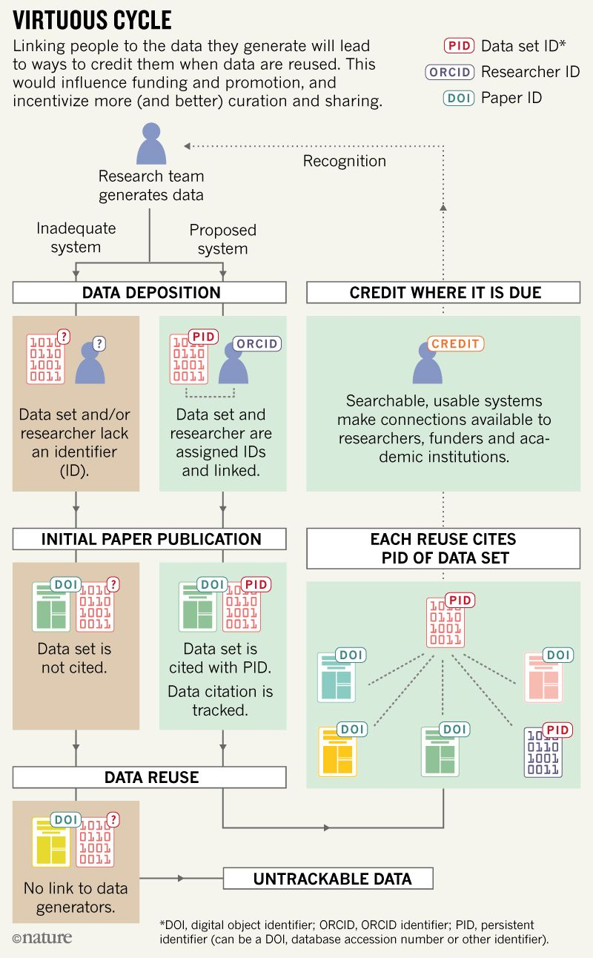
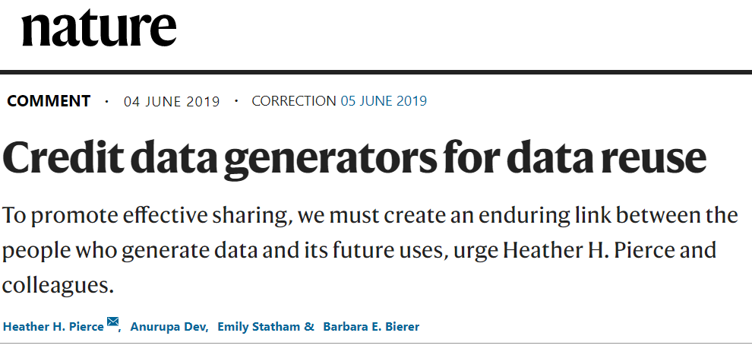
Best practices for crediting data generators
ORCID for author attribution
Citation & DOI for dataset attribution
Proper use of data citations in derivative works
Updated promotion criteria at research institutions

Slide 13
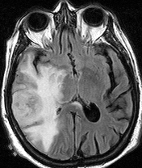
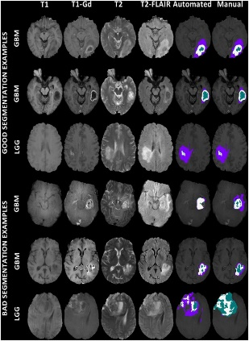
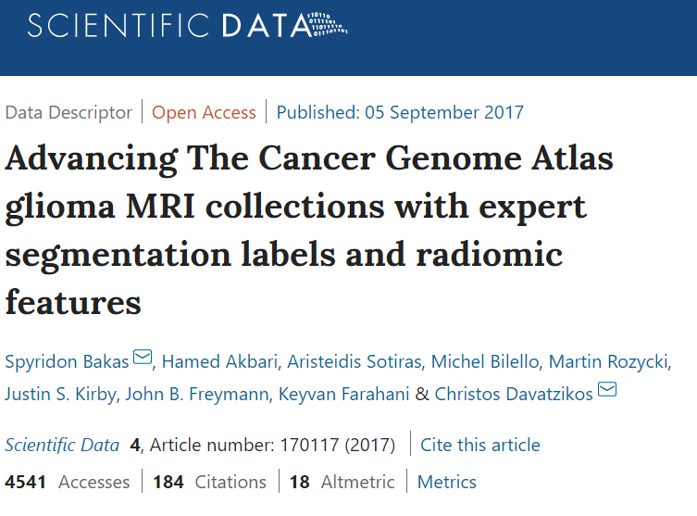

Best practices for crediting data generators
Analysis Dataset Citation (segmentations)
Spyridon Bakas, Hamed Akbari, Aristeidis Sotiras, Michel Bilello, Martin Rozycki, Justin Kirby, John Freymann, Keyvan Farahani, and Christos Davatzikos. (2017) Segmentation Labels and Radiomic Features for the Pre-operative Scans of the TCGA-GBM collection. The Cancer Imaging Archive. https://doi.org/10.7937/K9/TCIA.2017.KLXWJJ1Q
Original Data Citation (images used for study)
Scarpace, L., Mikkelsen, T., Cha, soonmee, Rao, S., Tekchandani, S., Gutman, D., … Pierce, L. J. (2016). Radiology Data from The Cancer Genome Atlas Glioblastoma Multiforme [TCGA-GBM] collection. The Cancer Imaging Archive. http://doi.org/10.7937/K9/TCIA.2016.RNYFUYE9
Data Descriptor Citation
Spyridon Bakas, Hamed Akbari, Aristeidis Sotiras, Michel Bilello, Michel Rozycki, Justin S Kirby, John B Freymann, Keyvan Farahani, Christos Davatzikos. "Advancing The Cancer Genome Atlas glioma MRI collections with expert segmentation labels and radiomic features", Nature Scientific Data, 4:170117 doi: 10.1038/sdata.2017.117 (2017).
Publication Citation
Menze, B. H. et al. The Multimodal Brain Tumor Image Segmentation Benchmark (BRATS). IEEE Transactions on Medical Imaging 34, 1993–2024 (2015).

Slide 14
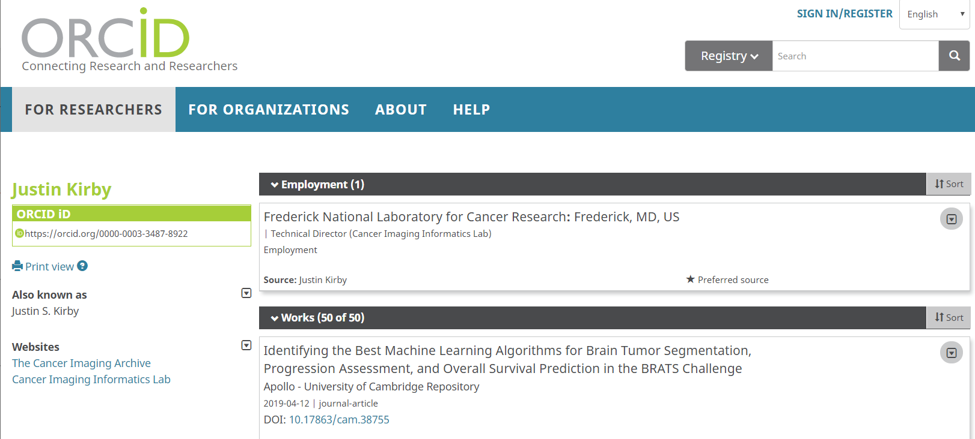
ORCiD – “Works” can include dataset & publication citations

Slide 15
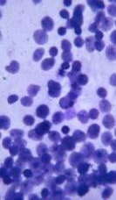
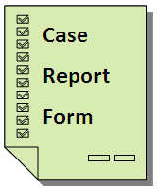
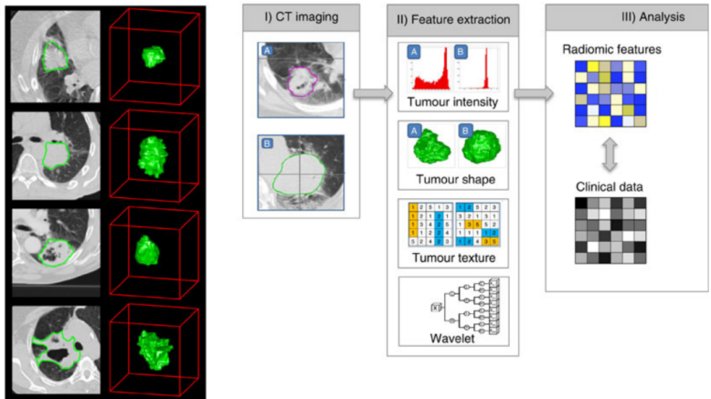
Example database implementation: The Cancer Imaging Archive
  New collection proposals are reviewed by the TCIA Advisory Group for quality/utility
  110 collections consisting of ~47,300 subjects available for download
  Covers radiology, radiation therapy, and pathology image modalities
  Wide variety of cancers + phantoms
  Most have associated supporting data
    Demographics/outcomes/therapy
    Image analyses (annotations, segmentations, features)
    Genomics/Proteomics
  http://www.cancerimagingarchive.net

Slide 16
TCIA Mission
Provide services to encourage data sharing
for cancer imaging research
De-identification and Quality Assurance Process.
Live Submission Support from beginning to end.
Reliable, Persistent Hosting on TCIA
Data citations for academic credit

Slide 17
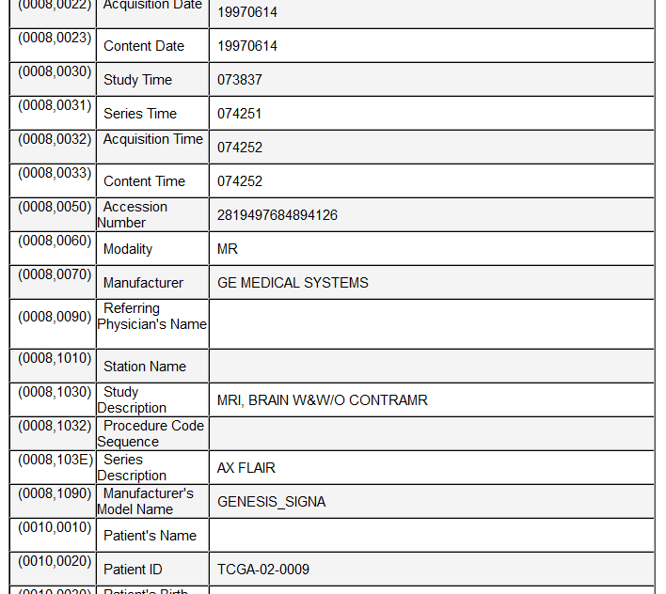
Tackling the de-identification challenge
PHI can appear in hundreds of places in DICOM
  Dates
  Identifiers
  Descriptions

Slide 18
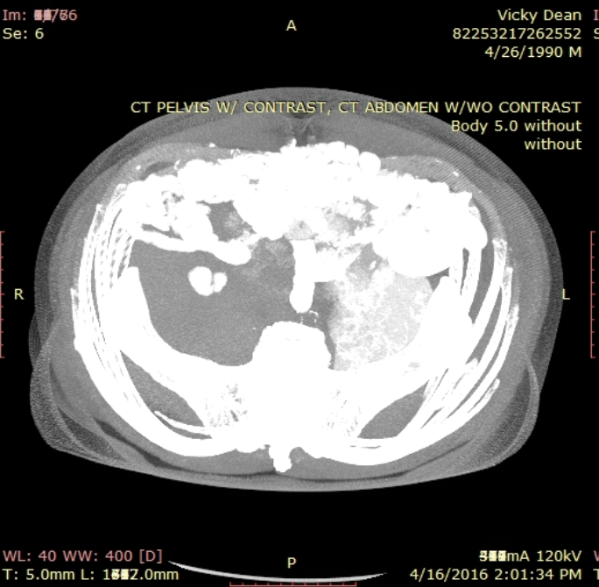
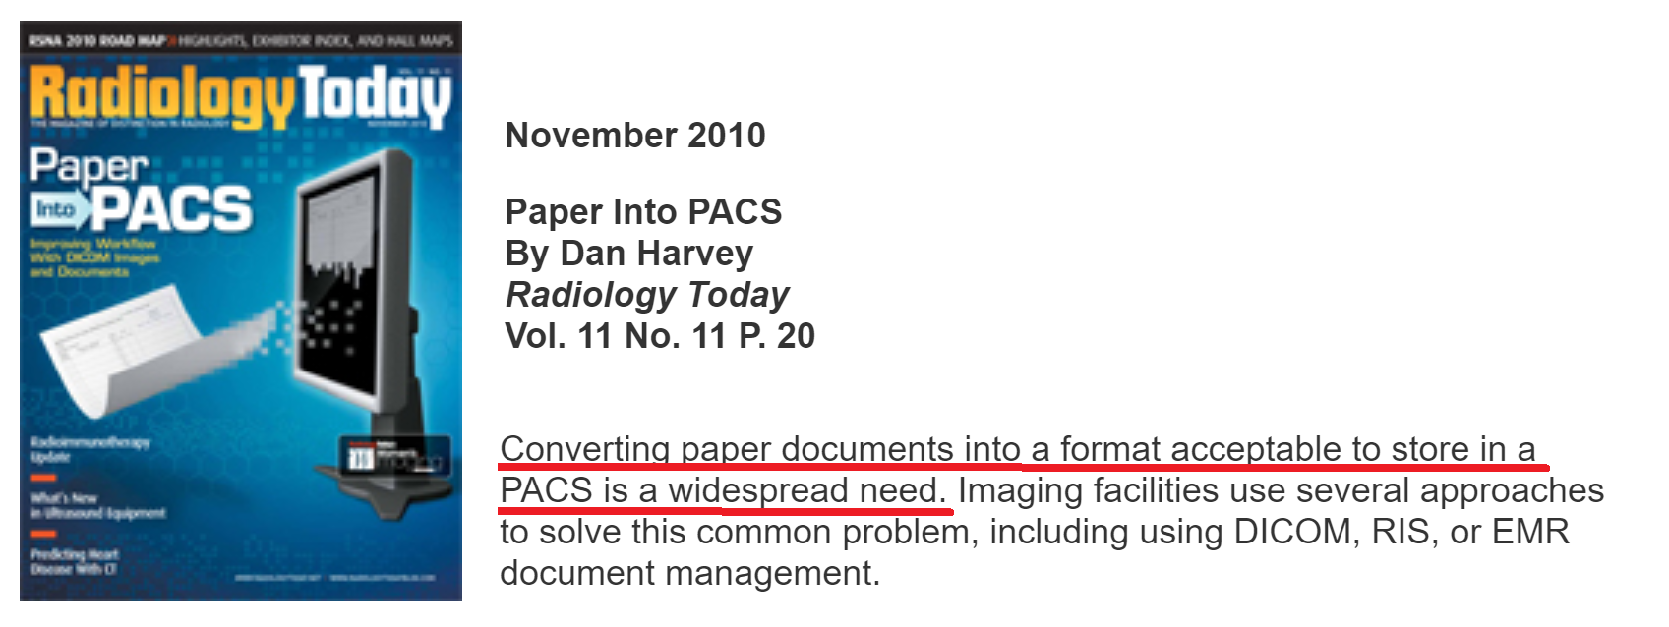
Tackling the de-identification challenge
Documents saved as images PHI in the image pixels
(e.g. billing, patient records) (fake example)

Slide 19
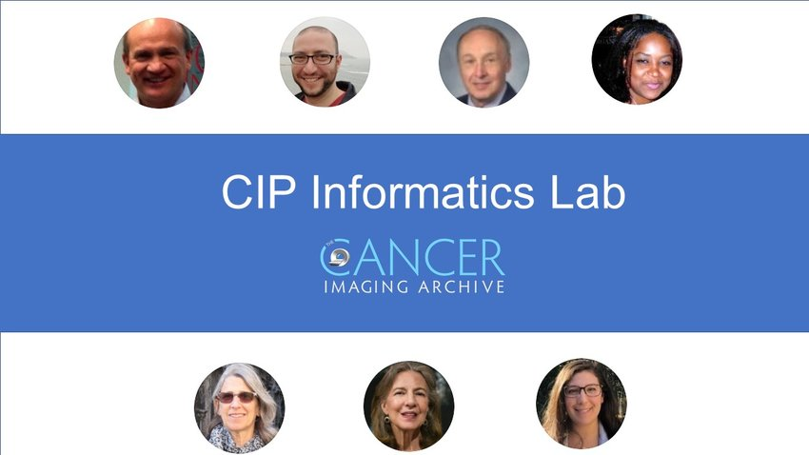
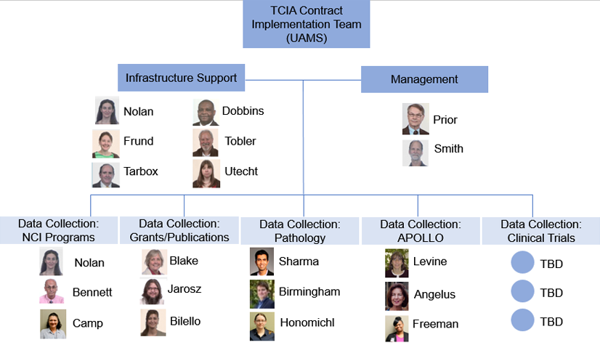


De-id and curation is a major effort
5 curation teams
Infrastructure support
Management

Slide 20
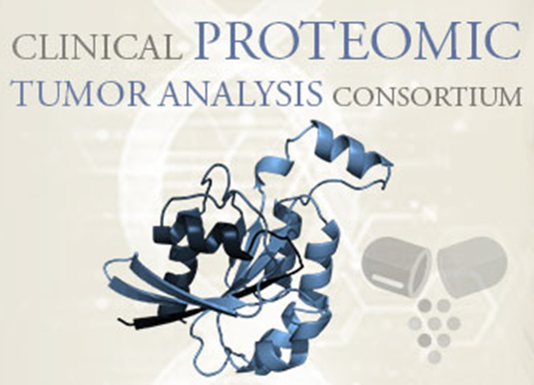
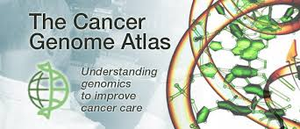


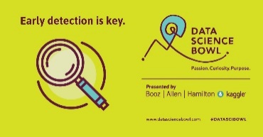

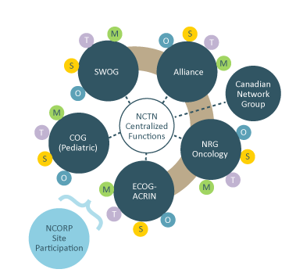


New TCIA Datasets
NCI data collection initiatives
“Community” proposals
reviewed monthly
Data generated by NCI/NIH Grants
Challenge
competitions
Publication
data sharing
requests

Slide 21
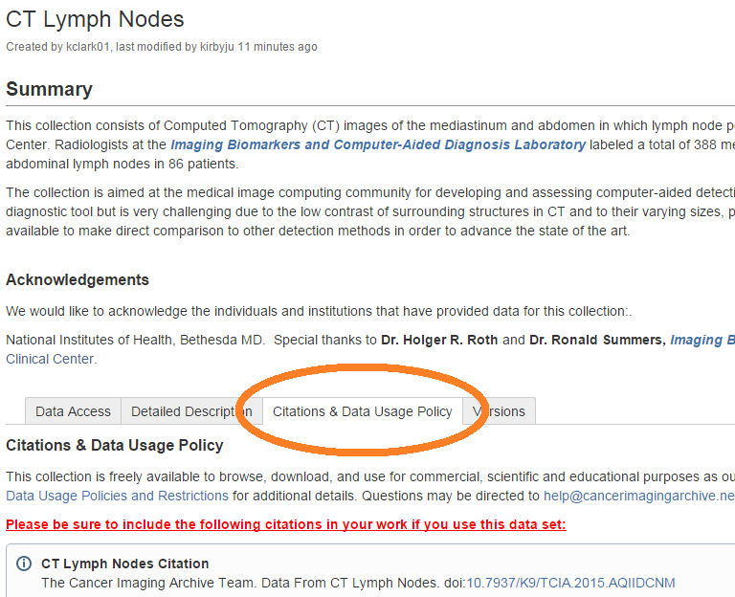
Citations and data usage policy
Citations (credit for data sharing!)
  DOI’s generated and linked to author ORCiDs
Data Usage Policy
  FAIR principles (Findability, Accessibility, Interoperability, and Reusability)
  Generally 100% open (no login)
  11 datasets require special access requests
  Creative Commons license

Slide 22
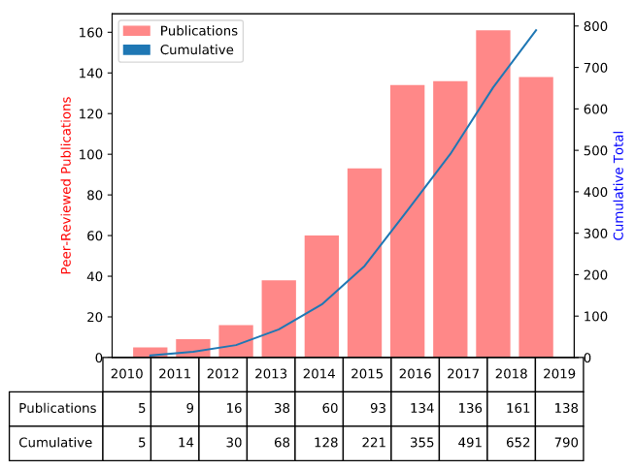
TCIA Metrics
Over 20,000 active users per month
~45 million images
Downloads of ~100TB per month
30 incoming data sets to be curated
790 peer reviewed publications based on TCIA
Widely used by industry due to permissive Creative Commons licensing

Slide 23
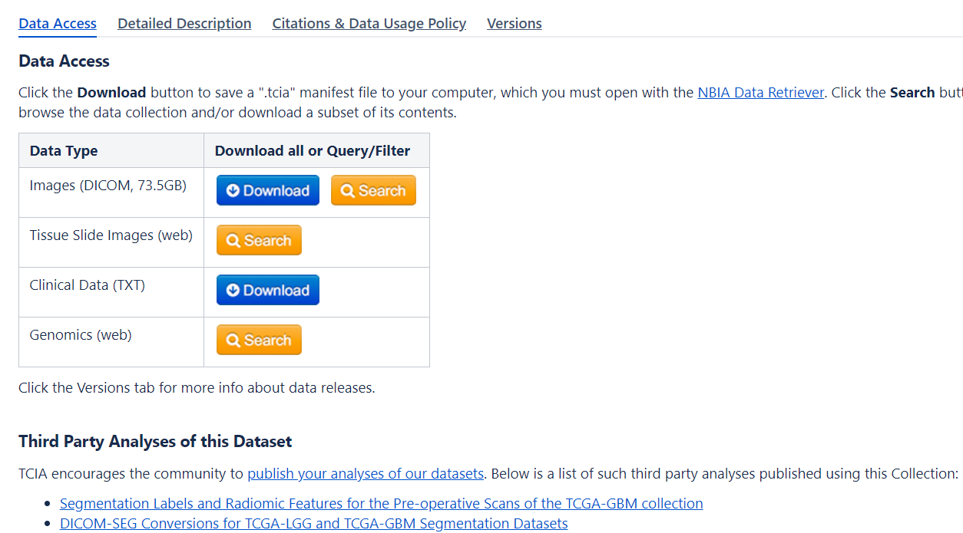
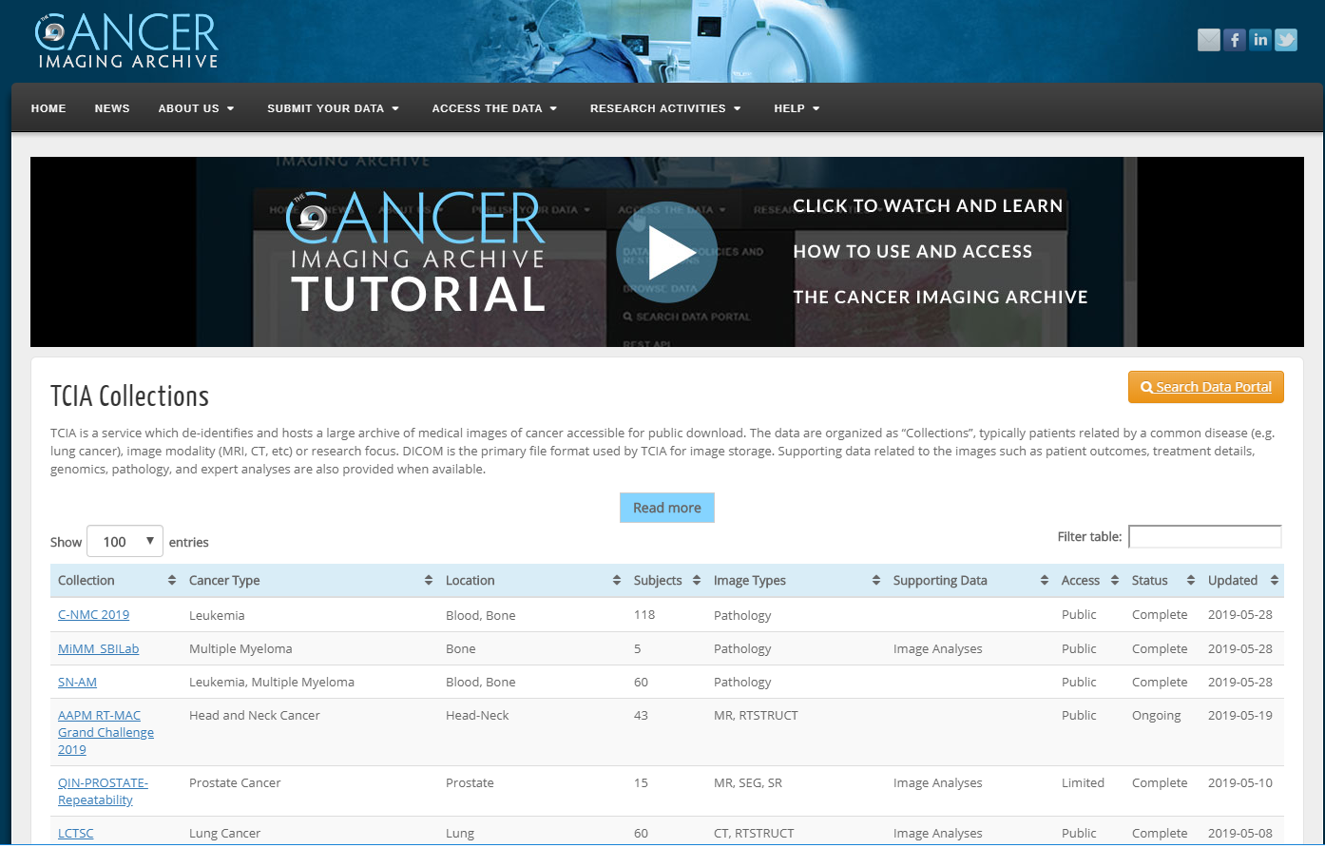
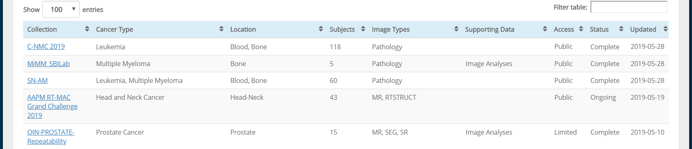
Browsing & bulk downloading TCIA datasets

Slide 24
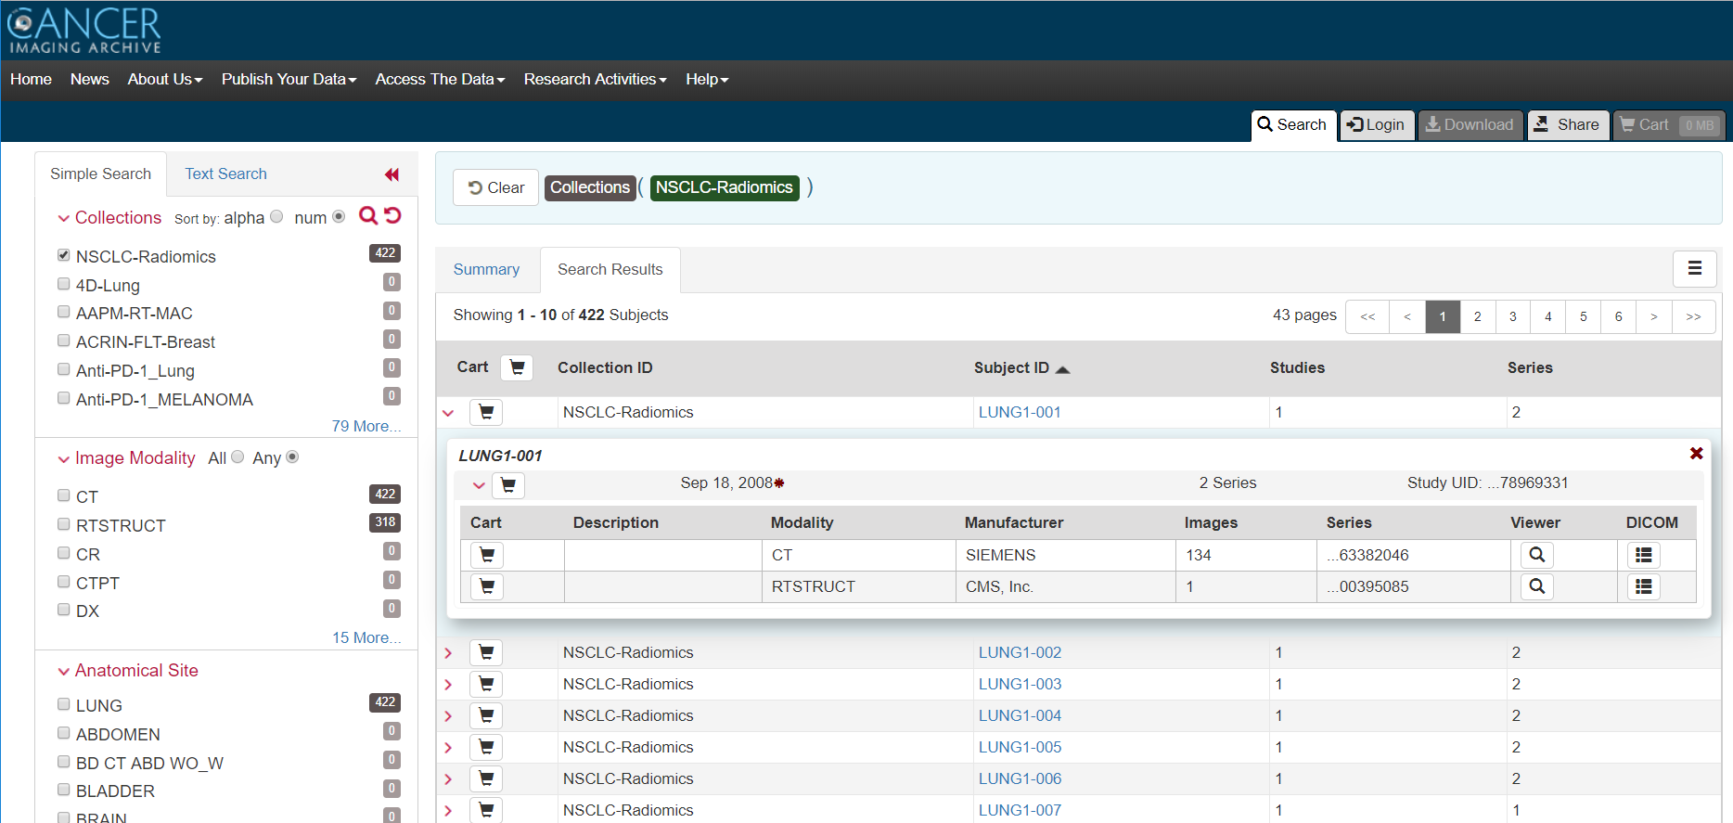
Building queries across multiple datasets
Filter by
  Collection name
  Image modality
  Anatomical site
  Etc..
Preview individual scans
Review DICOM metadata
Download images
Export metadata
Share queries/datasets with colleagues

Slide 25
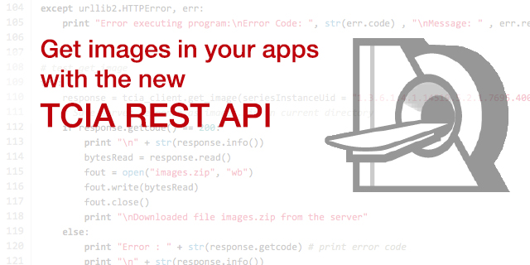
Application Programming Interface (API)
Enables software developers to access data directly without a web browser
Extensive documentation provided

Slide 26
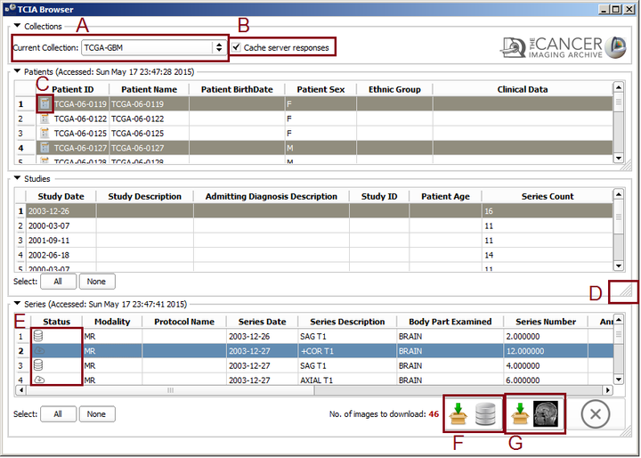
TCIA API integration examples
3D Slicer – TCIA Browser

Slide 27
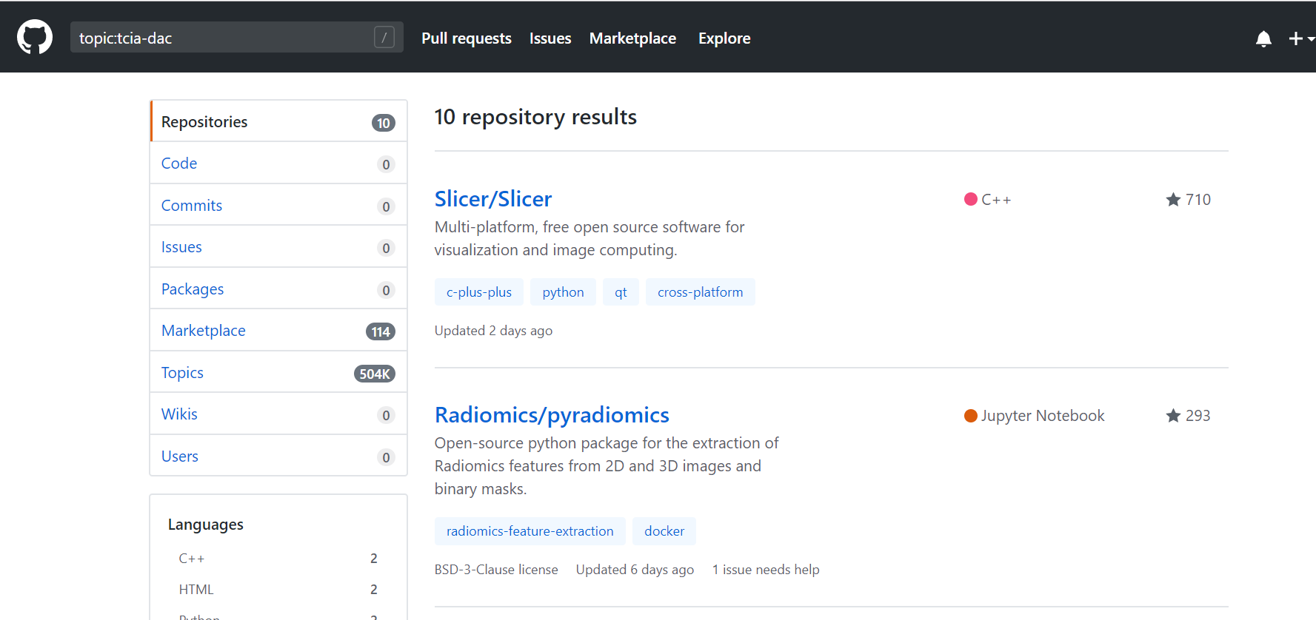
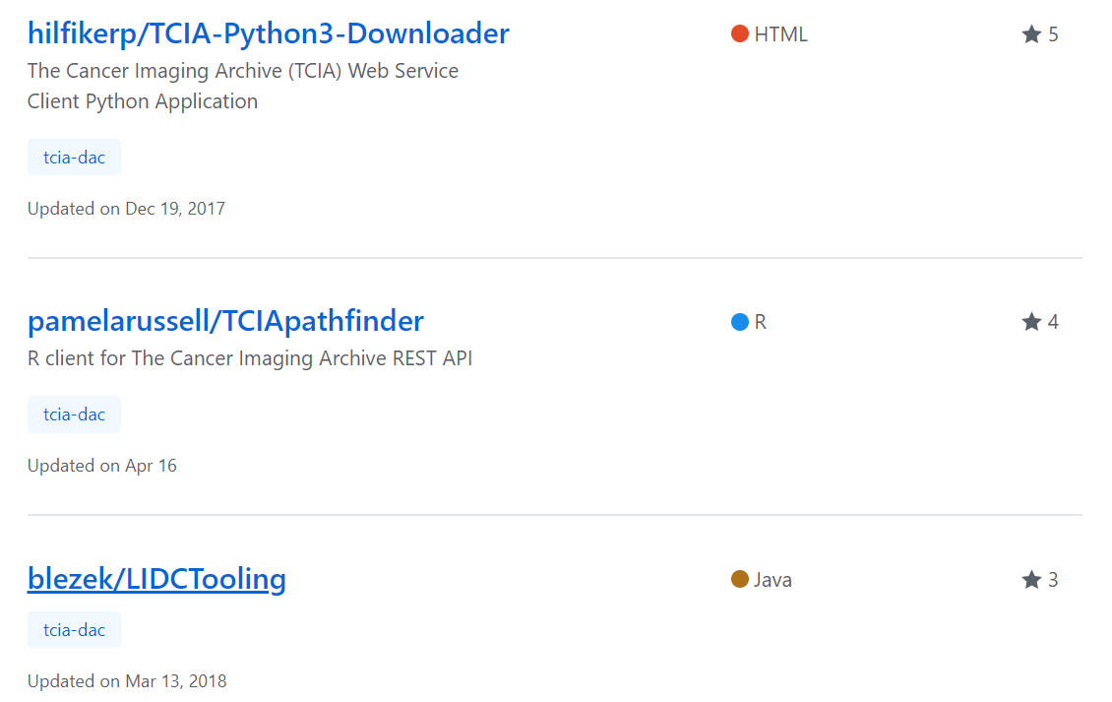
TCIA community code sharing
Tag your Github repo with “tcia-dac” topic tag to appear in the list

Slide 28
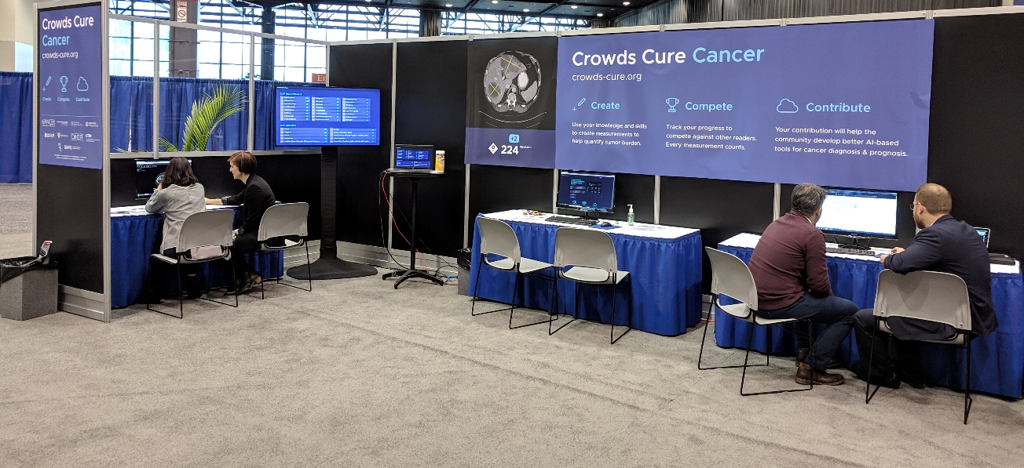

3rd Party Analysis of Existing Data - Example
Crowd-sourcing the labeling of lesions in TCIA data
to create training datasets for ML/AI analyses

Slide 29



Social Media to push new data notifications
Twitter: @TCIA_News
Facebook: The Cancer Imaging Archive (page)
LinkedIn: The Cancer Imaging Archive (group)
Notes:
Manage The Cancer Imaging Archive (TCIA)Increase public availability of high quality cancer imaging data sets for researchSupport NIH data sharing requirements for the cancer imaging communityEnable cancer imaging researchers to adhere to Findability, Accessibility, Interoperability, and Reusability (FAIR) Principles Create a culture of open data sharing and collaboration among cancer imaging researchers
Enable the development of new technologies and methodologies forclinical imaging data de-identification and curationintegrative, multi-disciplinary data analysis (e.g. radiogenomics)deep learningradiomics
Provide leadership and subject matter expertise to NIH data collection activities such as

Slide 30
Other Data Sources for Radiomics Research
NIH Chest X-ray Dataset of 14 Common Thorax Disease Categories
Neuroimaging Informatics Tools and Resources Clearinghouse
XNAT Central
Image Data Archive (Neurosciences)
Federal Interagency Traumatic Brain Injury Research (FITBIR)
National Institute of Mental Health Data Archive (NIMH)
VIA/I-ELCAP SIMBA Public Access Database

Slide 31
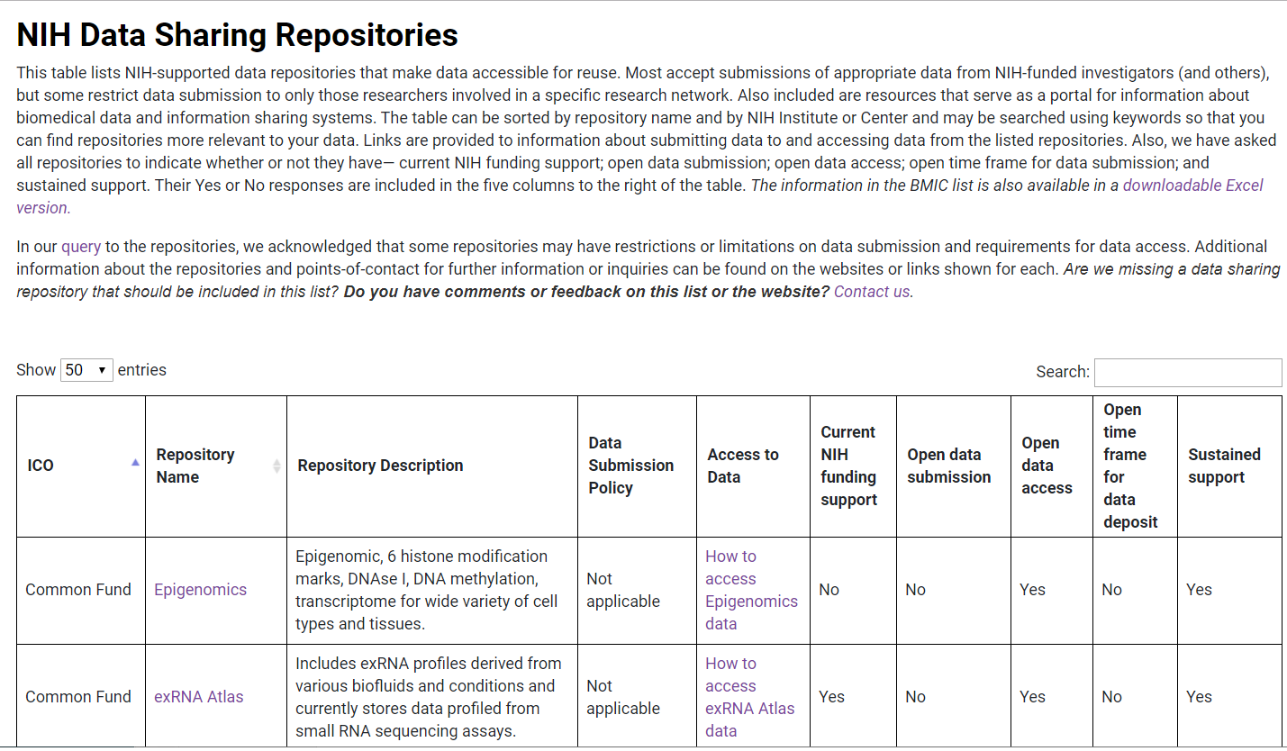
NCI/NIH data catalogs
https://www.cancer.gov/research/resources/data-catalog
https://www.nlm.nih.gov/NIHbmic/nih_data_sharing_repositories.html

Slide 32
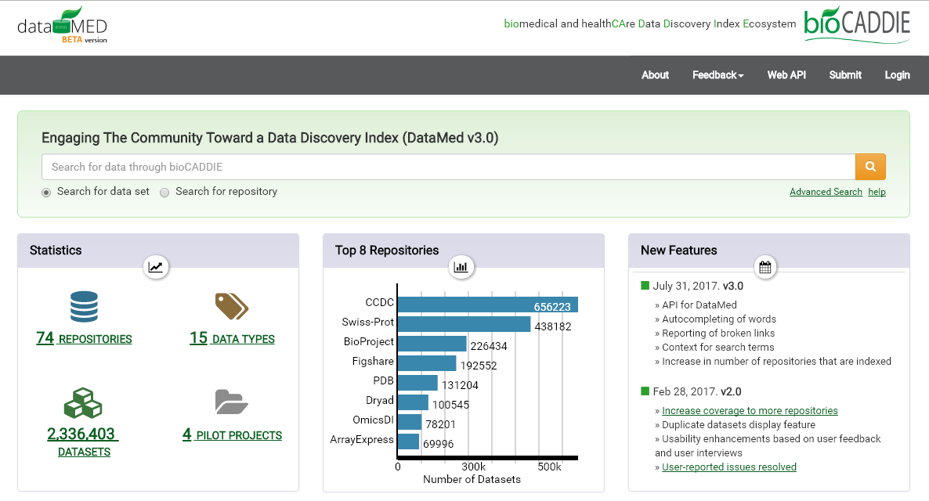
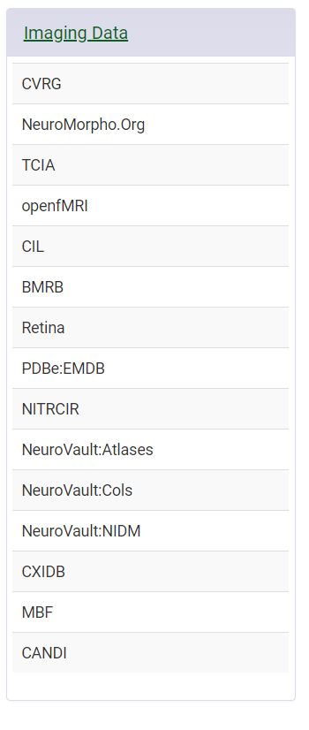
BioCADDIE Datamed – “Pubmed for data”
https://datamed.org/

Slide 33
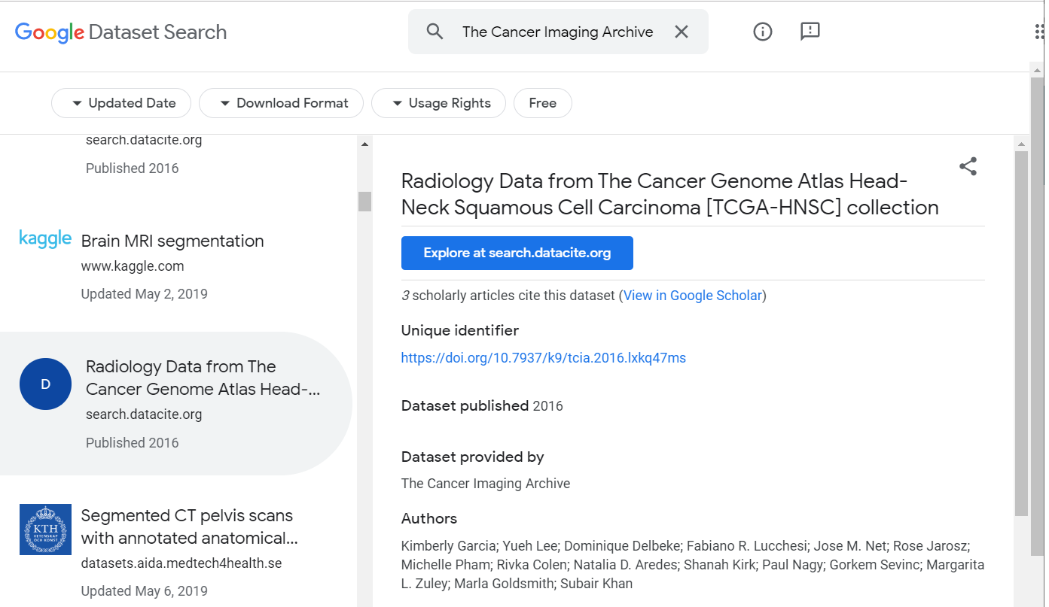
Google Dataset Search
https://toolbox.google.com/datasetsearch

Slide 34
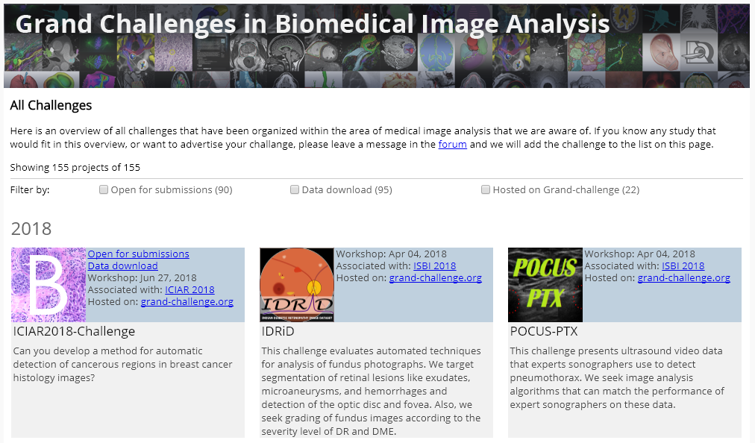
Challenge competitions
https://grand-challenge.org/All_Challenges/

Slide 35

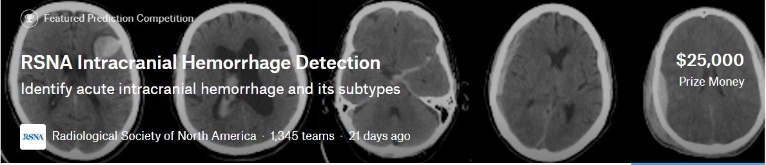
Challenge competitions: Kaggle
https://www.kaggle.com/c/data-science-bowl-2017
https://www.kaggle.com/c/rsna-intracranial-hemorrhage-detection

Slide 36

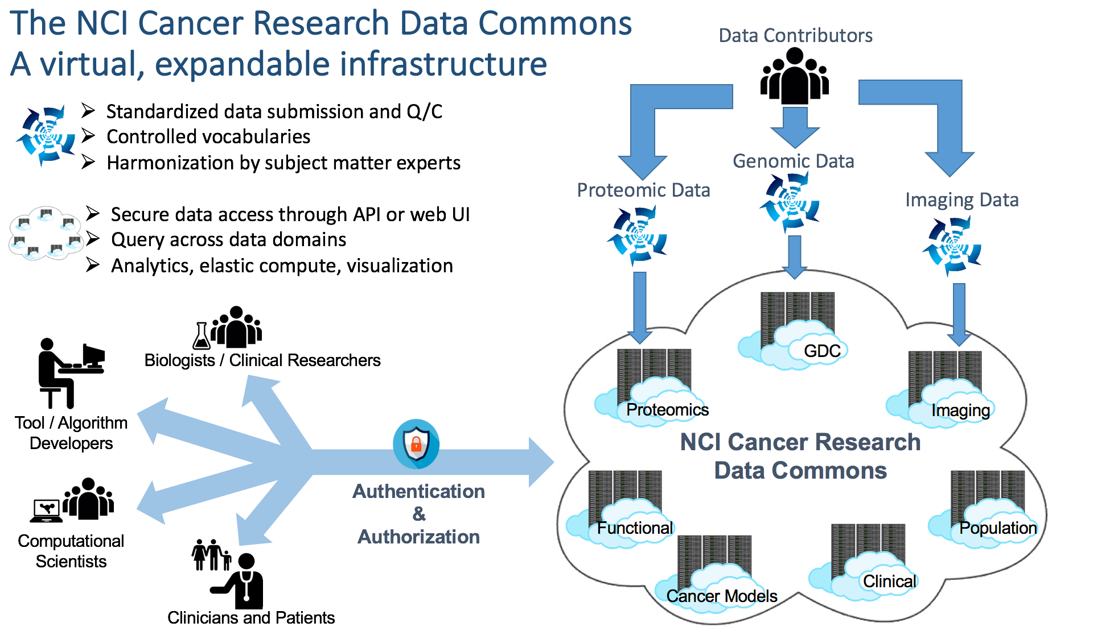
Future Directions: Imaging Data Commons
NCI’s Cancer Research Data Commons
Data + tools co-located in a cloud workspace
Integration with TCIA as a data source
Other Data Collection Centers

Slide 37
Future Directions: ImageNet for Radiology???
How many images/labels are needed?
What kinds of images/labels should we include?
Can we leverage readily available data sources as labels?
  Radiology reports
  RTSTRUCT
  DICOM headers
  Clinical data
Can this be done using existing public image datasets?

Slide 38
TCIA Acknowledgements
Fredrick National Laboratory for Cancer Research
John Freymann
Justin Kirby
Brenda Fevrier-Sullivan
Pam Angelus
Luis Cordeiro
Michelle Tacconelli
University of Arkansas
Dr. Fred Prior
Kirk Smith
Lawrence Tarbox
Dwayne Dobbins
Jeff Tobler
Sonya Utecht
Julie Frund
Bill Bennett
Tracy Nolan
Quasar Jarosz
Brittney Camp
Erica Bilello
Claren Freeman
Natasha Honomichl
Geri Blake
Diana Stockton
Erica Bilello
Robert Brown
Emory University
Dr. Ashish Sharma
Ryan Birmingham
Contractors
John Perry
Carl Jaffe
Betty Levine
NBIA Team (NCI/FNLCR/Ellumen)
Ulli Wagner
Scott Gustafson
Qinyan Pan
Russ Rieling
Carolyn Klinger
Martin Lerner
Tin Tran
Keyvan Farahani
Ed Helton
Imaging and Radiation Oncology Core
Dr. Michael Knopp
Connor Nealer
Rich Jacko
Jun Zhang

