Slide 1

http://cancerimagingarchive.net
Novel Discoveries Using NCI’s
Justin Kirby (justin.kirby@nih.gov)
Technical Director, Cancer Imaging Informatics Lab
Frederick National Laboratory for Cancer Research

Slide 2
TCIA’s Mission
Provide services to encourage data sharing
for cancer imaging research
De-identification and Quality Assurance Process.
Live Submission Support from beginning to end.
Reliable, Persistent Hosting on TCIA
Data citations for academic credit

Slide 3

TCIA components
The Cancer Imaging Archive
Data Collection Centers
Data Access Tools
Data Analysis Centers
3rd party web sites or tools which connect to TCIA’s API or mirror its data
Tools and staffing to support data collection, curation, and de-identification
Browse
Filter/Search
REST API

Slide 4
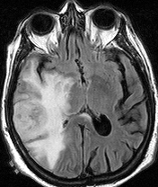
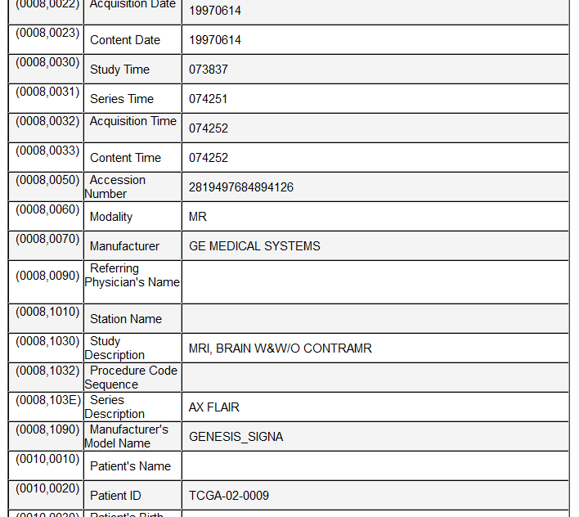
Tackling the de-identification challenge
PHI can appear in hundreds of places in DICOM
  Dates
  Identifiers
  Descriptions

Slide 5
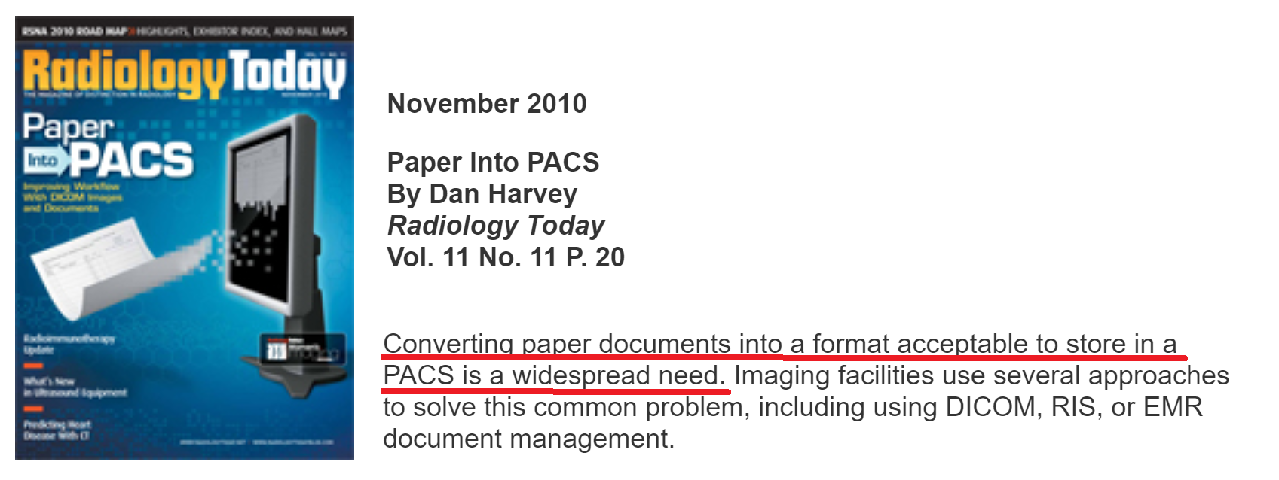
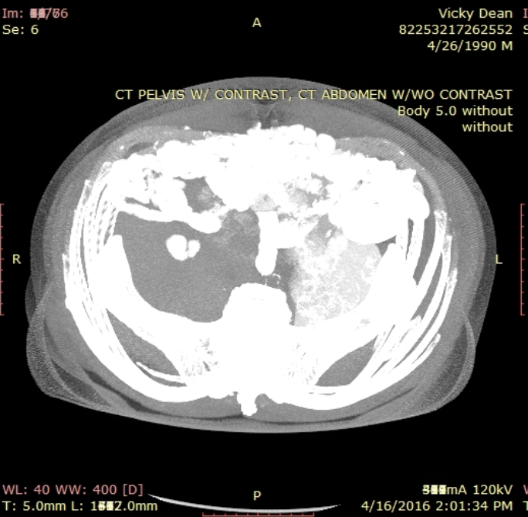
Tackling the de-identification challenge
Documents saved as images PHI in the image pixels
(e.g. billing, patient records) (fake example)

Slide 6
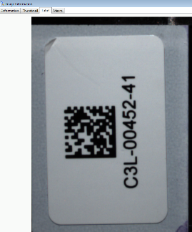
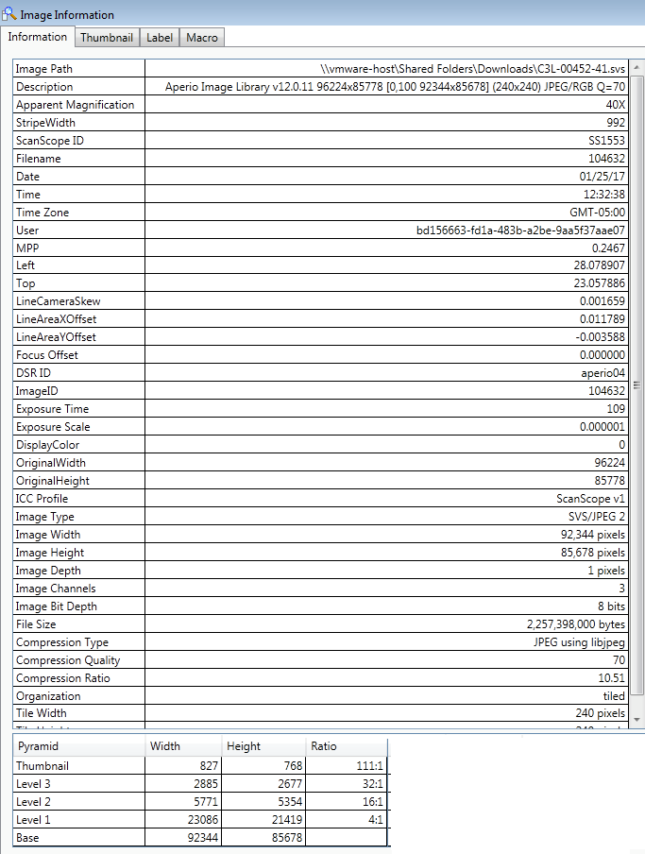
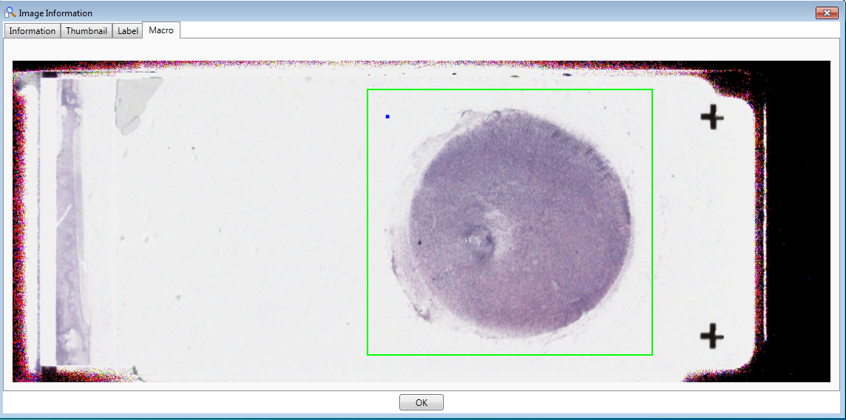
Histopathology image de-identification
Image metadata
Image labels/barcodes
Pixel data
Jane Doe
Dx = AML

Slide 7
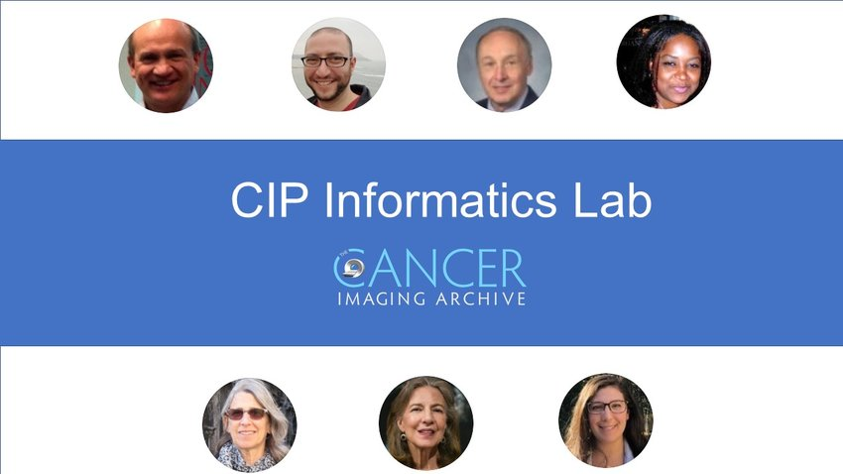
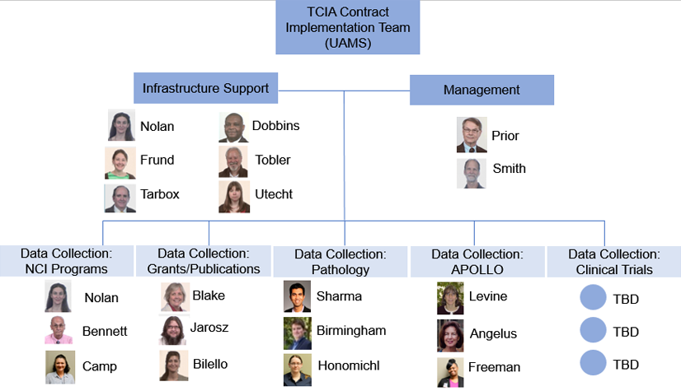


TCIA Staffing: De-id and curation is a major effort
5 curation teams
Infrastructure support
Management

Slide 8
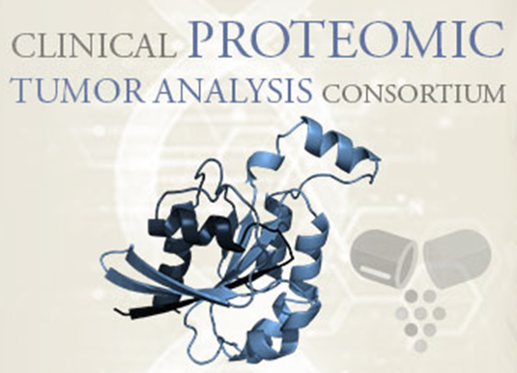
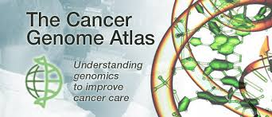


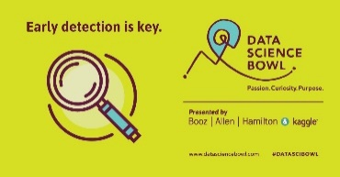

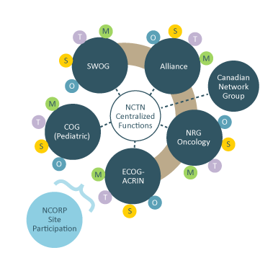


New TCIA Datasets
NCI data collection initiatives
“Community” proposals
reviewed monthly
Data generated by NCI/NIH Grants
Challenge
competitions
Publication
data sharing
requests

Slide 9
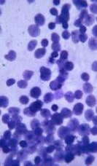
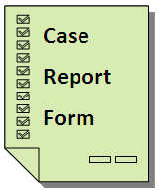
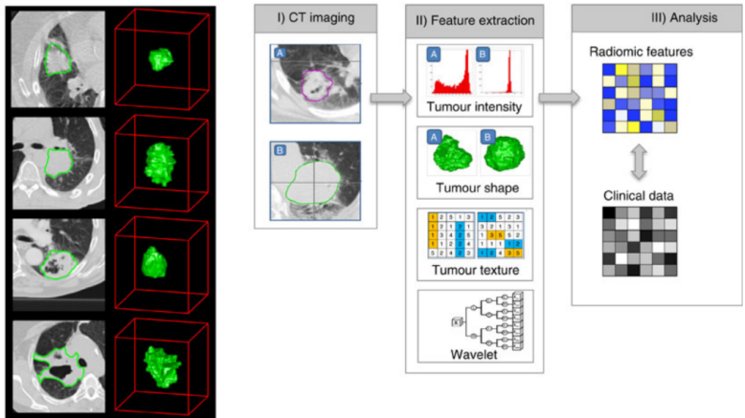
TCIA Overview
  New collection proposals are reviewed by the TCIA Advisory Group for quality/utility
  110 collections consisting of ~47,300 subjects available for download
  Covers radiology, radiation therapy, and pathology image modalities
  Wide variety of cancers + phantoms
  Most have associated supporting data
    Demographics/outcomes/therapy
    Image analyses (annotations, segmentations, features)
    Genomics/Proteomics
  http://www.cancerimagingarchive.net

Slide 10
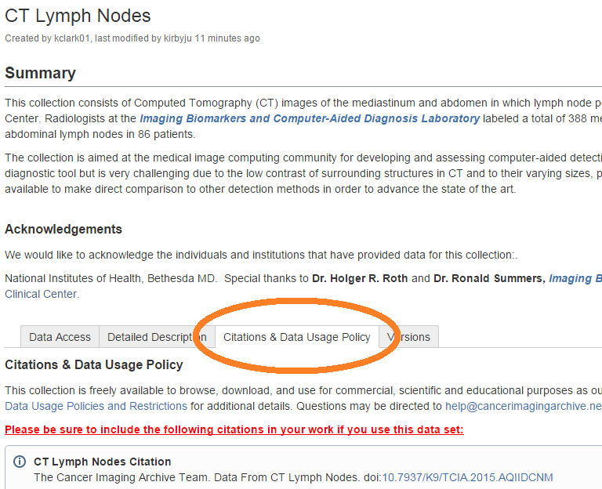
Citations and data usage policy
Citations (credit for data sharing!)
  Dataset
  Scientific manuscript
  TCIA manuscript
Data Usage Policy
  Generally 100% open (no login)
  11 datasets require special access requests
  Creative Commons Attribution license

Slide 11
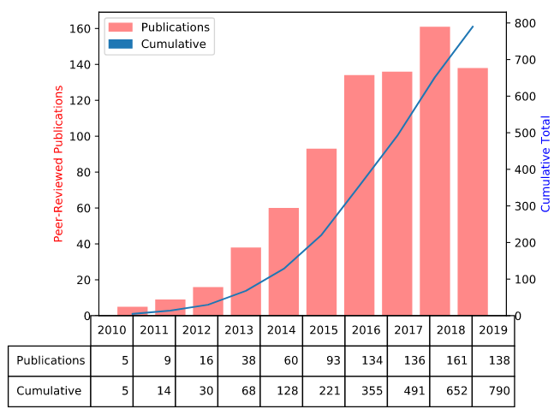
TCIA Metrics
Over 15,000 active users per month
Downloads of ~100TB per month
30 incoming data sets to be curated
790 peer reviewed publications based on TCIA
Widely used by industry due to permissive Creative Commons licensing

Slide 12
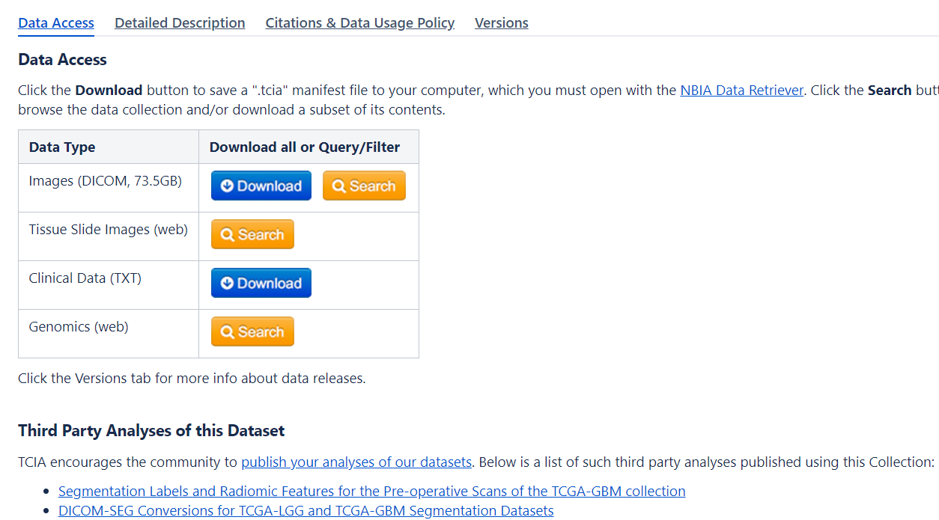
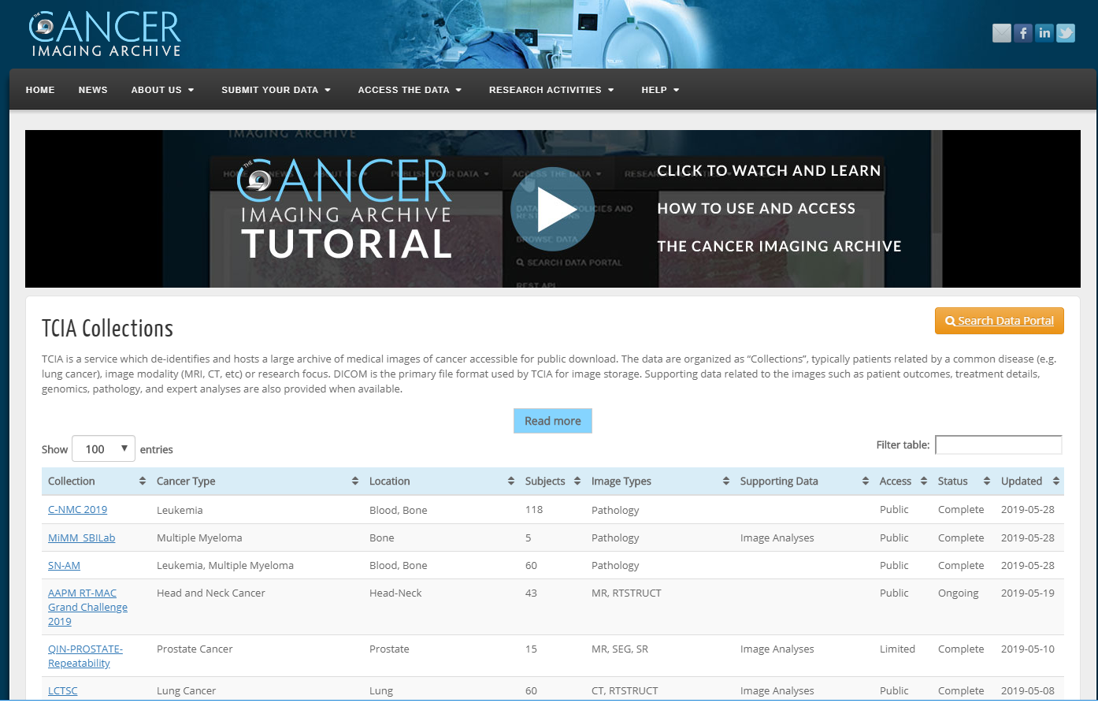
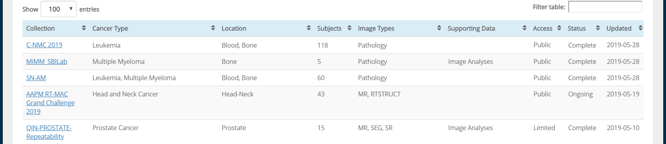
Browsing & bulk downloading TCIA datasets

Slide 13
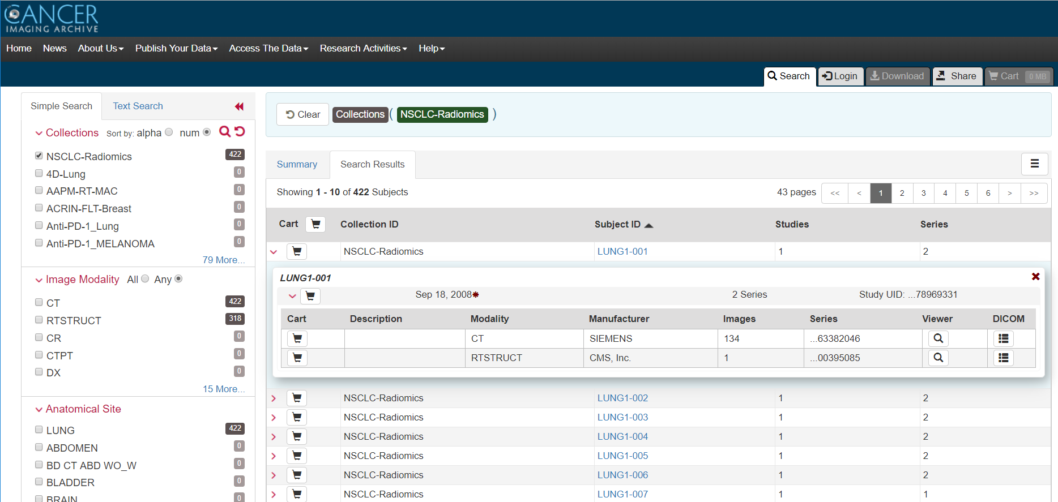
Building queries across multiple datasets
Filter by
  Collection name
  Image modality
  Anatomical site
  Etc..
Preview individual scans
Review DICOM metadata
Download images
Export metadata
Share queries/datasets with colleagues

Slide 14
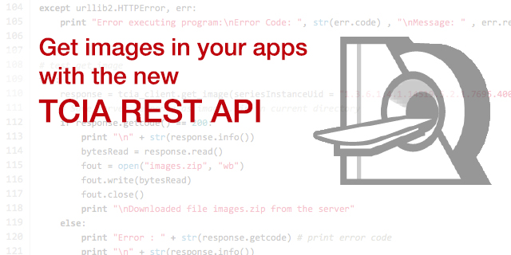
Application Programming Interface (API)
Enables software developers to access data directly without a web browser
Extensive documentation provided

Slide 15
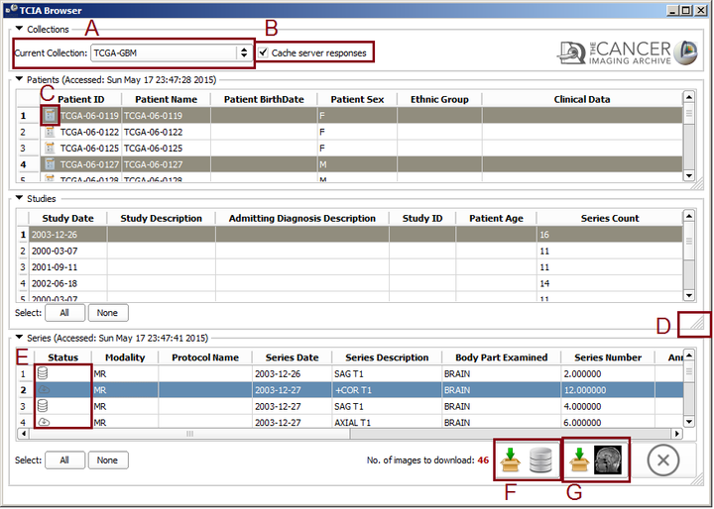
TCIA API integration examples
3D Slicer – TCIA Browser

Slide 16
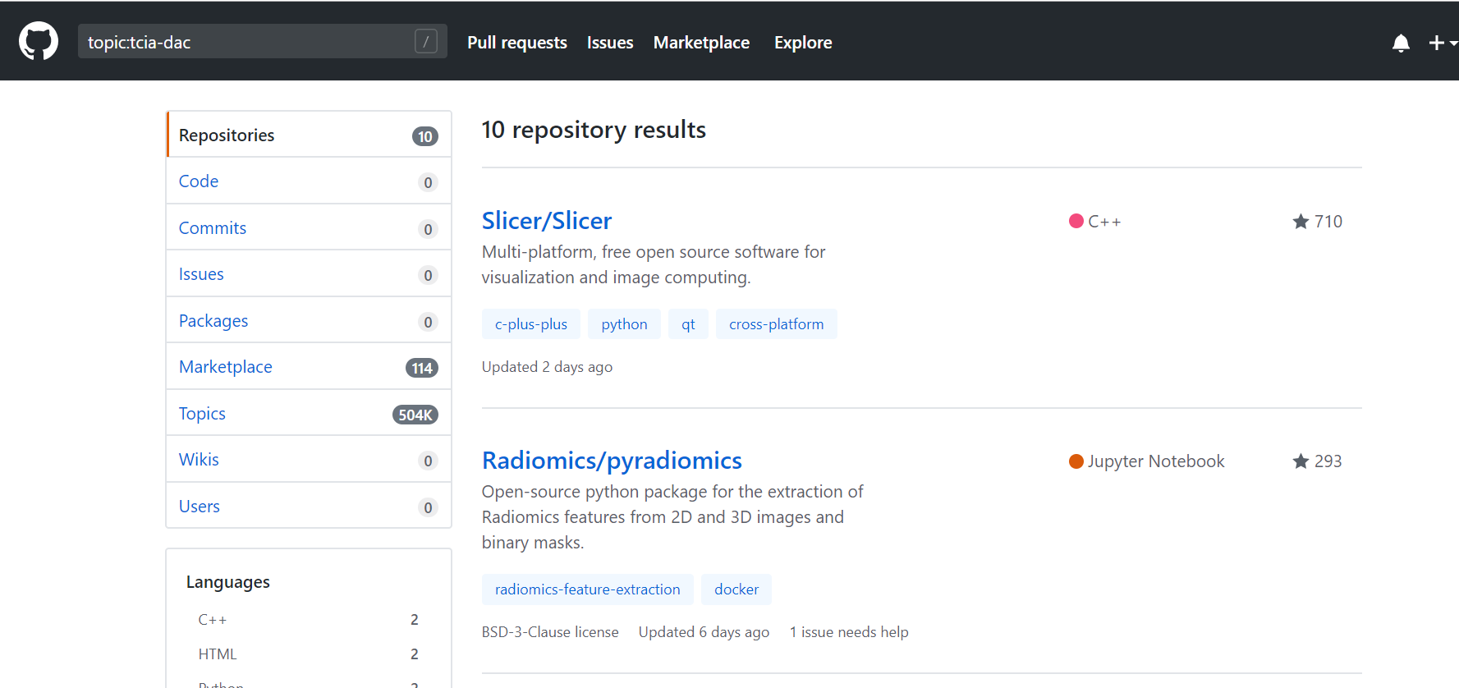
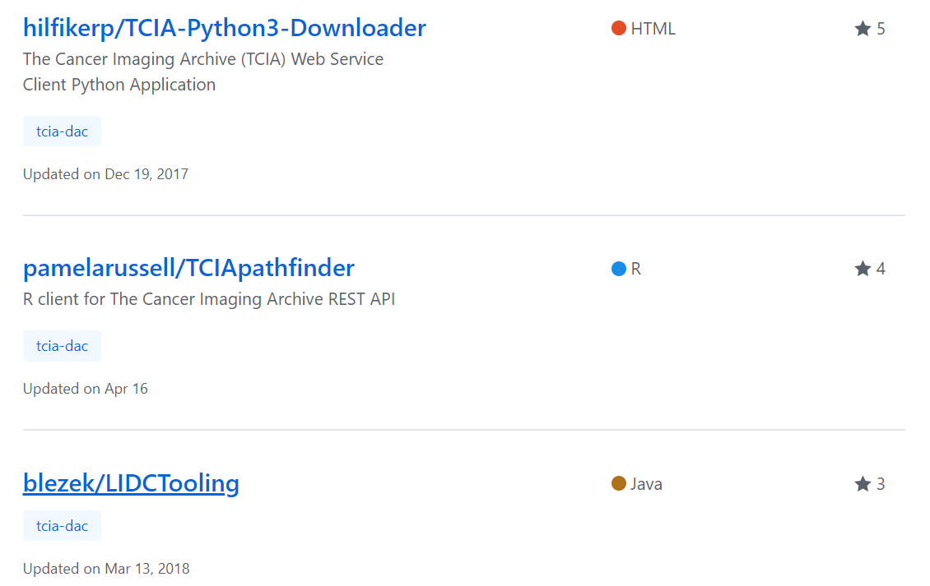
TCIA community code sharing
Tag your Github repo with “tcia-dac” topic tag to appear in the list

Slide 17
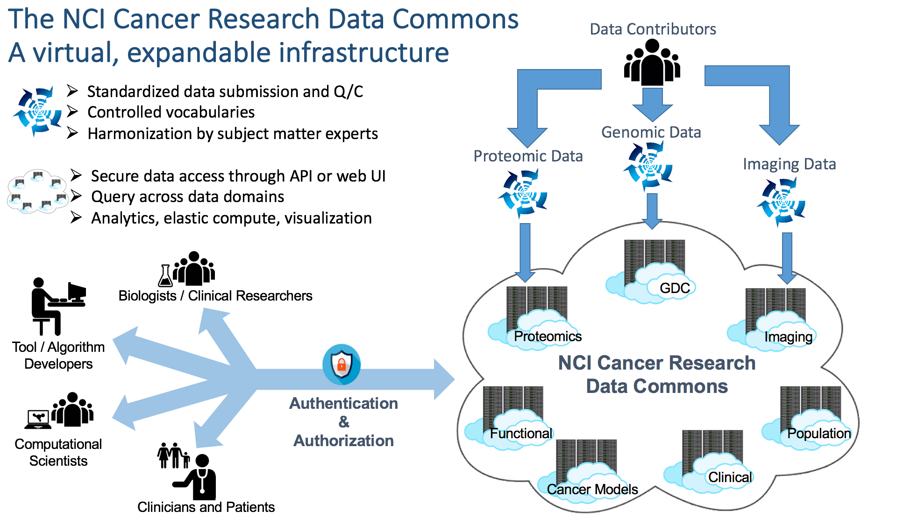

TCIA data in the NCI Data Commons

Slide 18
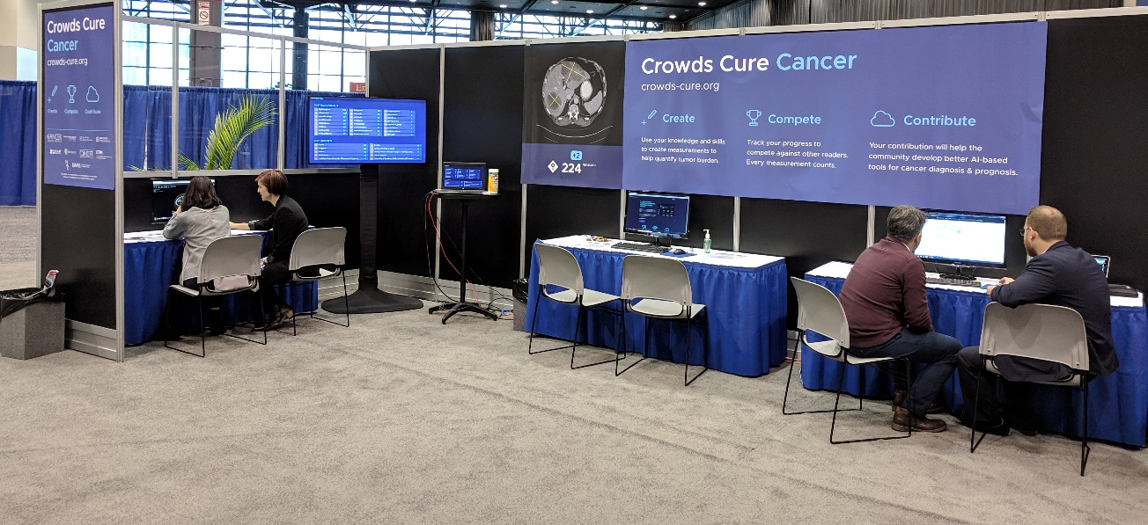

3rd Party Analysis of Existing Data - Example
Crowd-sourcing the labeling of lesions in TCIA data
to create training datasets for ML/AI analyses

Slide 19

Medical Physics Dataset Articles (MPDA) Special Issue
Seeking submissions from contributors who would like to publish articles about datasets they’ve shared on TCIA.
MPDAs make it easier to use publicly available data by allowing authors to publish manuscripts which describe scientifically or clinically valuable open-access datasets.
Unlike traditional manuscripts, these are focused on helping others reuse data rather than publishing novel scientific discoveries.
Dataset Articles from
Submission Deadline: December 20, 2019
https://aapm.onlinelibrary.wiley.com/hub/journal/24734209/mpda-call-for-papers

Slide 20
Invited Speakers
ECOG-ACRIN Clinical Trial Data Sharing
  Paul E. Kinahan, PhD
Imaging Proteogenomics in Ovarian Cancer
  Evis Sala, MD, PhD
Crowds Cure Cancer
  Jayashree Kalpathy-Cramer, MS, PhD
Registration of CT and Digitalized Pathology Images in Lung Cancer
  Mirabela Rusu, DPhil, MENG

Slide 21
Speaker datasets – Paul Kinahan
ACRIN-FMISO-Brain
  Kinahan, Paul; Muzi, Mark; Bialecki, Brian; Coombs, Laura. (2018). Data from ACRIN-FMISO-Brain. The Cancer Imaging Archive. http://doi.org/10.7937/K9/TCIA.2018.vohlekok
ACRIN-DSC-MR-Brain
  Kinahan, P., Muzi, M., Bialecki, B., Herman, B., & Coombs, L. (2019). Data from ACRIN-DSC-MR-Brain [Data set]. The Cancer Imaging Archive. DOI: https://doi.org/10.7937/tcia.2019.zr1pjf4i
ACRIN-NSCLC-FDG-PET
  Kinahan, P., Muzi, M., Bialecki, B., Herman, B., & Coombs, L. (2019). Data from the ACRIN 6668 Trial NSCLC-FDG-PET [Data set]. The Cancer Imaging Archive. https://doi.org/10.7937/tcia.2019.30ilqfcl
ACRIN-FLT-Breast
  Kinahan, Paul; Muzi, Mark; Bialecki, Brian; Coombs, Laura. (2017). Data from ACRIN-FLT-Breast. The Cancer Imaging Archive. http://doi.org/10.7937/K9/TCIA.2017.ol20zmxg

Slide 22
Speaker datasets – Evis Sala
TCGA Attribution
  "The results <published or shown> here are in whole or part based upon data generated by the TCGA Research Network: http://cancergenome.nih.gov/.“
TCGA-OV
  Holback, C., Jarosz, R., Prior, F., Mutch, D. G., Bhosale, P., Garcia, K., … Erickson, B. J. (2016). Radiology Data from The Cancer Genome Atlas Ovarian Cancer [TCGA-OV] collection. The Cancer Imaging Archive. http://doi.org/10.7937/K9/TCIA.2016.NDO1MDFQ
Genomics study
  Vargas, Alberto; Huang, Erich; Lakhman, Yulia; Ippolito, Joe; Bhosale, Priya; Mellnick, Vincent; Shinagare, Atul; Anello, Maria; Kirby, Justin; Fevrier-Sullivan, Brenda; Freymann, John; Jaffe, Carl; Sala, Evis,. (2016). Imaging Features, and Correlations with Genomic and Clinical Data from the TCGA Ovarian Radiology Research Group. The Cancer Imaging Archive. http://doi.org/10.7937/K9/TCIA.2016.PSJOXM47
Proteomics study
  Lucian Beer, Hilal Sahin, Ivana Blazic, Hebert Alberto Vargas, Harini Veeraraghavan, Justin Kirby, Brenda Fevrier-Sullivan, John Freymann, Carl Jaffe, Thomas Conrads, George Maxwell, Kathleen Darcy, Erich Huang, Evis Sala. (2019) Data from Integration of CT-based Qualitative and Radiomic Features with Proteomic Variables in Patients with High-Grade Serous Ovarian Cancer: An Exploratory Analysis. DOI: 10.7937/TCIA.2019.9stoinf1

Slide 23
Speaker datasets – Jayashree Kalpathy-Cramer
2017 Data Release
  Jayashree Kalpathy-Cramer, Andrew Beers, Artem Mamonov, Erik Ziegler, Rob Lewis, Andre Botelho Almeida, Gordon Harris, Steve Pieper, David Clunie, Ashish Sharma, Lawrence Tarbox, Jeff Tobler, Fred Prior, Adam Flanders, Jamie Dulkowski, Brenda Fevrier-Sullivan, Carl Jaffe, John Freymann, Justin Kirby. Crowds Cure Cancer: Data collected at the RSNA 2017 annual meeting. The Cancer Imaging Archive. doi: 10.7937/K9/TCIA.2018.OW73VLO2
2018 Data Release
  Trinity Urban, Erik Ziegler, Steve Pieper, Justin Kirby, Daniel Rukas, Britney Beardmore, Bhanusupriya Somarouthu, Evren Ozkan, Gustavo Lelis, Brenda Fevrier-Sullivan, Samarth Nandekar, Andrew Beers, Carl Jaffe, John Freymann, David Clunie, Gordon J. Harris, Jayashree Kalpathy-Cramer. Crowds Cure Cancer: Data collected at the RSNA 2018 annual meeting. The Cancer Imaging Archive. doi: 10.7937/TCIA.2019.yk0gm1eb

Slide 24
Speaker datasets – Mirabela Rusu
Madabhushi, A., & Rusu, M. (2018). Fused Radiology-Pathology Lung Dataset. The Cancer Imaging Archive. https://doi.org/10.7937/K9/TCIA.2018.SMT36LPN

Slide 25
Acknowledgements
Fredrick National Laboratory for Cancer Research
John Freymann
Justin Kirby
Brenda Fevrier-Sullivan
Pam Angelus
Luis Cordeiro
Michelle Tacconelli
University of Arkansas
Dr. Fred Prior
Kirk Smith
Lawrence Tarbox
Dwayne Dobbins
Jeff Tobler
Sonya Utecht
Julie Frund
Bill Bennett
Tracy Nolan
Quasar Jarosz
Brittney Camp
Erica Bilello
Claren Freeman
Natasha Honomichl
Geri Blake
Diana Stockton
Erica Bilello
Robert Brown
Emory University
Dr. Ashish Sharma
Ryan Birmingham
Contractors
John Perry
Carl Jaffe
Betty Levine
NBIA Team (NCI/FNLCR/Ellumen)
Ulli Wagner
Scott Gustafson
Qinyan Pan
Russ Rieling
Carolyn Klinger
Martin Lerner
Tin Tran
Keyvan Farahani
Ed Helton
Imaging and Radiation Oncology Core
Dr. Michael Knopp
Connor Nealer
Rich Jacko
Jun Zhang

Slide 26



Follow TCIA on Social Media
Twitter: @TCIA_News
Facebook: The Cancer Imaging Archive (page)
LinkedIn: The Cancer Imaging Archive (group)
Notes:
Manage The Cancer Imaging Archive (TCIA)Increase public availability of high quality cancer imaging data sets for researchSupport NIH data sharing requirements for the cancer imaging communityEnable cancer imaging researchers to adhere to Findability, Accessibility, Interoperability, and Reusability (FAIR) Principles Create a culture of open data sharing and collaboration among cancer imaging researchers
Enable the development of new technologies and methodologies forclinical imaging data de-identification and curationintegrative, multi-disciplinary data analysis (e.g. radiogenomics)deep learningradiomics
Provide leadership and subject matter expertise to NIH data collection activities such as

