Slide 1
Posda
The open source DICOM de-identification toolkit of TCIA
OSEHRA SUMMIT 2019
Bill Bennett, Instructor
UAMS Department of Biomedical Informatics (DBMI)
Geri Blake, Submissions Manager
UAMS DBMI

Slide 2




Slide 3
Posda
Perl Open Source DICOM Archive
An application for the archival and curation of DICOM datasets.
Now Perl and Python based

Slide 4

History of Posda
Hopkins data recovery circa 2002
RT object exploration 2004-2007
Moved to a file-oriented schema rather than DICOM normalized objects.
RT System test tools 2005 – 2010
Tag utilization explored. Verification/fixing of RTSTRUCT, etc
Pseudo phantom generation for IHE-RO 2008
Preparation of DICOM test data.
Tools for RT clinical trial QA 2010 – 2013
Editing DICOM files and maintaining provenance/versioning in directories.
DICOM curation tools 2013 - present

Slide 5
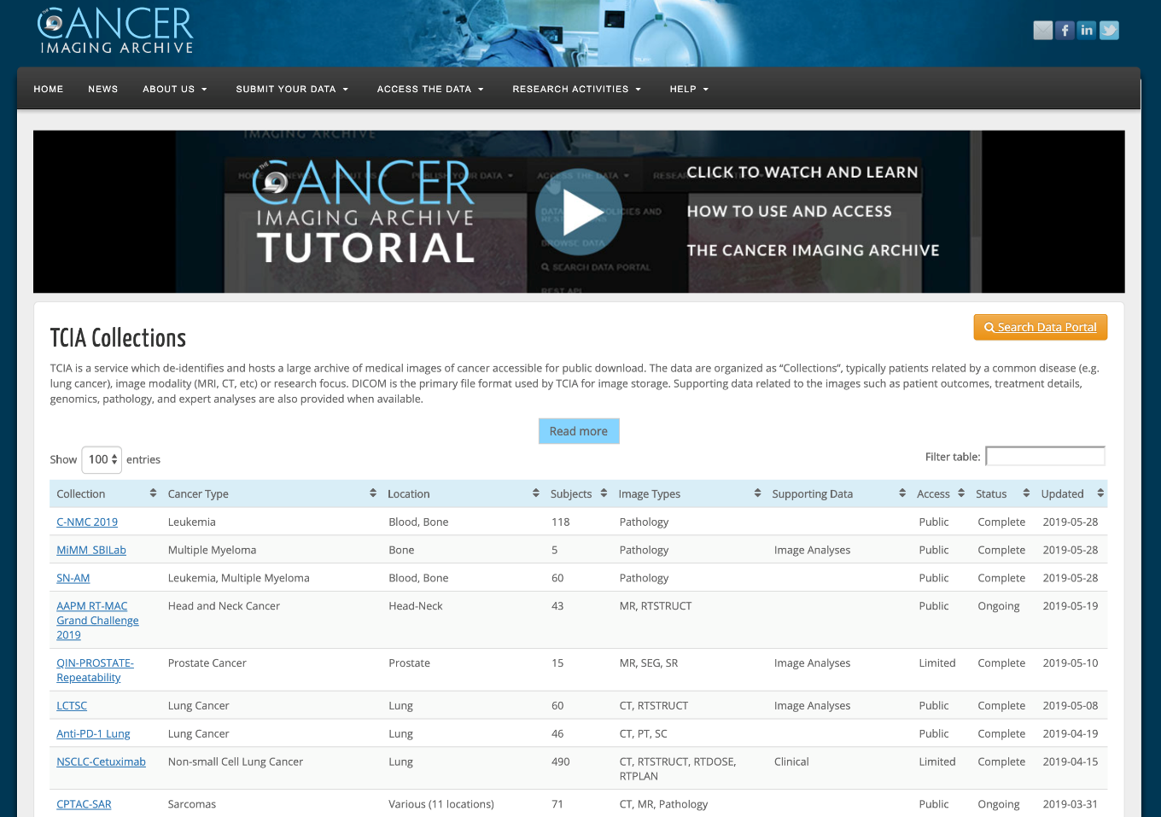
Today, Posda is the application used to de-identify and harmonize data (DICOM) hosted on the Cancer Imaging Archive.
  100 collections
  19,767 subjects
  34,905 studies
  19,564,234 images
  6.32 TB of data
  Covers most modalities (CT/MR/PET/RT)

Slide 6
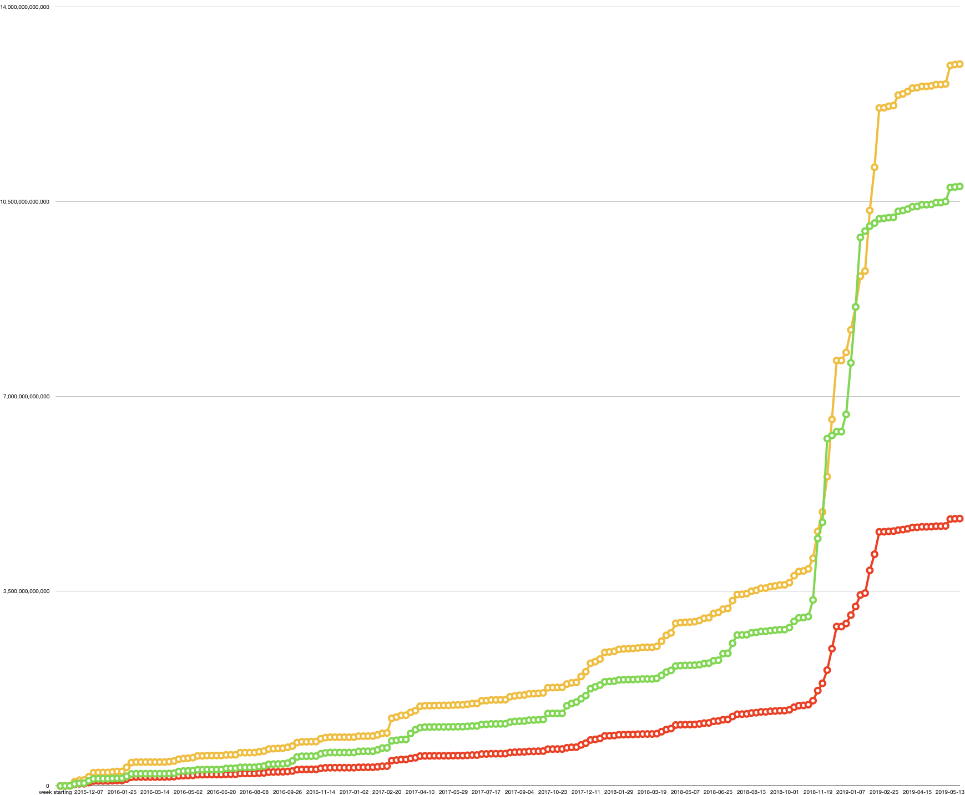
Yellow: total # of bytes
Green: # of files (scaled)
Red: # bytes of visible files
Graph representing the number of files under management in the Posda database.
Growth over 3.75 years
13 TB
43 M
4.8 TB
2015-11-02
2017-02-20
2018-11-05

Slide 7
Size of collections in Posda
Collections: imaging data, clinical data, pathology data, etc. submitted by a particular site or sites relating to a compilation of inter-related data. The data is often related by cancer type and treatment or imaging modality.
Collection | Total_Size (bytes)
VICTRE | 1,027,214,553,738
LDCT-and-Projection-data | 1,023,186,498,176
Phantom FDA | 319,047,552,346
LDCT | 223,150,847,942
MyelomaTT3aPET | 194,331,558,234
HNSCC | 155,313,121,138
Exceptional-Responders | 128,983,146,434
ACRIN-NSCLC-FDG-PET | 128,639,725,524
collection │ total_bytes │ num_files │ avg_file_size
──────────────────────────┼───────────────┼───────────┼───────────────
VICTRE │ 1027214553738 │ 217915 │ 4713831
LDCT-and-Projection-data │ 1023186498176 │ 10094559 │ 101360
Can you make this an animation?

Slide 8
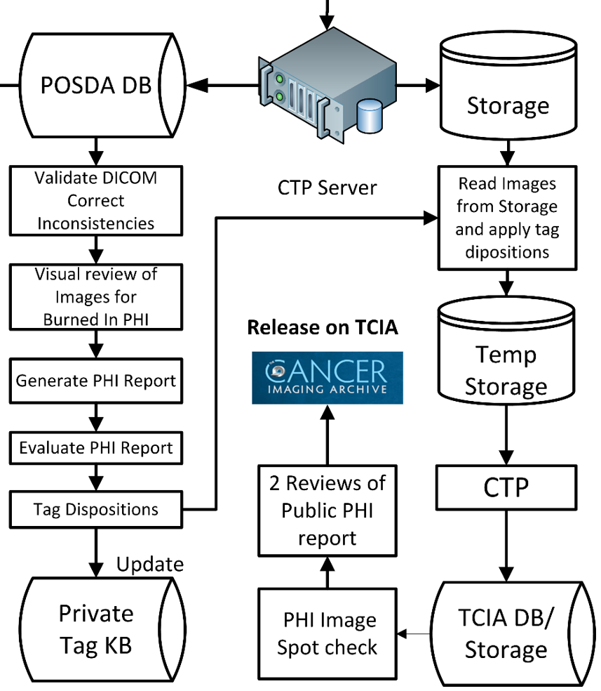
Scalability
TCIA curation process

Slide 9
Scalability
Data Access
Visual PHI Review
DICOM TAG/Non visual PHI Review
Bulk DICOM Edits
Maintaining History of Operations
Operational issues for curating large quantities of medical and imaging data - computing time and human review.

Slide 10

Data Access
Posda File organization
The files are organized in a database (not by directory).
Posda eliminates all file duplicates using MD5 digest.
Posda records date/time any file is imported.
All files are unique and immutable
Scalability

Slide 11
Visual Review
What didn’t work : Visual review using the tool on NBIA (National Biomedical Imaging Archive)
What does : current Visual PHI Review
  Review series holistically (all images in series at one time) by creating a projection using Kaleidoscope.
  Application for quickly viewing and deciding viability (good/bad).
Scalability

Slide 12
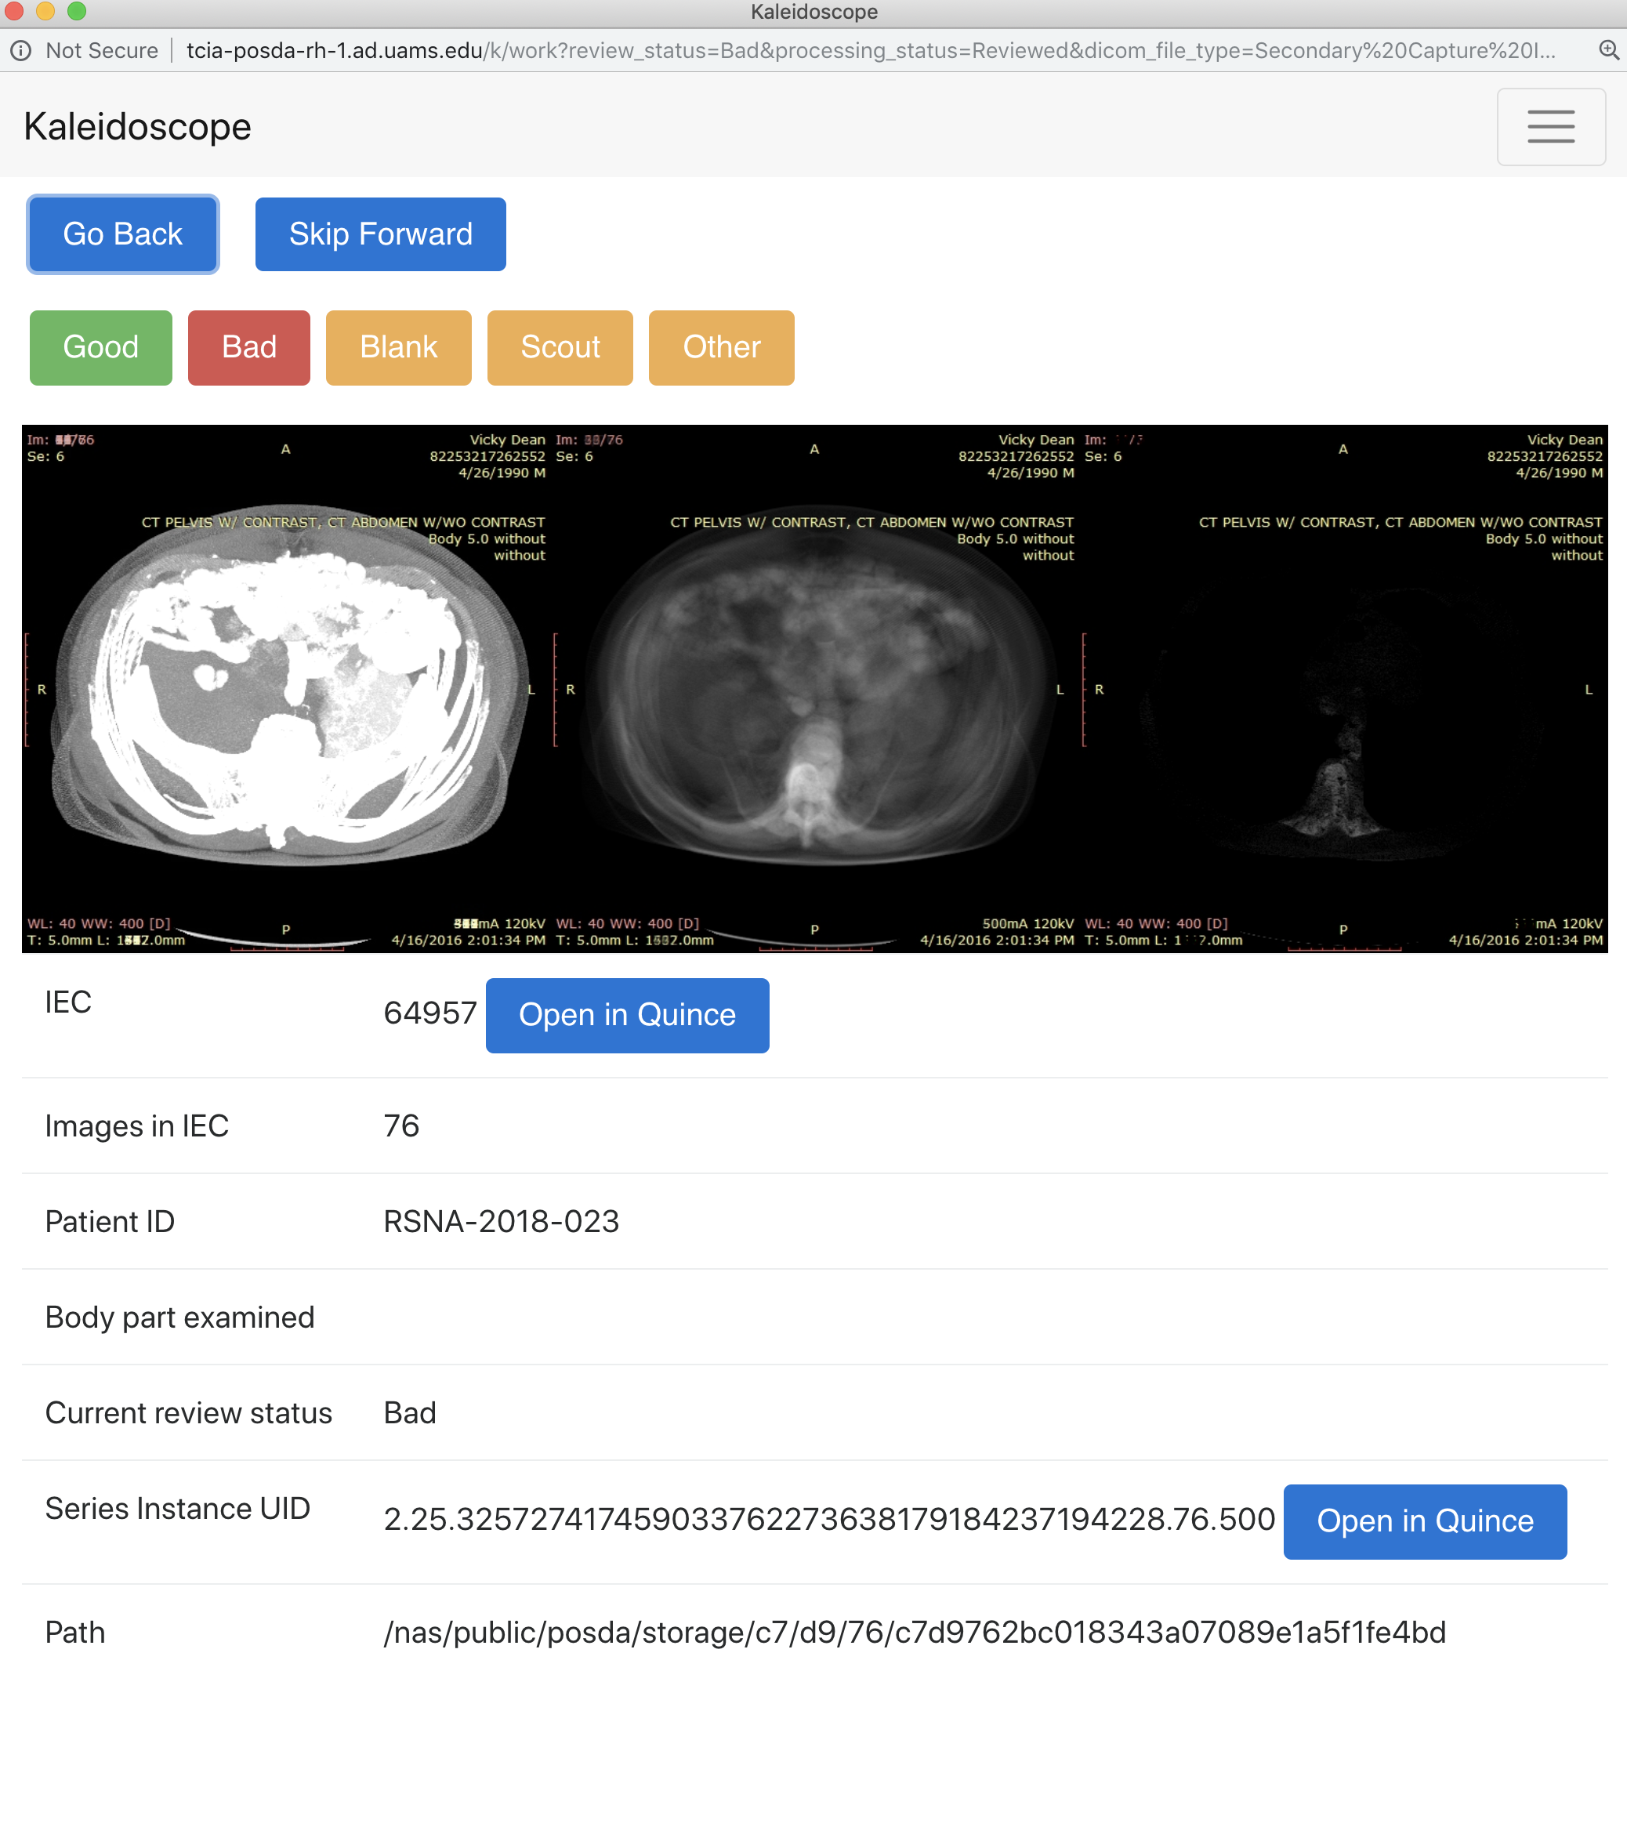

Slide 13
PHI Review
What didn’t work: “Tagsniffer” CTP
What does: current PHI review
  Produces a simplified report, easily scanned, easily excerpted, edits derived programmatically from excerpts.
Scalability

Slide 14
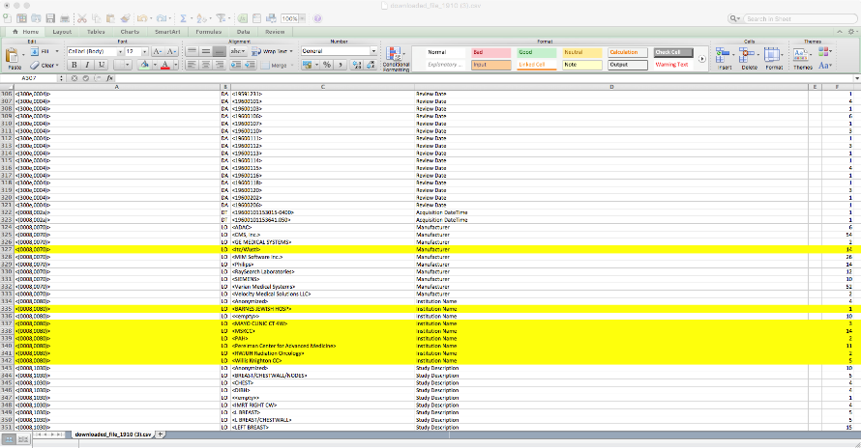
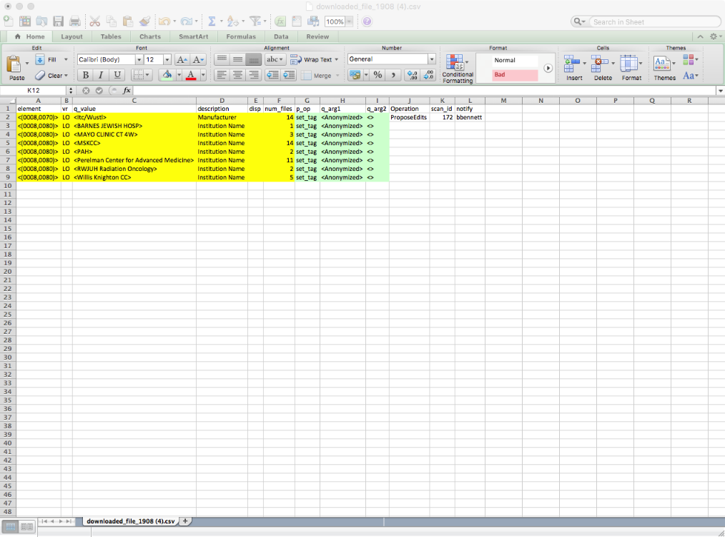
Scan report
Lots of lines (30K for this one)
Sorted (and sortable)
Scanned by curators
Hi-light anything suspicious
Edit template
White is supplied by PHI script
Yellow is cut/pasted from report
Aqua is supplied by curation mgr
Uploaded and run to do edits

Slide 15
Bulk DICOM edits
After we had scalable bulk DICOM edits affecting tens of thousands (out of hundreds of thousands) of files, in hundreds (out of thousands) of DICOM series, we found:
  Sometimes the edits weren’t right (typos happen)
  It really slowed us down to go back and fix
So we had to find a way to to verify edits quickly
  A little harder than you might think
  Involves having a “smart” DICOM compare
Scalability

Slide 16
Maintaining the history of operations on a collection basis.
Preserve provenance of data
Ability to back out/replay edits
Allows for continuous process quality improvement
Use the concept of a timeline for each collection (described as “activities”)

Slide 17
Three Different User Interface Paradigms
Traditional Web App
Database Query Engine/Spreadsheet Execution Engine
Activity Based/Workflow Interface
  Works well, but doesn’t scale for PHI scan
  Still used for Visual review
  Highly scalable solution for PHI scanning and Bulk edits
  Excellent prototyping tool!
  But not intuitive for non-expert users
  More intuitive for users. Keeps high scalability.
  Enhances provenance preservation
These paradigms emerged organically:
Implement what you see the users doing

Slide 18
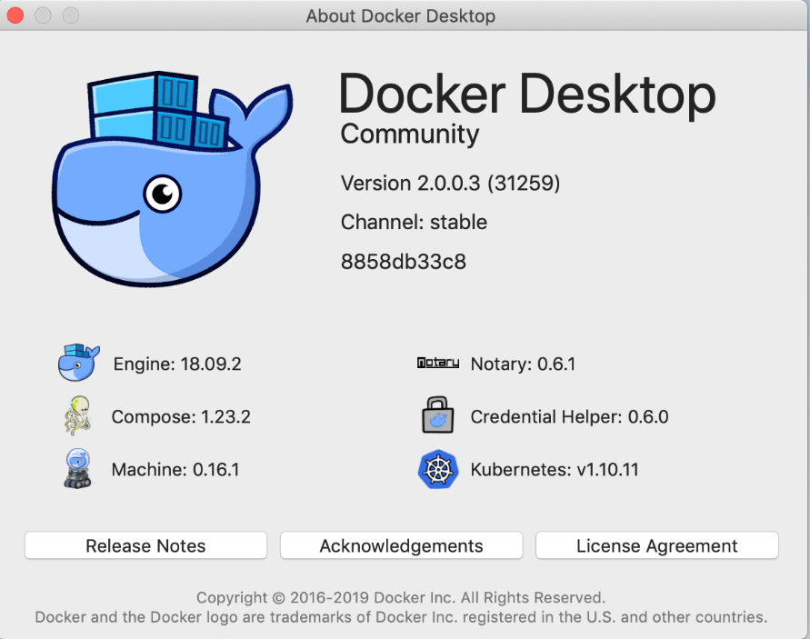
Distribution and Scalability
Scalability goes two ways:
Run on large systems, handle big data
Run on small systems, be portable
Posda addresses this using Docker
Installs on MacBook Pro (in about 15 min)
Includes about 9 Docker containers

Slide 19
Summary
Mature tool
Based on real-world use
Highly scalable, easily installed.
Open source (Apache license).
Can be used on MacBook Pro.®

Slide 20
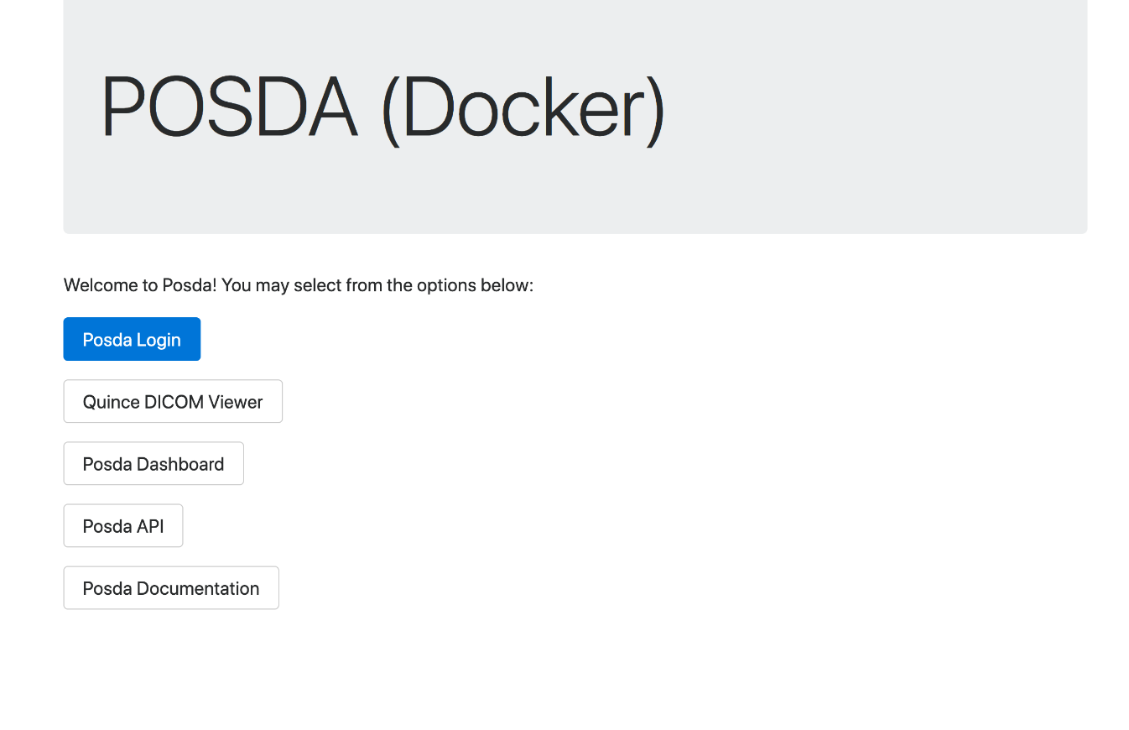
Release Schedule
0.1 2018-06-01 A
0.5 2019-03-19 A
0.5.1 2019-03-11 A
0.6 2019-04-29 A
0.7 2019-07-15 P (Mr Clean)
0.8 2019-08-15 P (Mayday)
0.9 2019-10-30 P (Cthulu)
1.0 2020-12-25 P (Christmas)

Slide 21
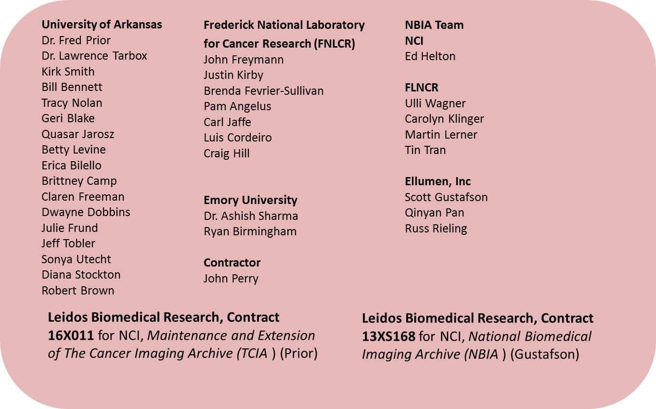
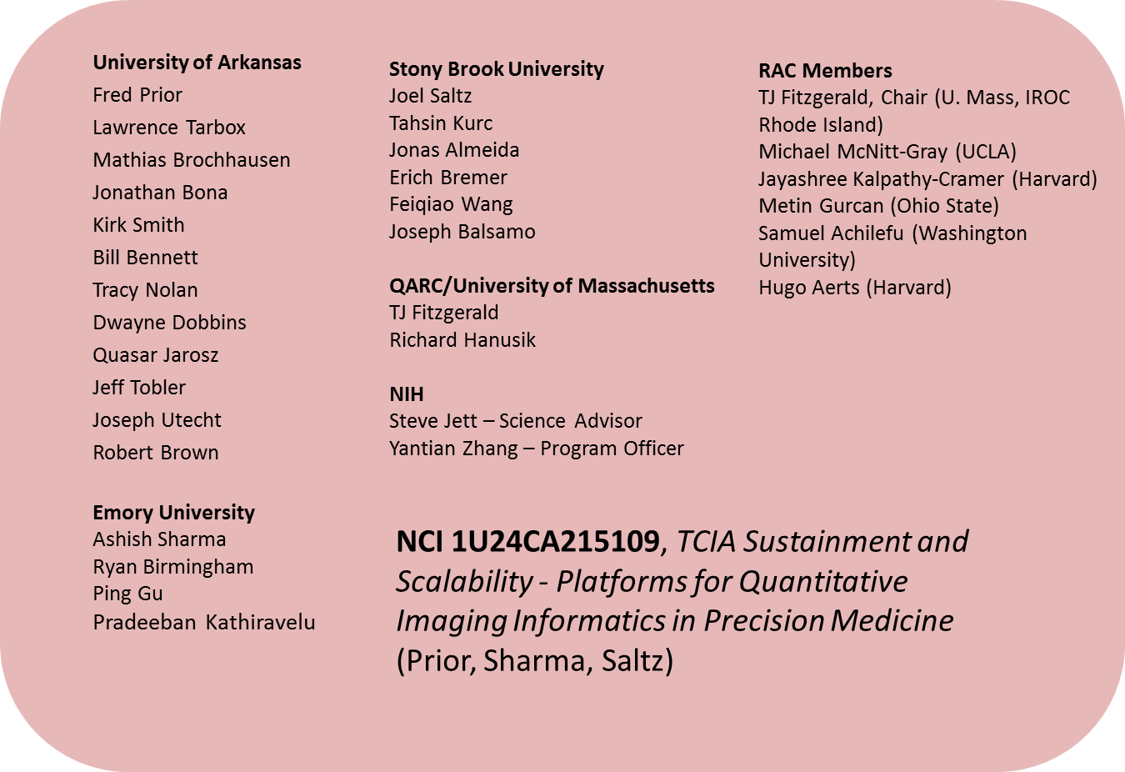
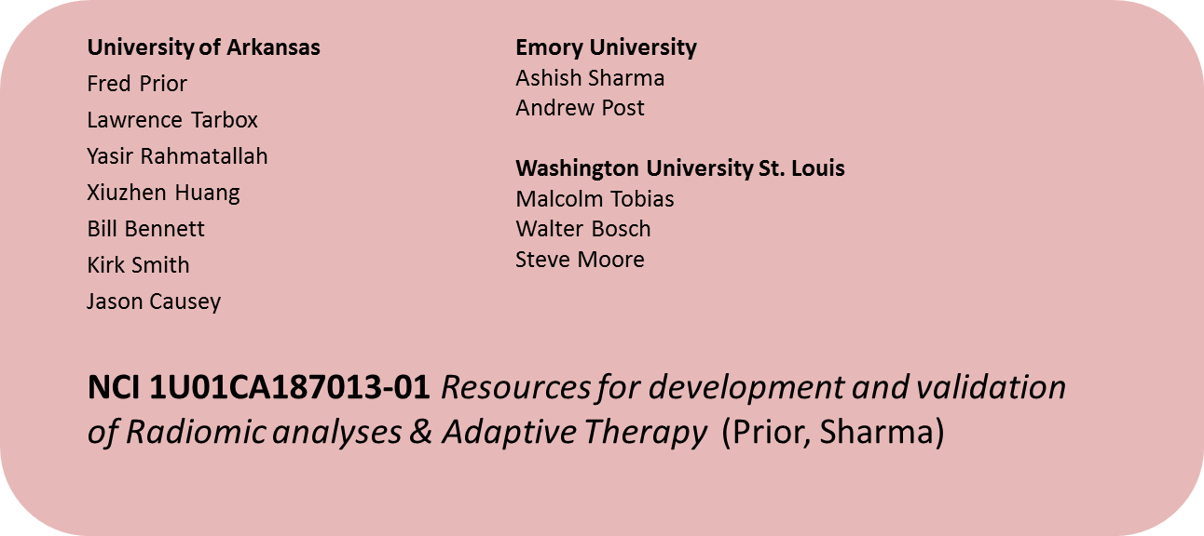
Acknowledgements
This project has been funded in whole or in part with federal funds from the National Cancer Institute, National Institutes of Health under Contract No. HHSN261200800001E. The content of this publication does not necessarily reflect the views or policies of the Department of Health and Human Services, nor does mention of trade names, commercial products, or organizations imply endorsement by the U.S. Government. Under this contract the University of Arkansas is funded by Leidos Biomedical Research subcontract 16X011. Support was also provided by U24CA215109 and U24CA180924

